Slide 1
The search for deeply bound kaonic nuclear states at J-PARC
Toshihiko Hiraiwa
Kyoto University
On behalf of the J-PARC E15 collaboration

Slide 2
Contents
Introduction
  KN interaction
  Kaonic nuclei
J-PARC E15 Experiment
  Experimental method
  Present Status
Summary and Outlook

Slide 3
Introduction

Slide 4
Low-energy KN interaction
K-nucleon interaction
  Low energy Kp scattering
  Kaonic hydrogen level shift (KEK-PS E228)
Kaonic nuclei
  Kaon bound states with a few nucleons
  Extract the information about KN interaction below KN threshold
M.Iwasaki et al. , PRL 78, 3067(1997)
Strongly attractive (I=0)
How strong?

Slide 5
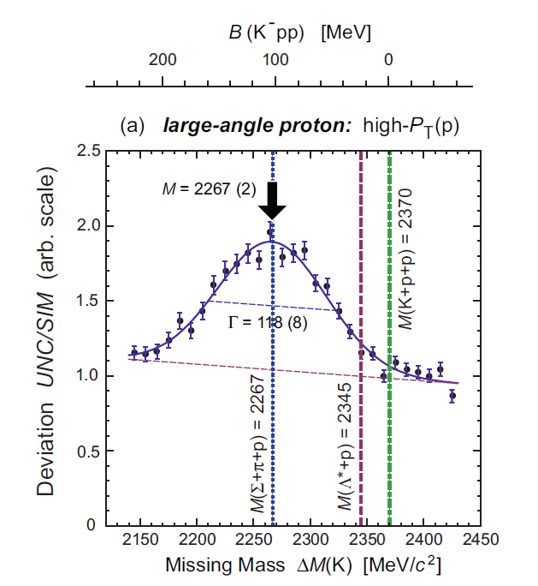
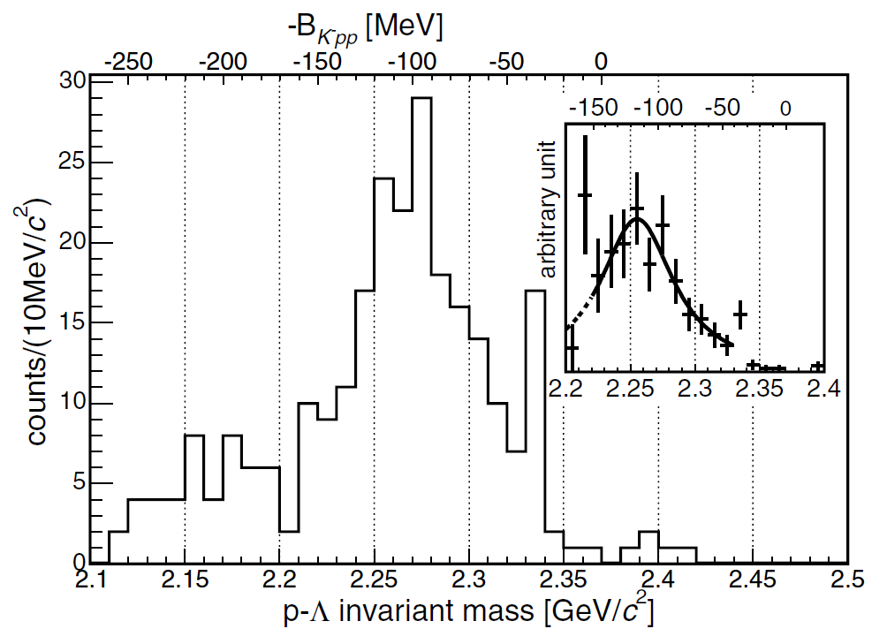
Experimental results on K⁻pp
FINUDA
  Invariant mass of back-to-back Λp pairs in K⁻ absorptions
  B = 115±6(stat)±4(syst) MeV
  Γ = 67±14(stat)±3(syst) MeV
DISTO
  pp → K⁺X⁺, X⁺→ pΛ
  B = 105±2(stat)±5(syst) MeV
  Γ = 118±8(stat)±10(syst )MeV
M.Agnello et al. ,
PRL 94, 212303 (2005)
T.Yamazaki et al. ,
PRL 104, 132502 (2010)

Slide 6
Theoretical study on K⁻pp
 | B.E [MeV] | Γ [MeV] | Method
Yamazaki and Akaishi | 48 | 61 (mesonic) | Variational Method (ATMS)
Shevchenko, Gal, and Mares | 55-70 | 90-110 (mesonic) | Coupled Channel Faddeev Calculation
Ikeda and Sato | 60-95 | 45-80 (mesonic) | Coupled Channel Faddeev Calculation
Nishikawa and Kondo | ~126 |  | Skyrme Model
Dote, Hyodo, and Weise | 20±3 (s-wave) | 40-70 (mesonic) | Chiral SU(3) Variational Method
Arai, Oka, and Yasui | depend on g_{Λ*Λ*σ} |  | Variational Method (as Λ*p state)
K⁻pp bound states should exist!
  A deep state or shallow state?
  Decay width is sufficiently narrow?

Slide 7
J-PARC E15 Experiment

Slide 8
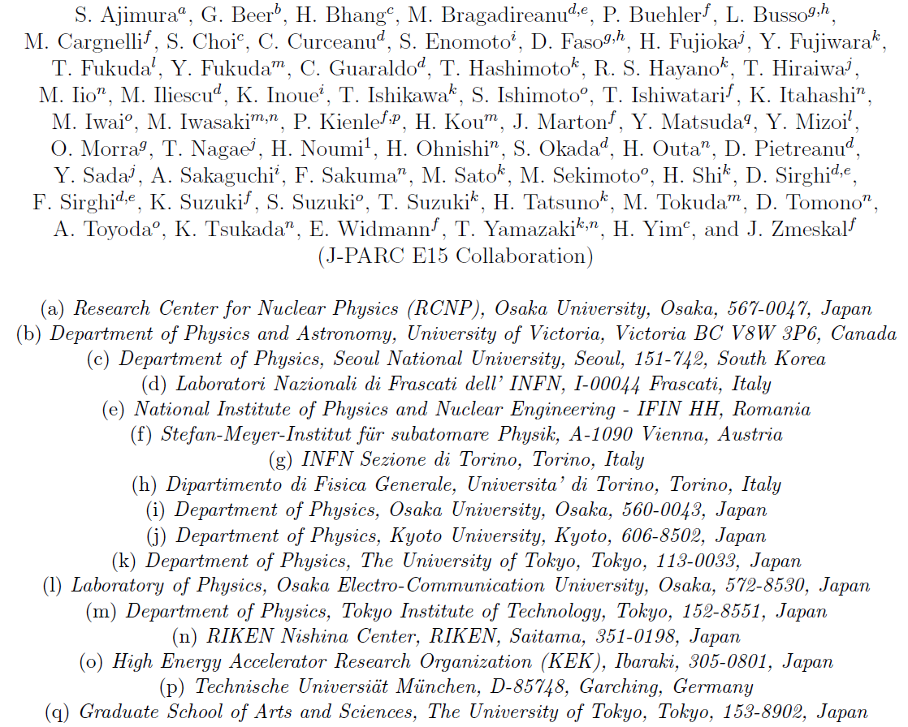
J-PARC E15 Collaboration

Slide 9
J-PARC E15 experiment
Experimental search for K⁻pp bound states using in-flight (K⁻, n) reaction on ³He
³He
neutron
K⁻
Formation
K⁻pp
cluster
Missing mass
Spectroscopy
via neutron
Decay
Mode to decay charged particles
Λ
p
π⁻
We can observe both the
“Formation” and “Decay”
of K⁻pp bound state
Invariant mass reconstruction
p

Slide 10
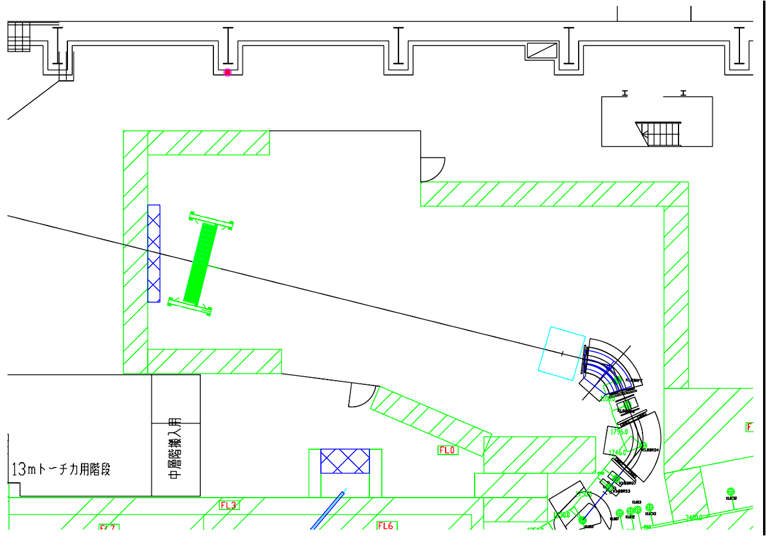
Experimental Setup
J-PARC K1.8BR
Neutron counter
Beam sweep magnet
Cylindrical Detector System
Neutron
1.0 GeV/c K⁻
TOF length 15m
Beamline Spectrometer

Slide 11
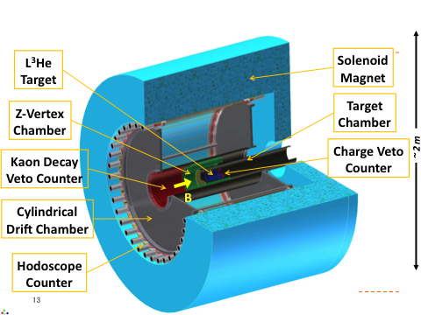
Cylindrical Detector System
A newly developed system for invariant mass study
Expected mass resolution :
- σ ~ 3.0 MeV/c² for Λ
- σ ~ 13 MeV/c² for K⁻pp
( σ_{cdc} = 200 μm / Field : 0.5 T)

Slide 12
Present status

Slide 13
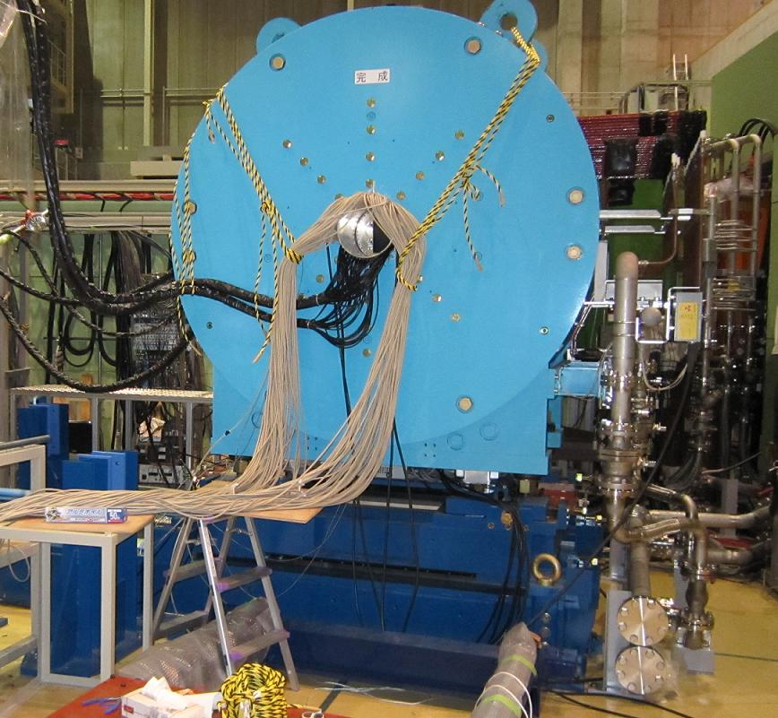
Solenoid magnet
Performance
Field strength : 0.5 T
(maximum field : 0.7 T)
Aperture : 1.2 m
Length : 1.2 m
Characteristic curve (B vs A)
Excitation test have been performed in May 2010.
Field strength [T]
Design value (max field : 0.7T) was successfully achieved!
current [A]

Slide 14
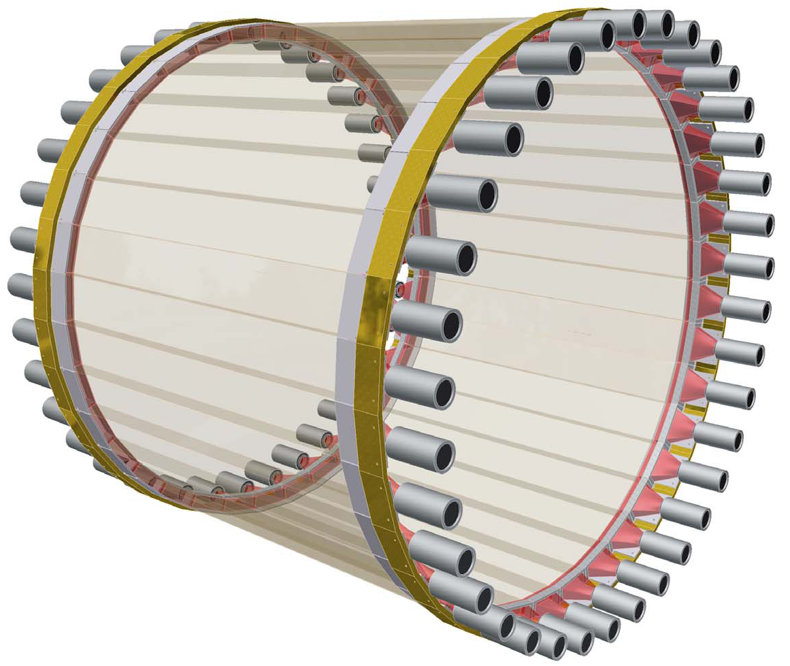
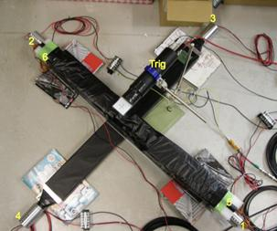
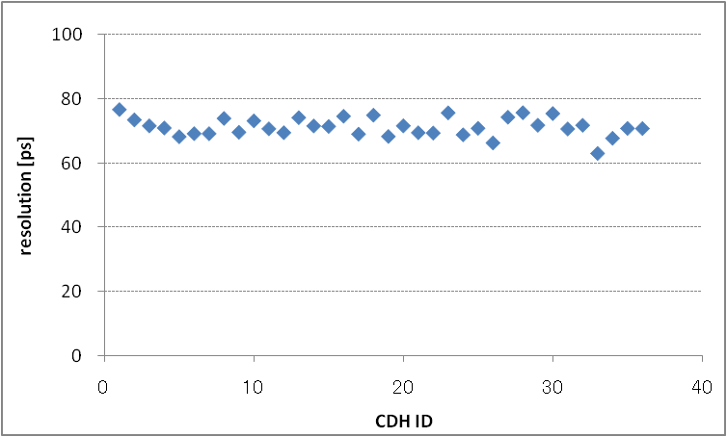
Cylindrical Detector Hodoscope (CDH)
Plastic scintillation counters for trigger and PID
Cosmic-ray test
Size : 99 x 30 x 700 mm³
(W x T x L)
Configuration : 36 modules
PMT : fine-mesh type (H8409)
σ_{int} = 71.1 +/- 2.9 ps
Intrinsic time resolution ~ 71 ps

Slide 15
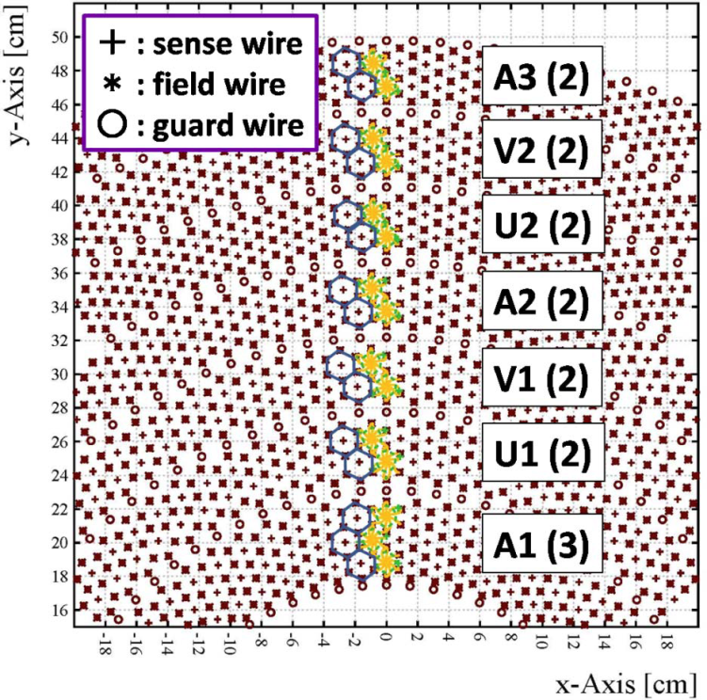
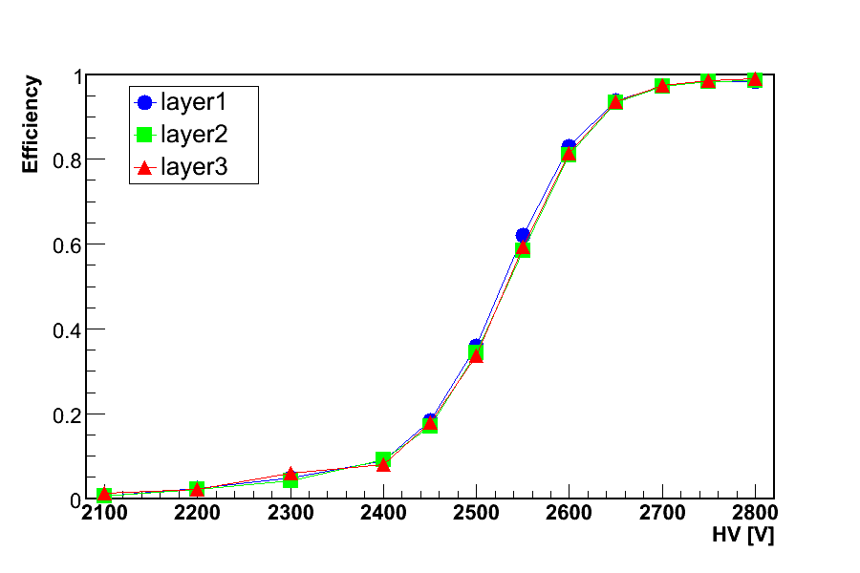
Cylindrical Drift Chamber
(CDC)
Size
  Inner diameter : 300 mm
  Outer diameter : 1060 mm
  Length : 950 mm
Cell
  Hexagonal (Drift length~9mm)
Layer
  15 layers (7 super layers)
  AA’A UU’ VV’ AA’ UU’ VV’ AA’
Read out : 1816 ch
Gas : Ar-C₂H₆ (50:50)
Efficiency curve
Using ⁹⁰Sr
Efficiency of >99% was achieved for all layers using ⁹⁰Sr.

Slide 16
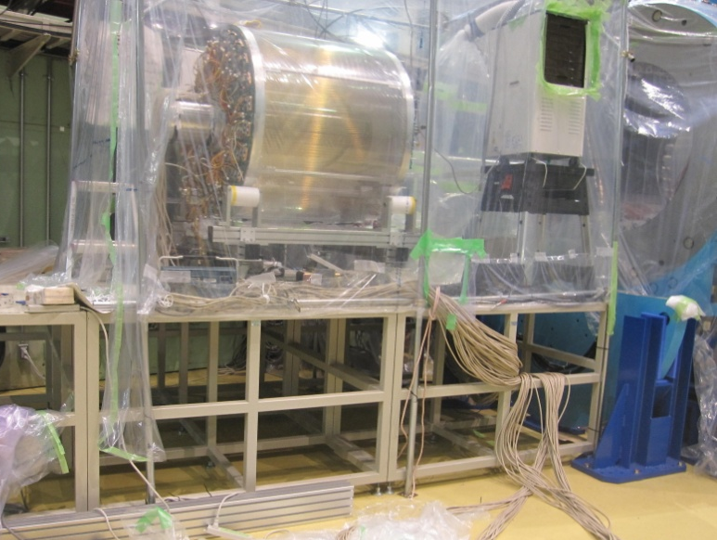
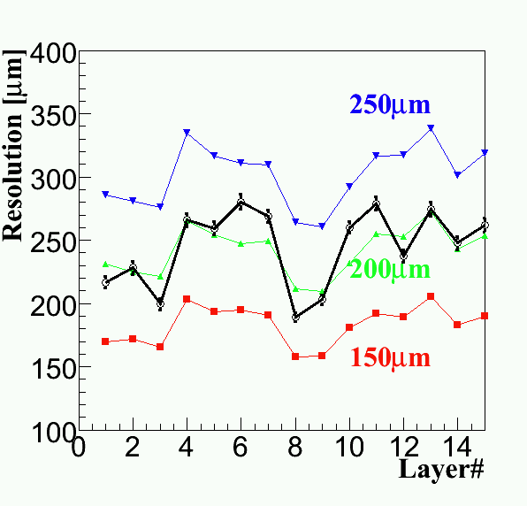
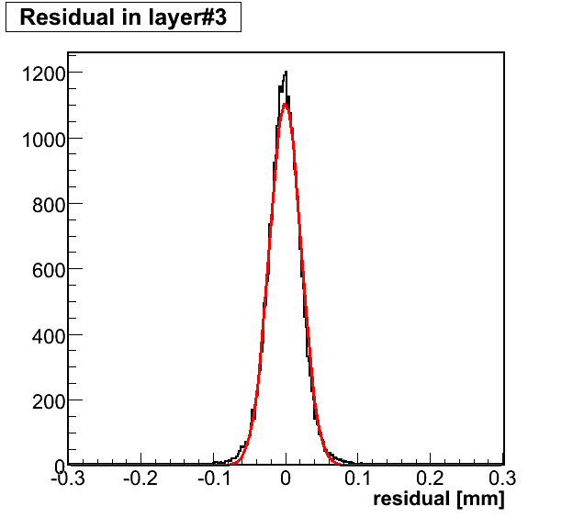
CDC test with cosmic ray
Check the performance of CDC
with cosmic ray
By comparing with a simulation,
Intrinsic resolution ~ 200 μm.
Residual
Intrinsic resolution
cosmic ray
σ=206 μm

Slide 17
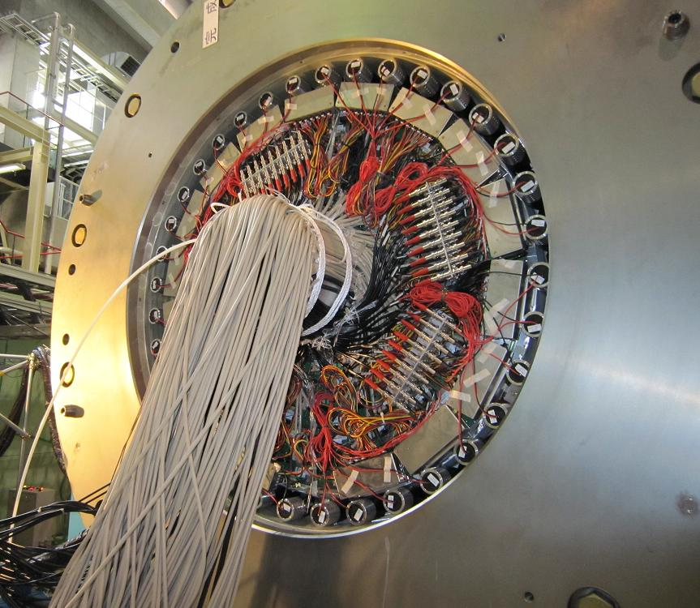
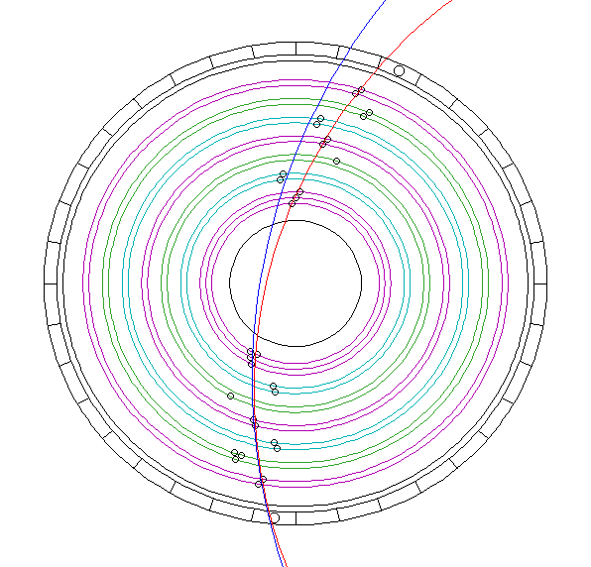
Current status of CDS
All of the components(CDC, CDH) have been installed into the solenoid magnet.
Typical Event Display
P_{t} ~ 180 MeV/c
CDS commissioning with 0.5 T magnetic field is now under way using cosmic ray.
P_{t} ~ 220 MeV/c

Slide 18
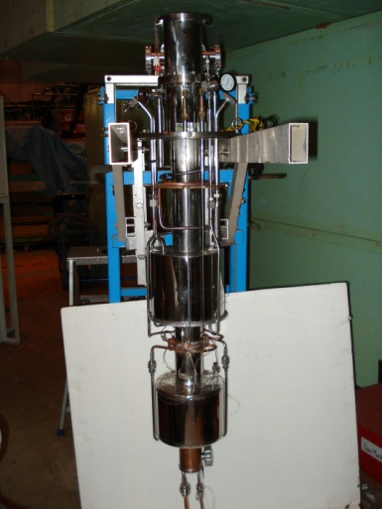
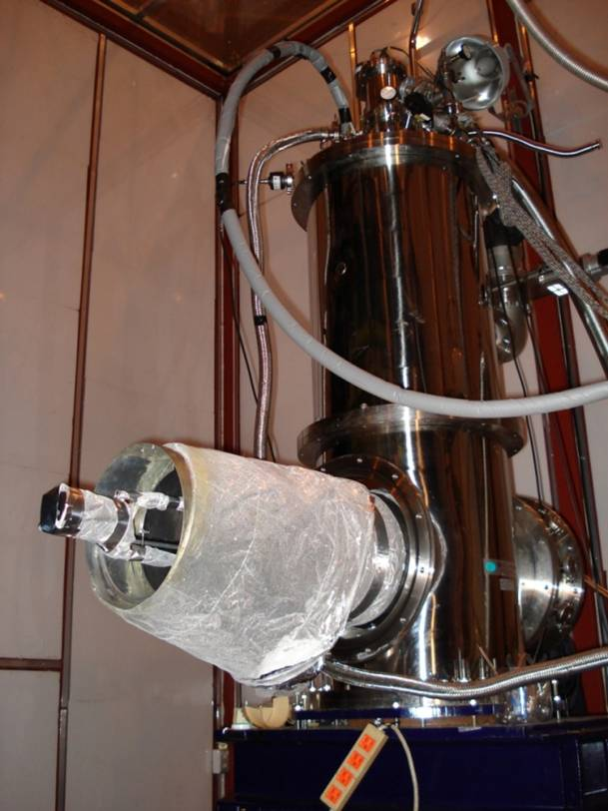
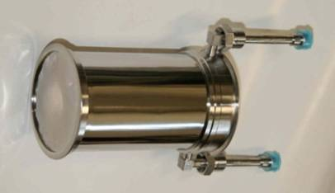
Liquid ³He target
Cooling test with 200L ³He gas
Calculation
Development and test of Liquid ³He target system was already completed!!
Temperature in the Target Cell | 1.3 K
Pressure in the Target Cell | 33 hPa
Liq. ⁴He Consumption | 45 L/day
Heat Load to the 1K Parts | 0.19 W

Slide 19
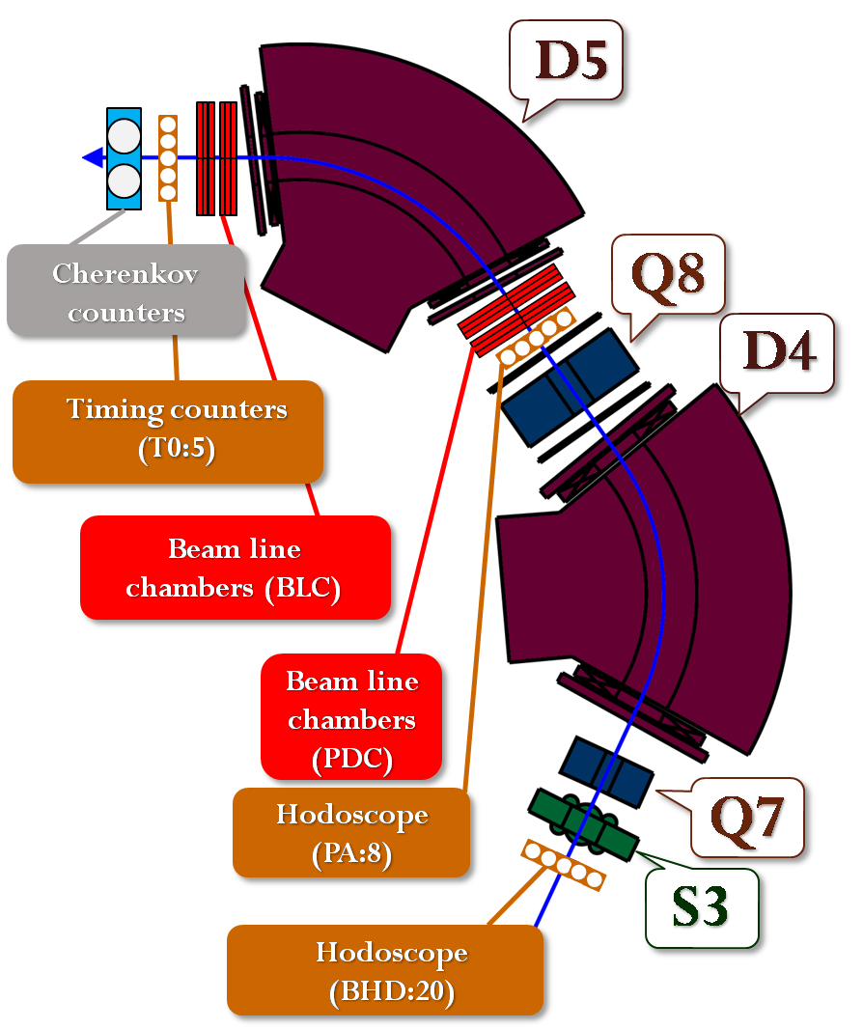
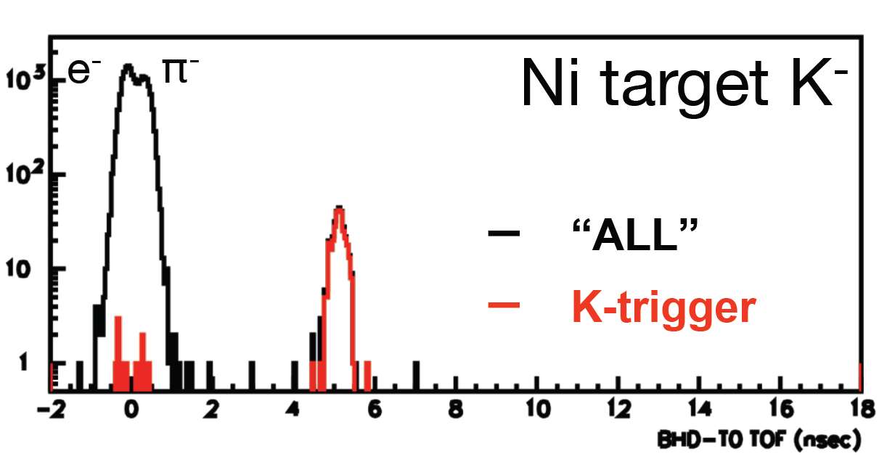
Beamline spectrometer
K⁻ was successfully identified using time-of-flight method.
Hardware trigger for Kaon works very well.
Beam tune for J-PARC E17 exp. is under way.
Ni target
0.75 GeV/c
DC separator ON
K⁻
BHD-T0 TOF [ns]

Slide 20
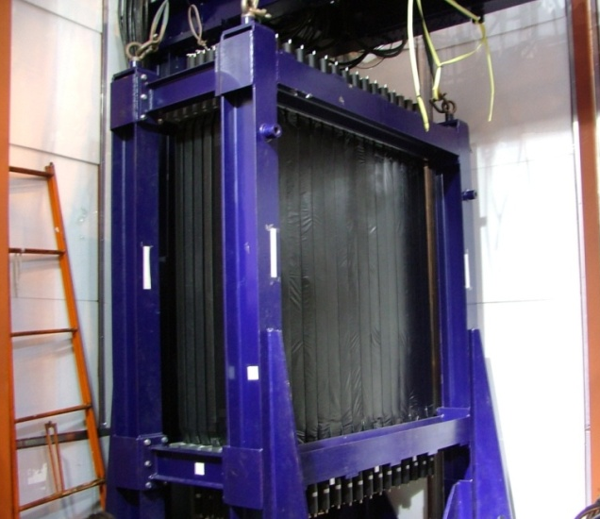
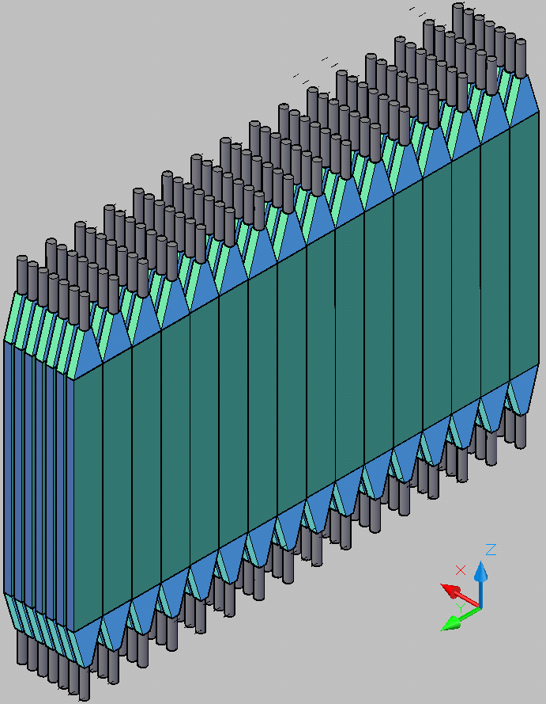
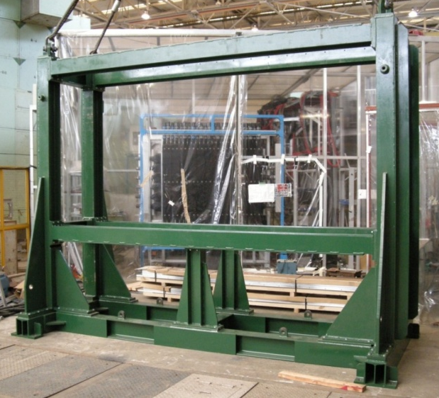
Neutron counter
E549 neutron counter
3.2 m
rearrange
1.5 m
support frame for E15
20 x 5 x 150 cm³ Plastic Scintillator
Configuration : 16 (wide) x 7 (depth)
Surface area : 3.2m x 1.5m
missing mass resolution for K⁻pp
σ = 9.2 MeV/c² (P_{n}=1.3 GeV/c, σ_{TOF}=150 ps)

Slide 21
Summary and outlook
J-PARC E15 experiment
  search for a K⁻pp bound state using in-flight (K⁻, n) reaction
  measure the missing mass and invariant mass of
  K⁻pp states simultaneously
The preparation is well under way.
Physics data is coming soon!
Thank you for your attention!

Slide 22
Back up

Slide 23
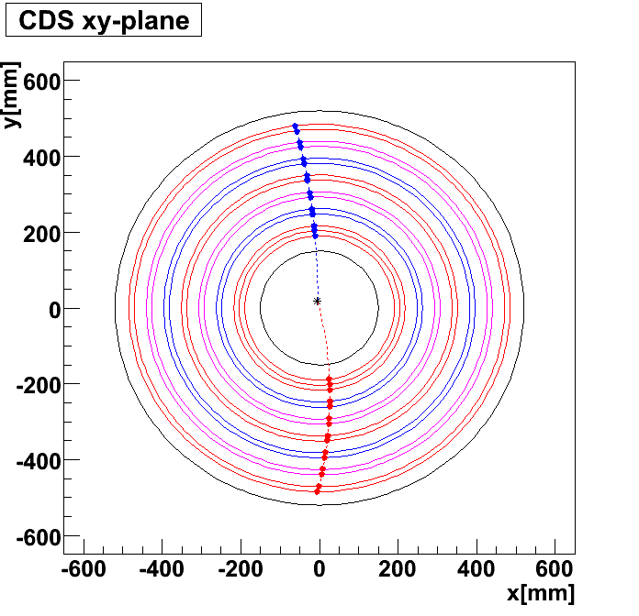
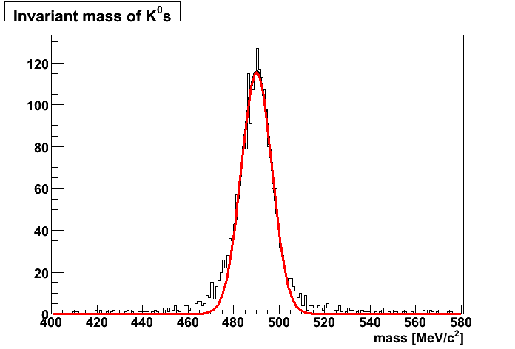
Expected mass spectra of K⁰s
Monte Carlo Simulation
(Geant4)
K⁻ p -> K⁰s n (P_{K}=1GeV/c)
K⁰s->π⁻π⁺
CDC resolution : 200 μm
Field strength : 0.5 T
π⁻
K⁰s vertex
π⁺
K⁰s
Expected mass resolution
σ ~ 6.7 MeV/c²

Slide 24
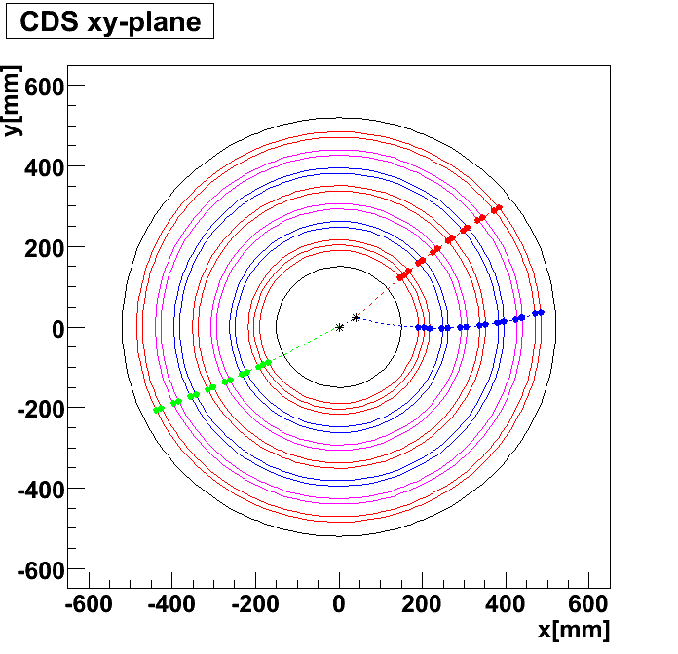
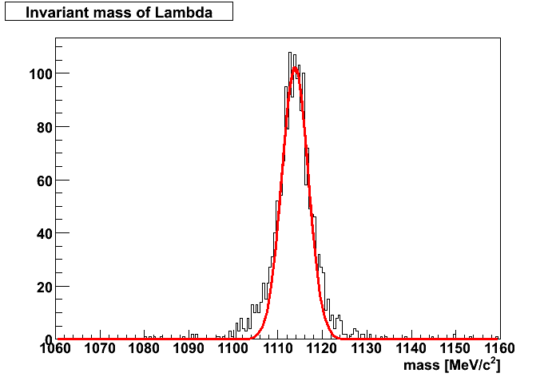
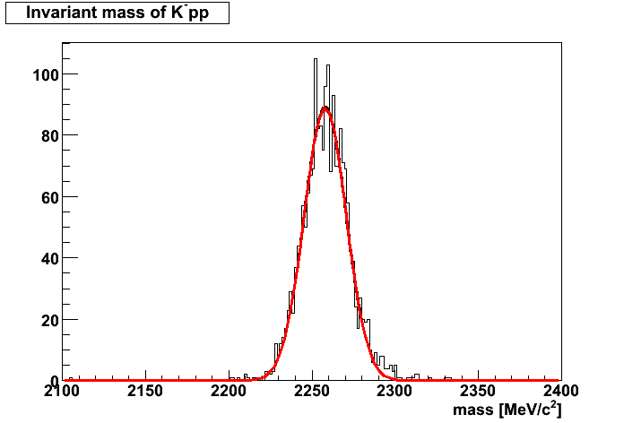
Expected mass spectra of K⁻pp (Λ)
K⁻pp -> Λ p
Λ -> pπ⁻
  Generate Λp isotropically assuming the two decay
B.E. : 100 MeV
Width : 0 MeV
Expected mass resolution
σ~ 3.0 MeV/c² for Lambda
σ ~ 13 MeV/c² for K⁻pp
p
K⁻pp vertex
p
π⁻
Λ vertex
Lambda
K⁻pp

Slide 25
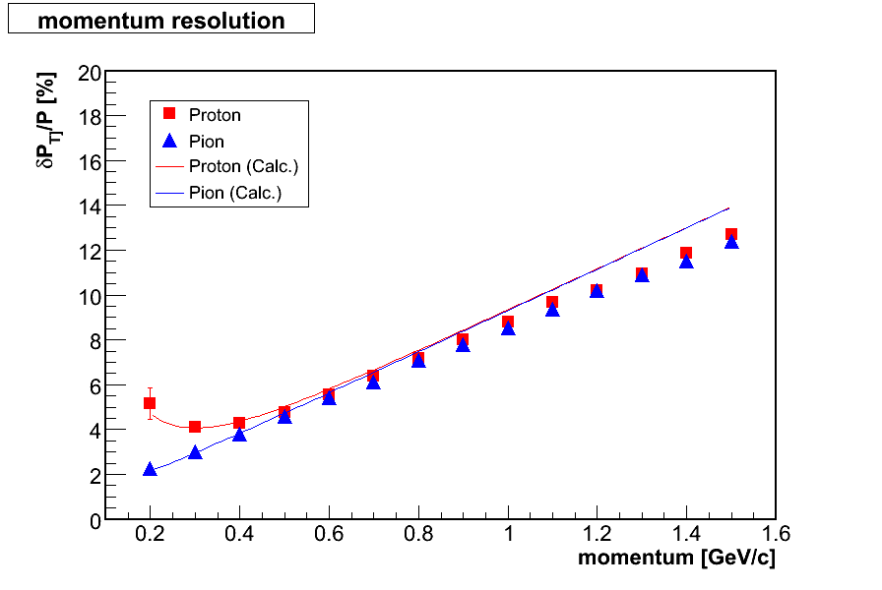
Momentum resolution
Transverse momentum resolution was estimated by Geant4 simulation
Theoretical calculation is found in
R.Gluckstern, NIM 24 (1963) 381.

Slide 26
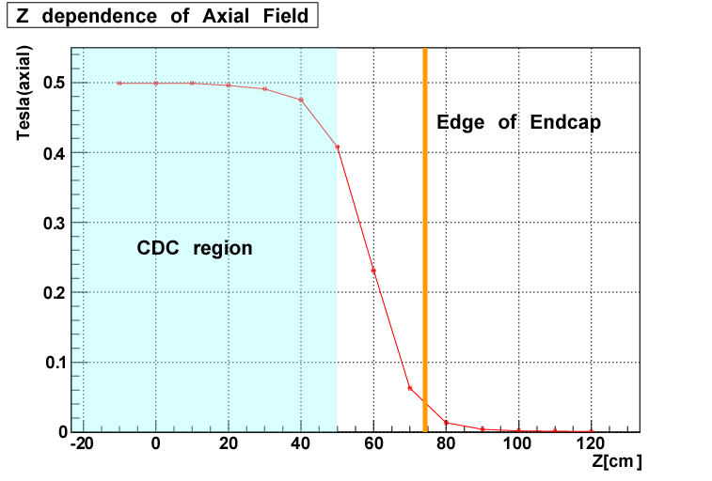
Z-position dep. of magnetic field
magnetic field [T]
z-position [cm]

