Slide 1
THE ALICE EXPERIMENT AT CERN LHC:
STATUS AND FIRST RESULTS
Ermanno Vercellin
Università and INFN Torino, Italy
On behalf of the ALICE collaboration
Outline
Heavy-ions at the LHC
ALICE Status
Performance
First results
Conclusions and outlook

Slide 2
Heavy ions at the LHC - I
 | SPS | RHIC | LHC
√s_{NN} (GeV) | 17 | 200 | 5500
dN_{ch}/dy | 500 | 850 | 1500-4000
τ⁰_{QGP} (fm/c) | 1 | 0.2 | 0.1
T/T_{c} | 1.1 | 1.9 | 3-4
ε (GeV/fm³) | 3 | 5 | 15-60
τ_{QGP} (fm/c) | ≤2 | 2-4 | ≥10
τ_{f} (fm/c) | ~10 | 20-30 | 30-40
V_{f}(fm³) | few 10³ | few 10⁴ | Few 10⁵
The LHC is the ideal place to study the QGP:
hotter - bigger -longer lived
Abuntant production of jets and heavy flavors

Slide 3
Heavy-ions at the LHC
cc ~ 20 × RHIC
bb ~ 100 × RHIC
jets !
Hard probes at the LHC
study medium with probes of
known mass and colour charge:
powerful approach!
ALICE GOAL:
- Heavy-ion: to measure all the known observables to characterise the medium formed in the collisions
- p-p: part of the ALICE physics program, baseline for A-A and intrinsic interest

Slide 4
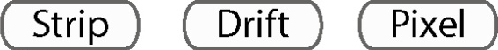



Size: 16 x 26 meters
Weight: 10,000 tons
Detectors: 18
The collaboration:
~ 1000 members,
31 countries, 110 Institutes

Slide 5
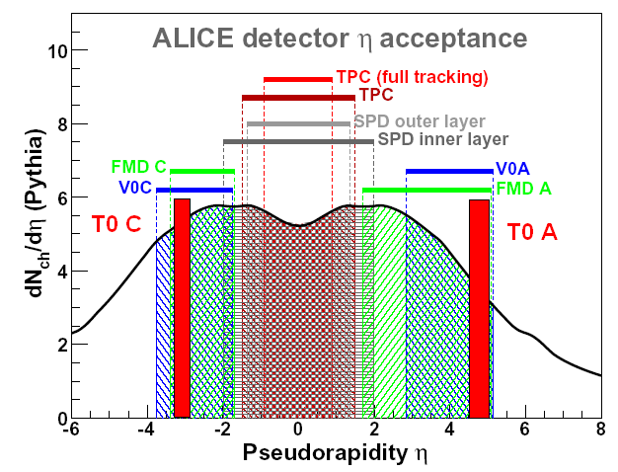
ALICE Acceptance
central barrel -0.9 < η < 0.9
  2 π tracking, PID (ITS, TPC, TRD, TOF)
  single arm RICH (HMPID)
  single arm em. calo (PHOS)
  jet calorimeter
forward muon arm -4.0 < η <-2.5
  absorber, 3 Tm dipole magnet
  10 tracking + 4 trigger chambers
multiplicity -3.4 < η < 5.1
  including photon counting in PMD
trigger & timing dets
  6 Zero Degree Calorimeters
  T0: ring of quartz window PMT's
  V0: ring of scint. Paddles
(charged particles)
µ arm

Slide 6
Particle Identification
stable hadrons (π, K, p): 100 MeV < p < 50 GeV
  dE/dx in silicon (ITS) and gas (TPC) + Time-of-Flight (TOF) + Cerenkov (RICH)
  dE/dx relativistic rise => extend PID to several 10 GeV
decay topology (K⁰, K⁺, K⁻, Λ, D⁺,…)
  K and Λ decays up to > 10 GeV
leptons (e, μ), photons, η,π⁰
  electrons in TRD: p > 1 GeV
  muons: p > 5 GeV
  π⁰ in PHOS: 1 < p < 80 GeV
Alice uses ~ all
known techniques!
TPC + ITS
(dE/dx)
π/K
K/p
e /π
TOF
e /π
π/K
K/p
HMPID
(RICH)
π/K
K/p
0 1 2 3 4 5 p (GeV/c)
TPC (rel. rise) π /K/p
TRD e /π
PHOS γ /π⁰
π/K
K/p
1 10 100 p (GeV/c)

Slide 7
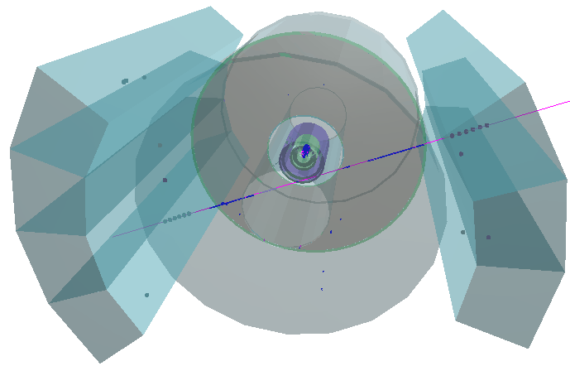
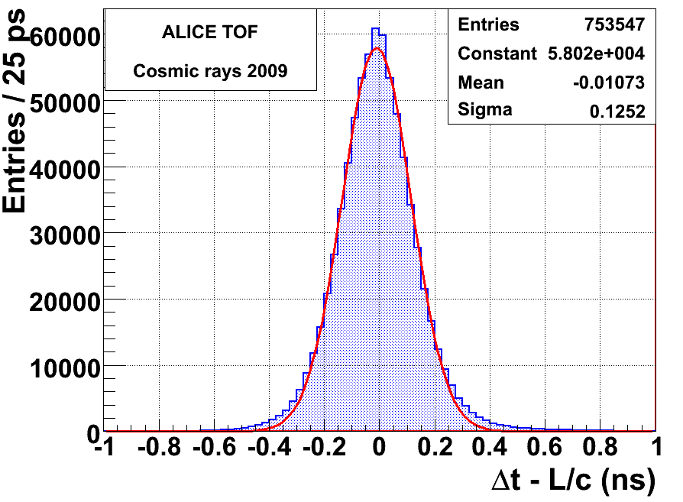
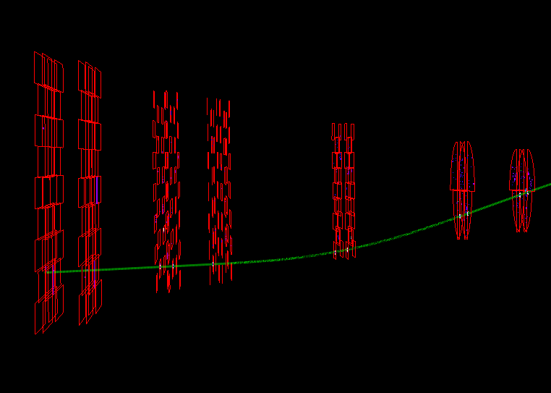
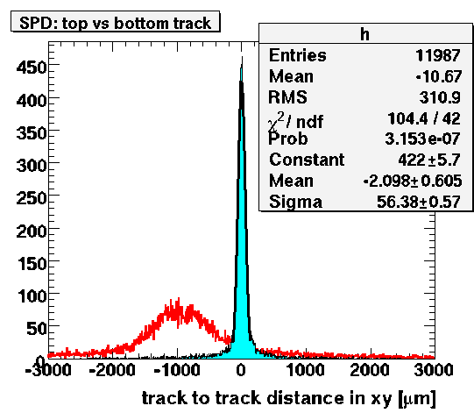
ALICE recent history and status
Detector installation until July 2009: see next slide for details on the sut-up
Cosmic runs (calibration, alignment) from August to mid November 2009.
Example: ITS pixel alignment, TOF resolution
σ_{TOF}=σ/√2
= 88 ps
TPC and TRD
SPD: initial alignment with cosmics see K. Aamodt et al. (ALICE), arXiv: 1001.0502 (accepted by JINST)
Muon spectrometer

Slide 8

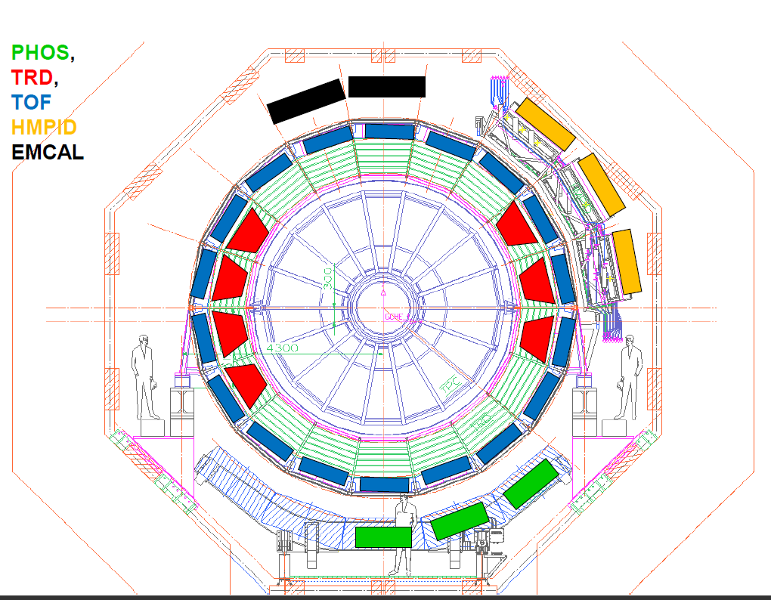
p-p data taking: detector configuration
ITS, TPC, TOF, HMPID, MUON, V0, To, FMD, PMD, ZDC (100%)
TRD (7/18)
EMCAL (4/12)
PHOS (3/5)
  at nominal T (-25 C)
HLT (60%)

Slide 9
p-p data taking: trigger configuration
based on interaction trigger reading all detectors:
  SPD (min bias) or V0-A or V0-C
  at least one charged particle in 8 pseudorapidity units
and single-muon trigger reading MUON, SPD, V0, FMD, ZDC :
  single muon, low-pT threshold, in the muon arm in coincidence with interaction trigger
activated in coincidence with the BPTX beam pickups:
  ‘bunch-crossing’ with bunches from both sides
  for control ‘bunch-crossing’ with bunch from side A or C only
  for control ‘bunch-crossing’ with no bunches
a fraction of ‘bunch-crossing’ trigger (no condition on trigger detectors)
  for control
  to measure relative fractions of single- and double-diffractive events
HLT in “Mode B” (no event rejection)

Slide 10
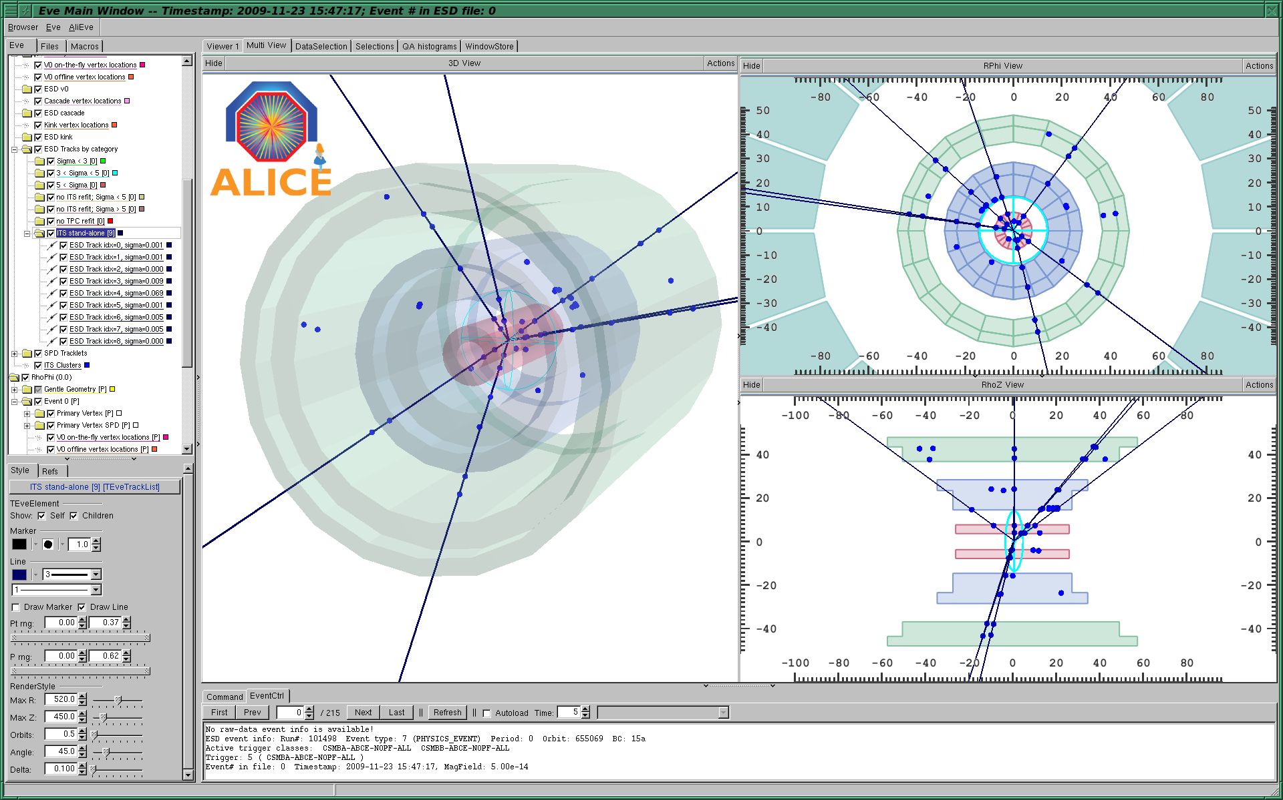
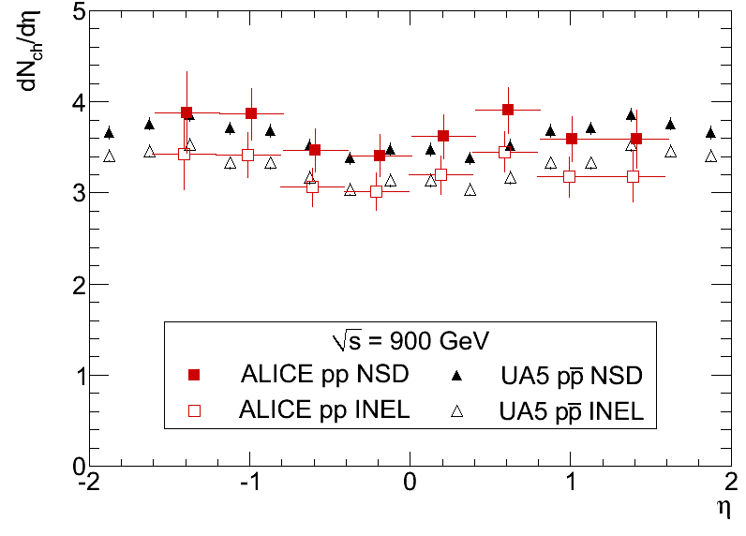
First p-p collisions and first physics - I
23/11/09 : pp
coll. at 900 GeV
From first collisions…
14/12/09 : pp
coll. at 2.36 GeV
…to the first paper on charged particle
pseudorapidity density
Submitted to EPJ C
on Nov. 28 2009,
Published on
EPJ C vol. 65, Jan 2010
March 2010 : pp
coll. at 7 TeV
INEL = non-diffr. + single-diffr. + double diffr.
NSD = non-single-diffractive

Slide 11
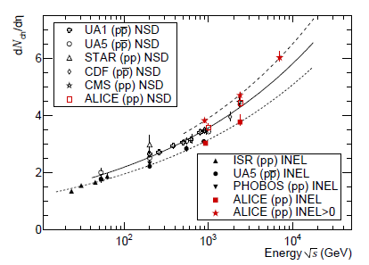
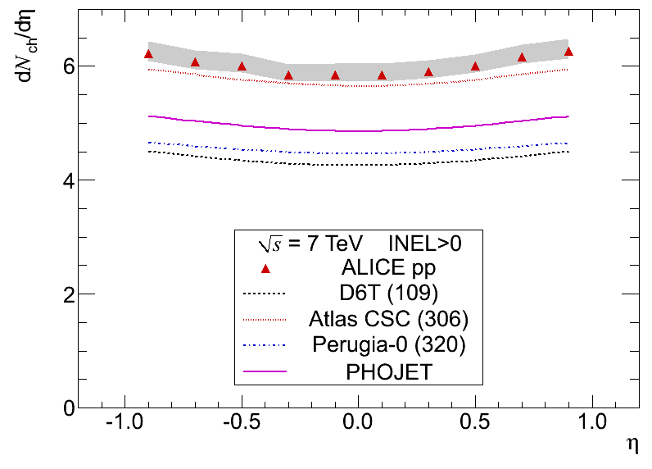
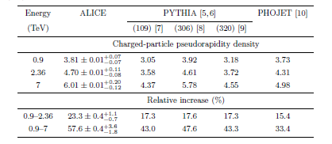
First p-p collisions and first physics - II
23/11/09 : pp
coll. at 900 GeV
14/12/09 : pp
coll. at 2.36 GeV
ALICE data similar to those obtained by CMS
dN/dη is larger and Increases faster with c.m. energy than predicted by generators; best agreement: PYTHIA – ATLAS CSC
dN/dη at 0.9 , and 2.36 TeV
arXiv:1004.3034 [hep-ex]
Accepted by EPJ C
March 2010 : pp
coll. at 7 TeV
dN/dη and multiplicity
distr. at 0.9 , 2.36 and 7 TeV
arXiv: 1004.3514[hep-ex]
Accepted by EPJ C

Slide 12
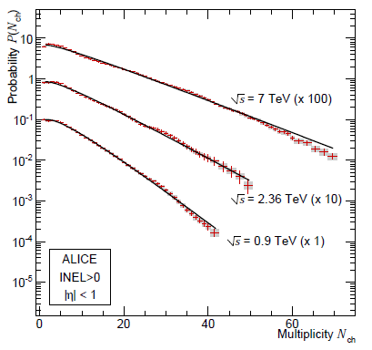
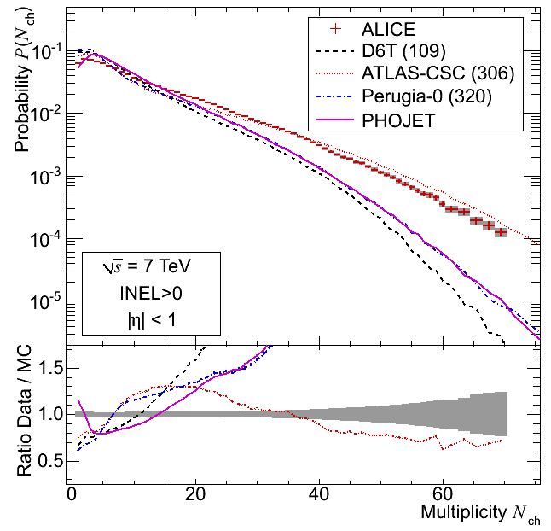
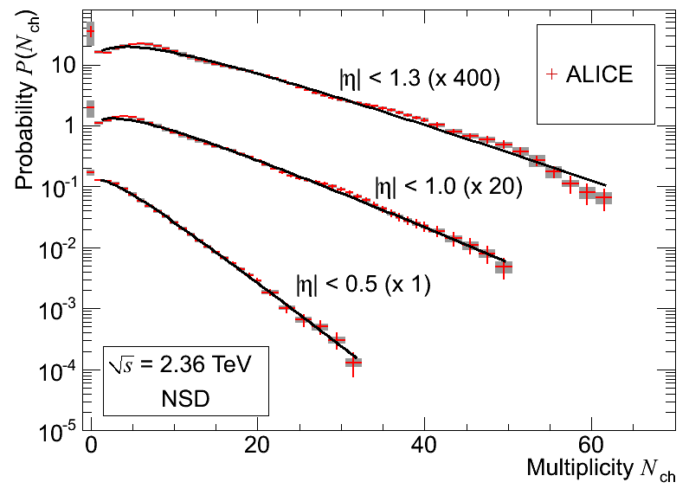
First p-p collisions and first physics - III
23/11/09 : pp
coll. at 900 GeV
The shape of our measured multiplicity distribution is not reproduced by any of the event generators considered.
14/12/09 : pp
coll. at 2.36 GeV
dN/dη at 0.9 , and 2.36 TeV
arXiv:1004.3034 [hep-ex]
Accepted by EPJ C
Fits with one NBD work also at all the three energies (0.9, 2.36 and 7 TeV)
XX/03/10 : pp
coll. at 7 TeV
dN/dη and multiplicity
distr. at 0.9 , 2.36 and 7 TeV
arXiv: 1004.3514[hep-ex]
Accepted by EPJ C

Slide 13
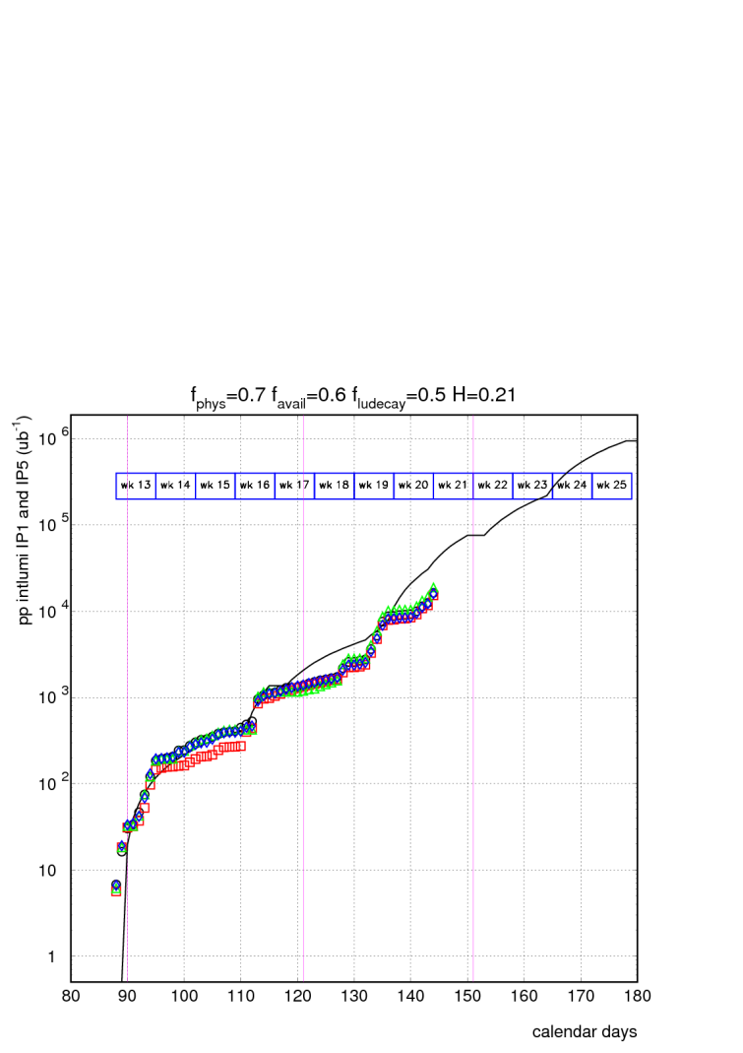
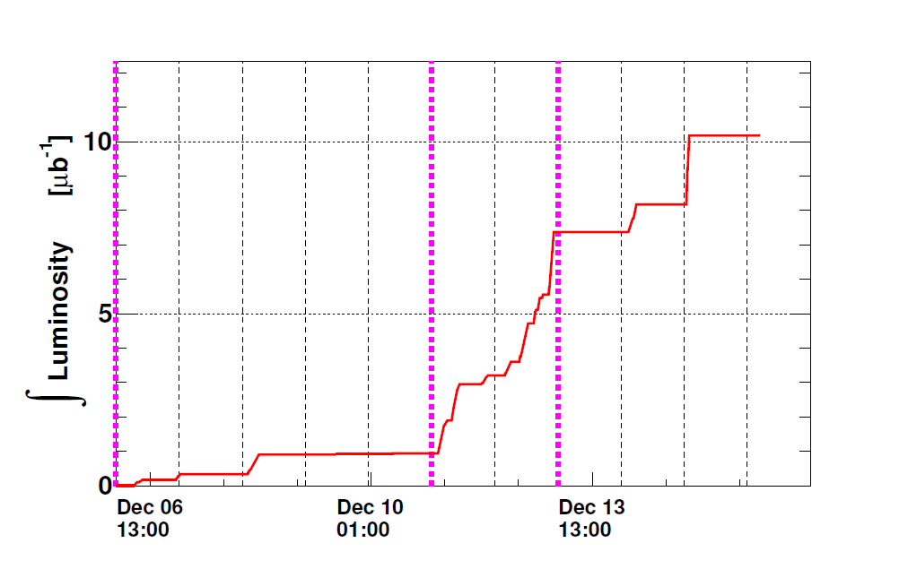
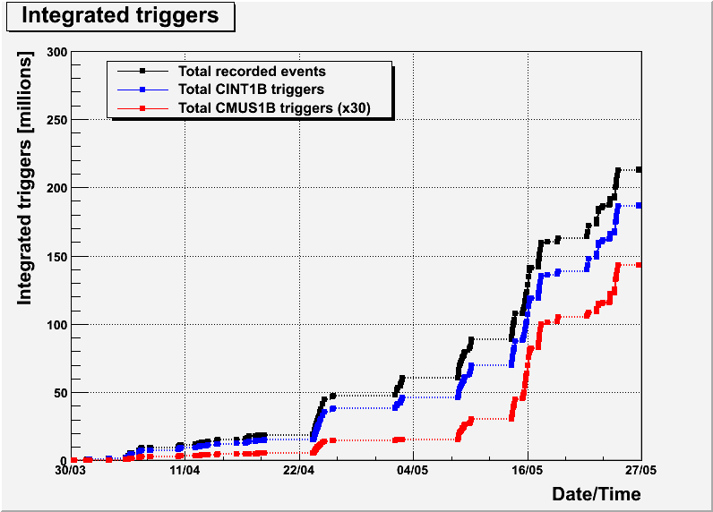
ALICE running 2009/2010
2009 (0.9 and 2.36 TeV)
  ~10.3 µb⁻¹
  ~ 500 k min bias
2010 (till 1/6) (0.9 and 7 TeV)
ALALICE: red
int lumi ~ 20 nb⁻¹
~ 180 M min bias

Slide 14
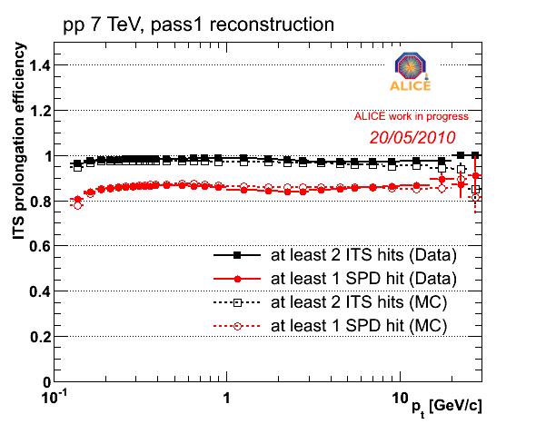
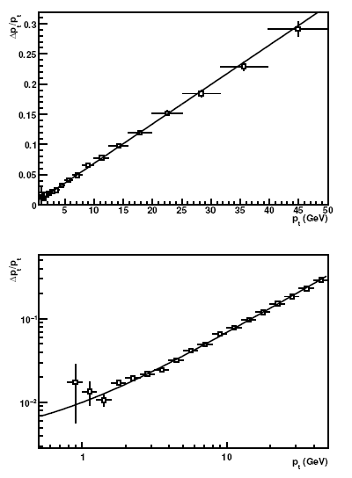
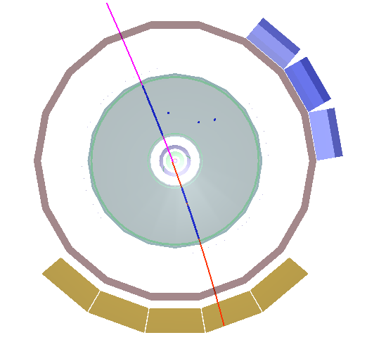
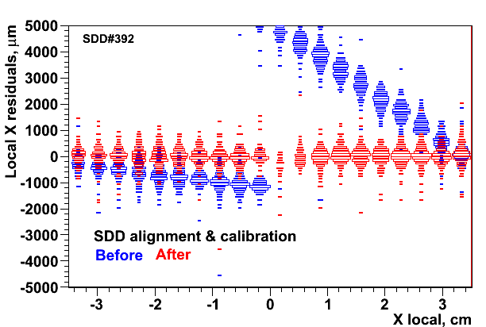
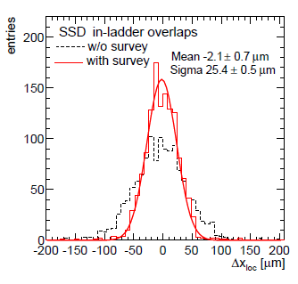
ALICE performance – Tracking
TPC-ITS track matching: Probability of the TPC track prolongation in ITS.
TPC p_{t} resolution from cosmics: e.g.: at 10 GeV/c 7%
(target value ~ 5%) -Details in
J. Alme et al. (ALICE TPC), arXiv:1001.1950 (subm. to NIM)
SDD: alignment + drift velocity calibration
  SSD: σ/√2 ~ 18 µm ~ intrinsic res.

Slide 15
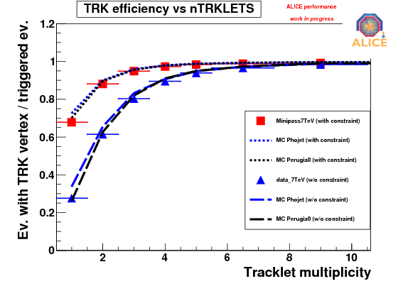
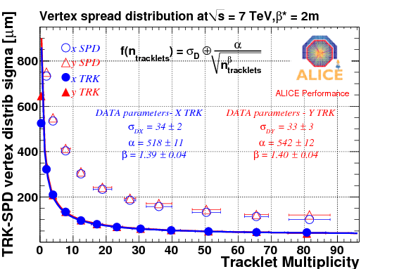
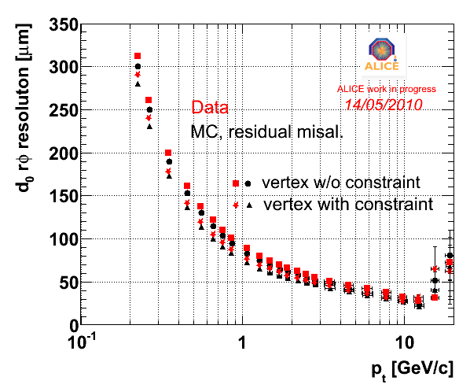
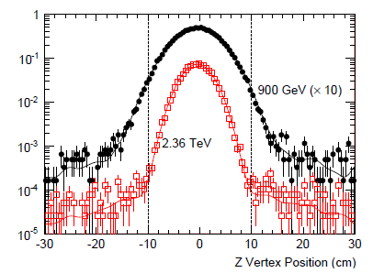
ALICE performance – Tracking and vertexing
Primary vertex efficiency VS multipl. for data and MCs, with and without the constraint on the luminous region.
Secondary vertex: transverse impact parameter resolution (TPC track quality cuts and 2 points in SPD). For each track, its impact parameter was estimated with respect to the primary vertex reconstructed without using this track. The resulting resolution is the convolution of the track -position and the primary-vertex resolutions.
Spread of the primary vertex (x,y) . Reconstructed with tracks and with SPD only: spread of vertices in data at 7 TeV Asymptotic limit estimates the size of the luminous region..
Vertex finding at work: distributions of event vertices along the beam direction obtained from SPD hits. The lines are from Monte Carlo.

Slide 16
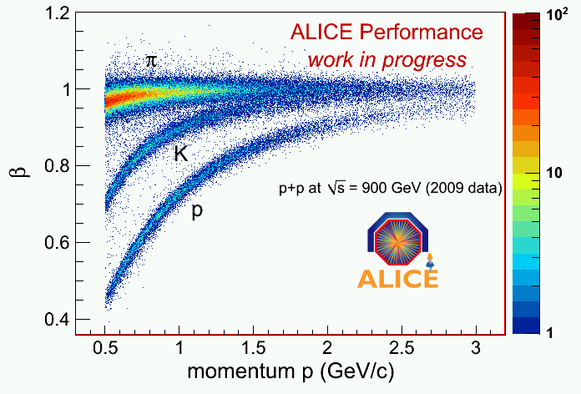
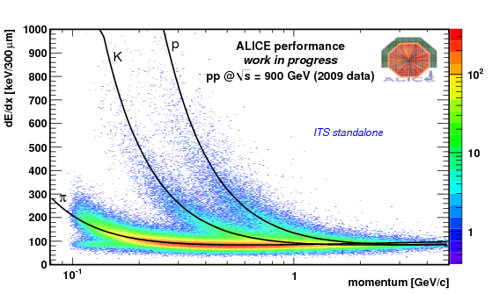
ALICE performance - PID
Dependence of the particle velocity measured by TOF on the particle momentum
de/dx of charged particles vs. their momentum in the TPC. The lines correspond to the ALEPH parameterization of the Bethe-Bloch curve.
dE/dx of charged particles vs their momentum, both measured by the ITS alone

Slide 17
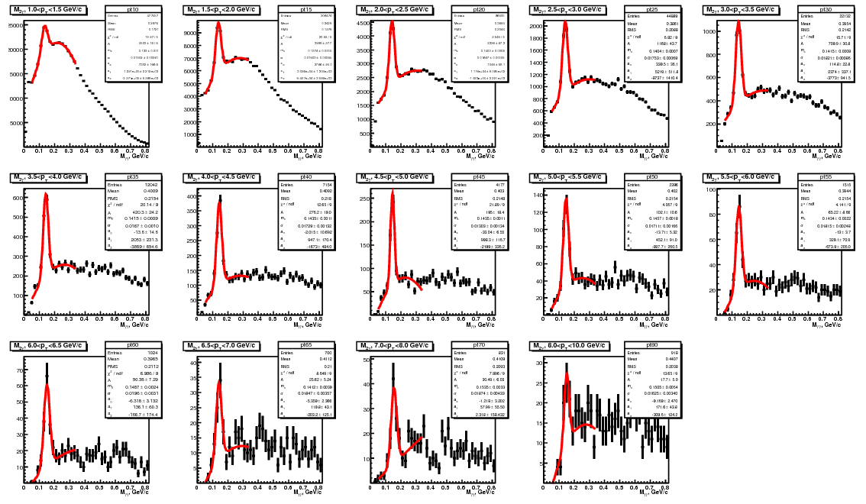
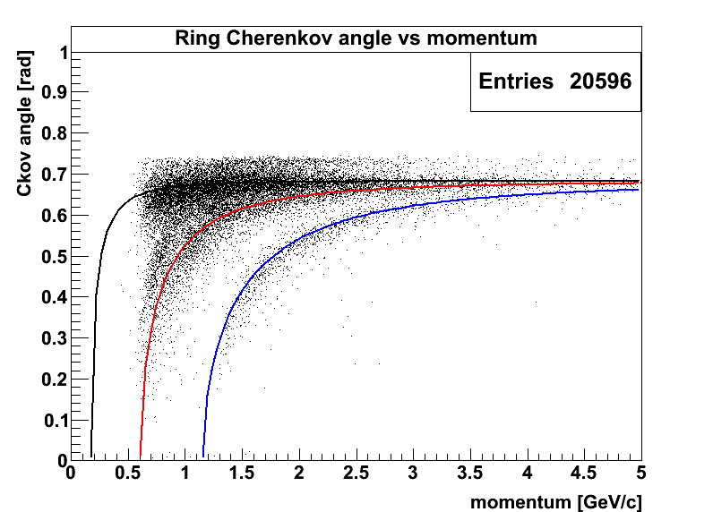
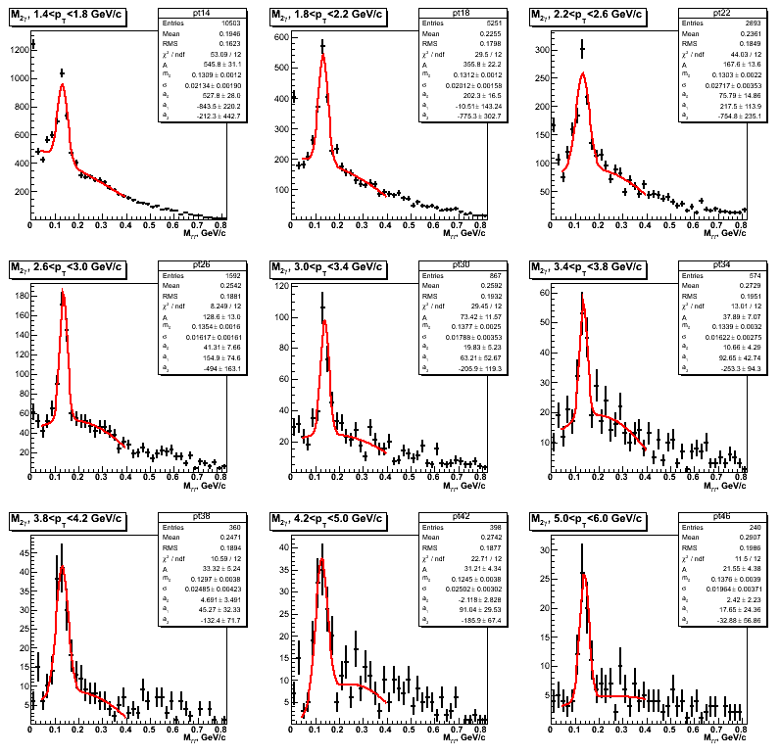
Photons and high momentum PID
γ−γ invariant mass distribution measured EMcal and PHOS
High-momentum Particle identification with the HMPID Cerenkov det.
π
EMCal
EMCal
ALICE work in progress
K
p
PHOS
PHOS

Slide 18
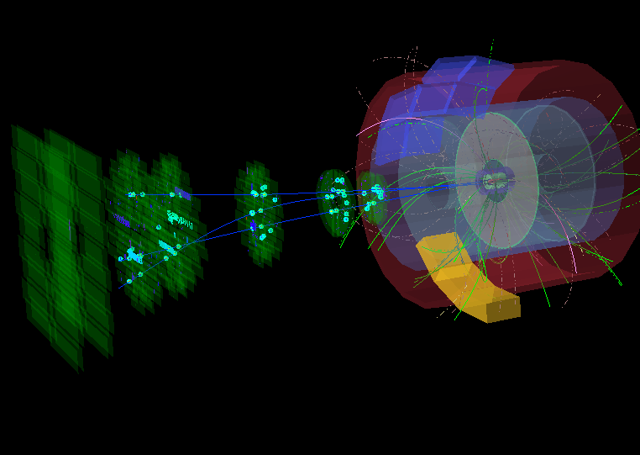
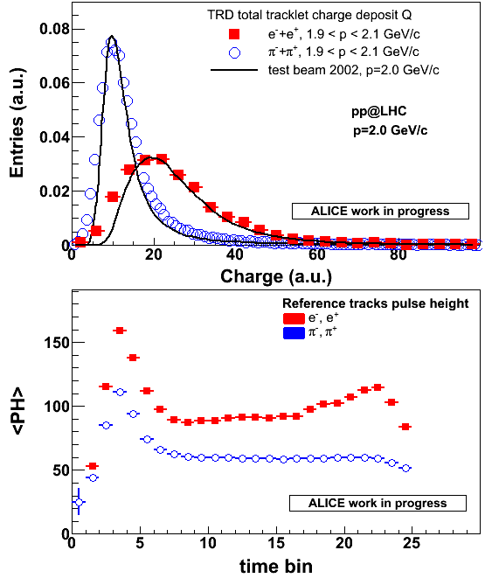
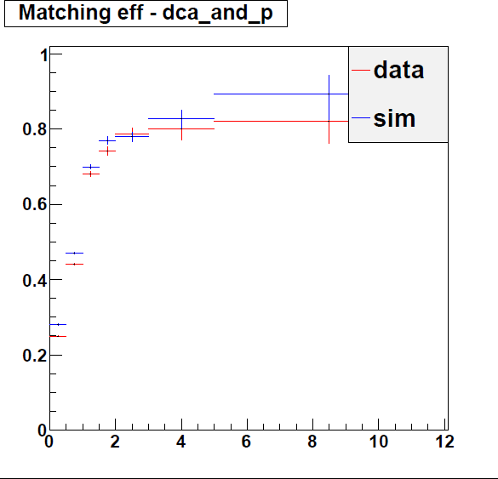
Electrons and muons
Muon detection in the forward muon spectrometer
e/π discrimination in the TRD
gain calibration with γ→e+e- K⁰_{s}→π+π-
ε
Tracking-trigger
matching efficiency
L0 trigger on p_{t} > 0.5 GeV
Pt (GeV/c)
18

Slide 19
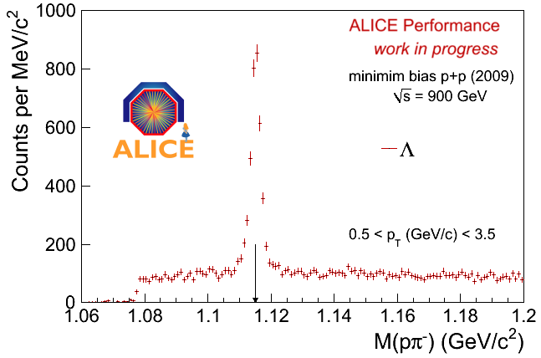
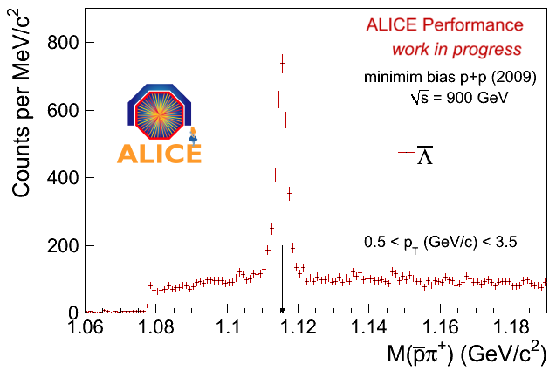
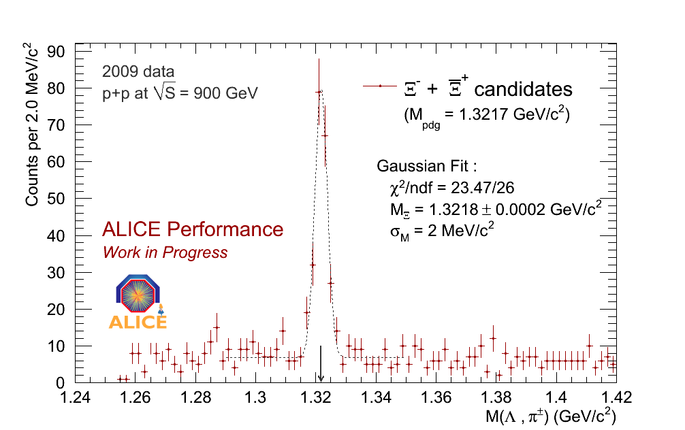
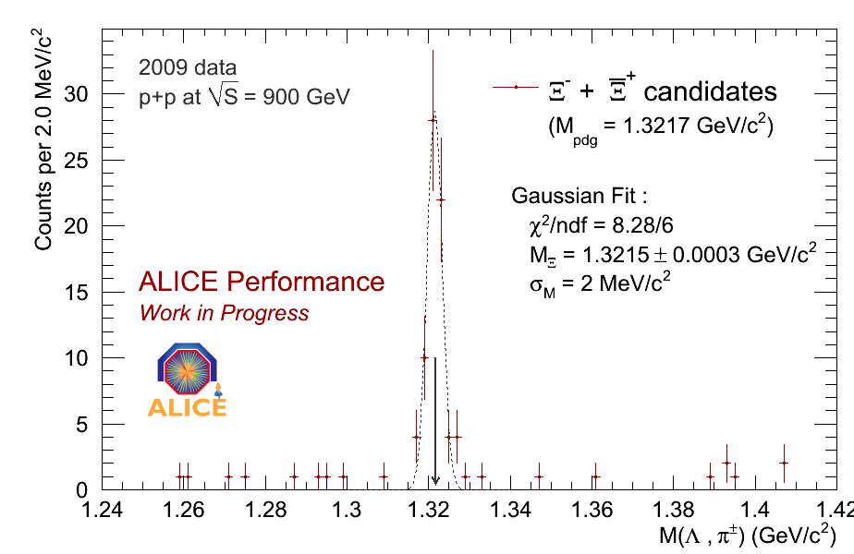
Hyperon detection

Slide 20
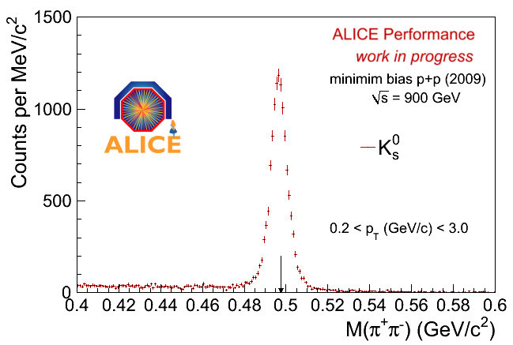
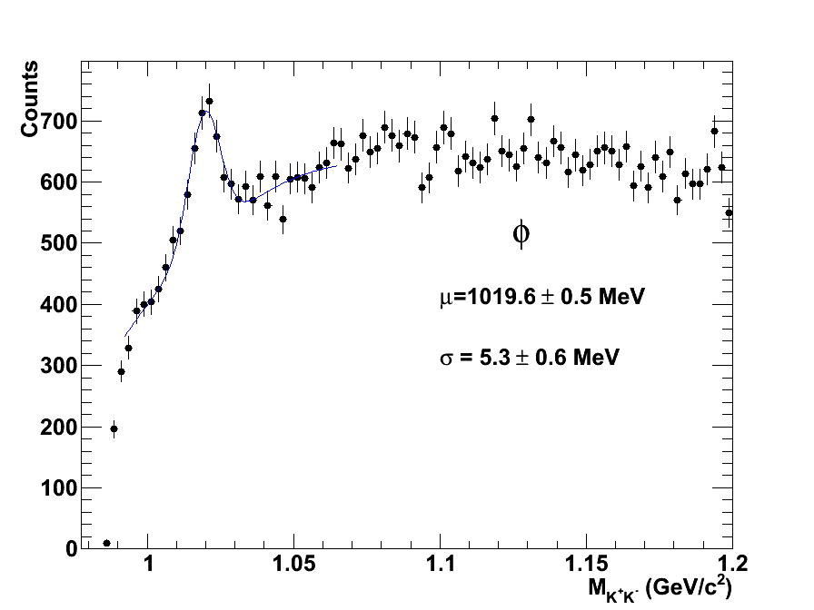
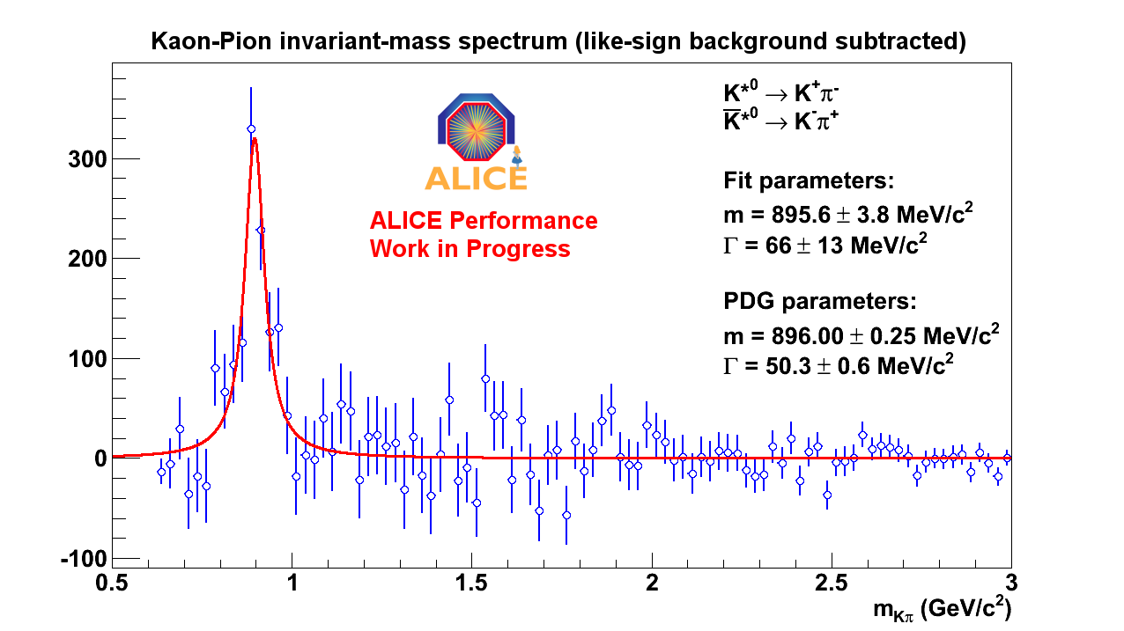
Meson detection
φ → Κ⁺Κ⁻
PDG: 1019.5 MeV

Slide 21
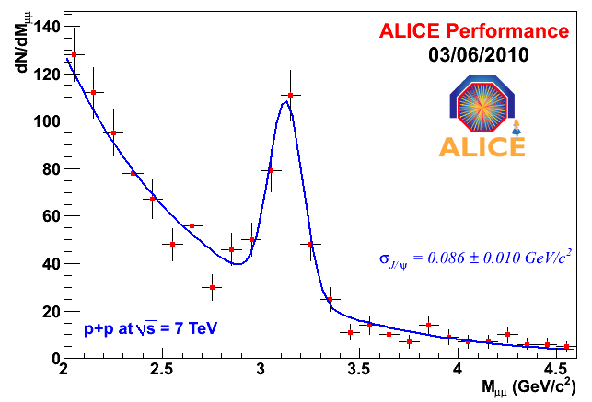
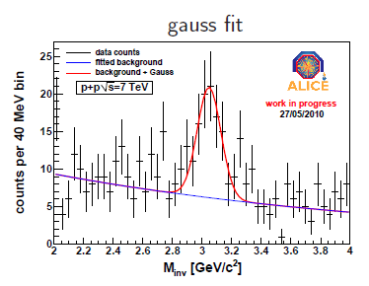
J/ψ
μ+μ- invariant mass spectrum as measured by the muon spectrometer .
Pseudorapidity interval 2.5<η<4.0 and down to zero transverse mom.
After first alignment with straight tracks, inv. mass resolution at J/ψ peak close to design value.
e+e- invariant mass spectrum as measured in the central barrel .
Pseudorapidity region -0.9<η<0.9

Slide 22
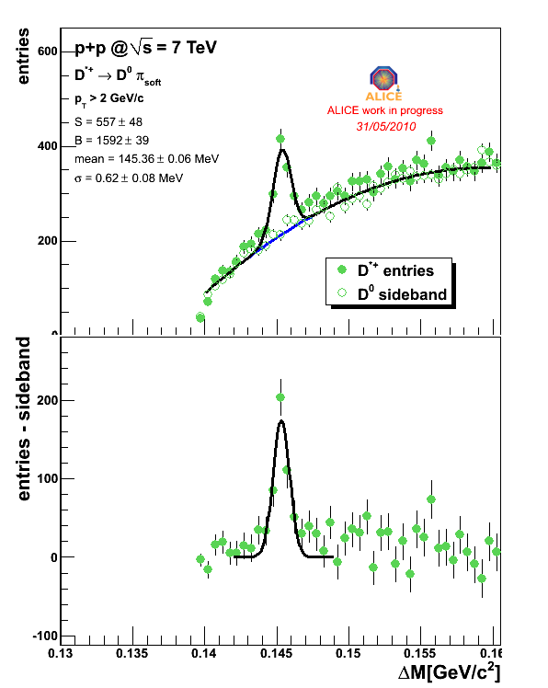
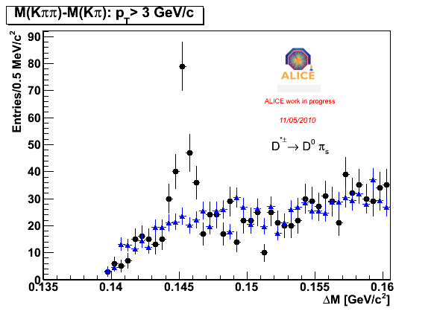
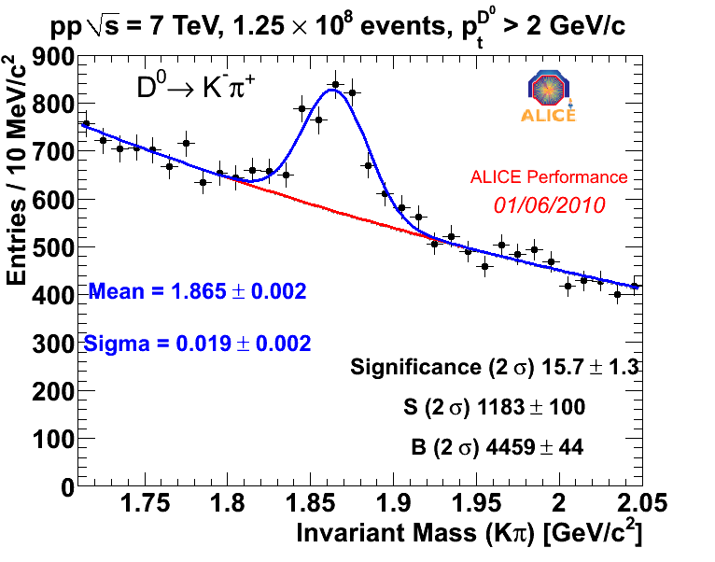
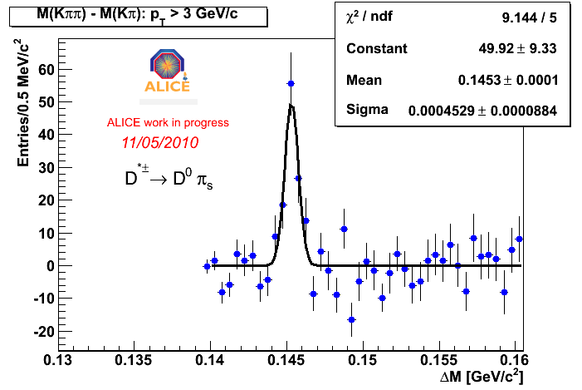
D - mesons

Slide 23
Other papers in advanced stage
Charged particle p_{T} distribution
Baryon-antibaryon asymmetry
Bose-Einstein correlations
Strangeness production (K⁰, Λ, Ξ, Φ)
Identified particles (π, K, p) p_{T} distribution

Slide 24
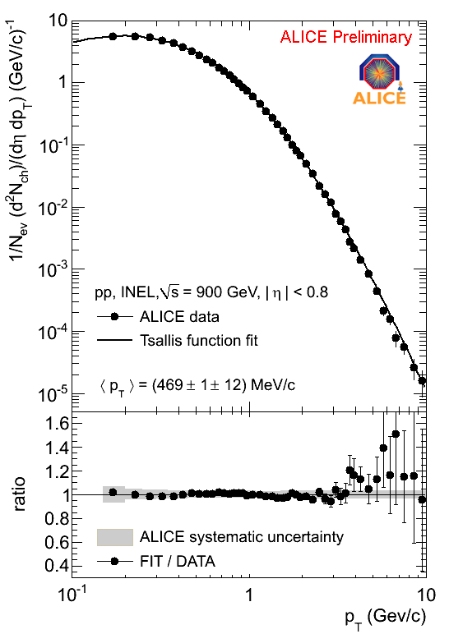
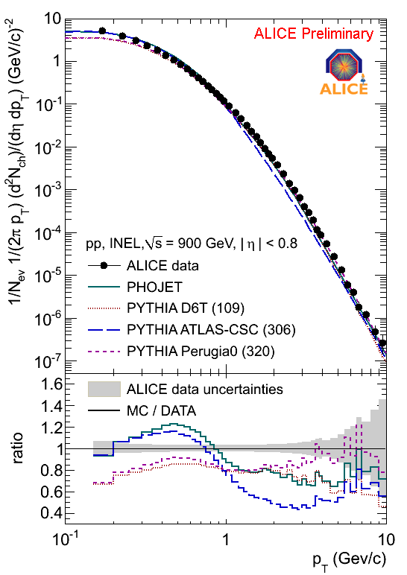
p_{T}-differential (900 GeV)
Tsallis fit
vs generators

Slide 25


<p_{T}> vs multiplicity (900 GeV)
vs generators

Slide 26


Baryon-antibaryon asymmetry

Slide 27

Bose-Einstein Correlations
Hambury Brown – Twiss correlation for identical bosons (π⁻)
full analysis ready, under internal approval
  vs charged particle multiplicity and K_{T}

Slide 28


Conclusions and Outlook for 2010
ALICE has successfully started the p-p data taking campaign
First physics resultes already published, other expected be published soon
More to come:
  π⁰, η
  c and b production
  J/ψ production
  high multiplicity
  jet correlations
  event shape
  underlying events
  reconstructed jets
  b-tagged jets
  …
and of course…
Pb-Pb!

Slide 29

ALICE training in view of heavy-ion collisions

