Slide 1
Unpolarized and polarized elementary kaon electroproduction at MAMI
Patrick Achenbach
U Mainz
June 2o12

Slide 2
Electrophotoproduction of strangeness
γ + N → K + Y
γ + p → K⁺ + Λ
γ + p → K⁺ + Σ⁰
γ + p → K⁰ + Σ⁺
γ + n → K⁰ + Λ
γ + n → K⁰ + Σ⁰
γ + n → K⁺ + Σ⁺
n: neutron target
K+ : anti- kaon
p: proton target
K⁰ : neutral kaon
In electroproduction …
hadron structure is cleanly probed
electron vertex is well‐known from QED
one‐photon exchange is accurate on the % level

Slide 3
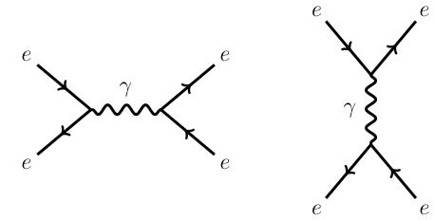
The “virtual” photon
p
p
p
●
strangeness production in response of nucleon to electromagnetic field
●
time
p
Q² > 0: space-like
Q² < 0: time-like
space
degree-of-polarization of photons:
ε is Lorentz invariant under boosts along the virtual photon direction
no longitudinal polarization possible for real photons with Q² = 0

Slide 4
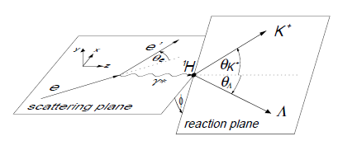
p(e,e‘K)Λ in the one-photon-exchange approximation
five-fold differential cross section separates into virtual photon flux and virt. photoproduction
with degree of polarisation:
structure of virtual photoproduction cross section:
for polarized electrons with helicity h:
for Q² → 0 and unpolarized electrons relation to real photoproduction cross section

Slide 5
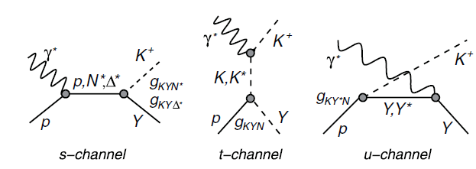
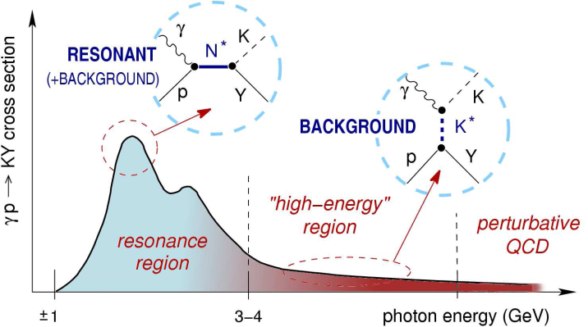
Effective Lagrangian models for strangeness production
[Fig. from T. Corthals]
• Saclay-Lyon A: no hadronic f. f., SU(3), crossing symmetry,
nucleon (spin 1/2 and 3/2) and hyperon resonances
extended Born terms (p, Λ, Σ, K), K*(890), K₁(1270) [T. Mart, C. Bennhold, Phys. Rev. C 61 (2000) 012201(R)]
• Kaon-MAID: hadronic f. f., SU(3), no hyperon resonances, only nucleon (spin 1/2 and 3/2) resonances
extended Born terms (p, Λ, Σ, K), K*(890), K₁(1270) [T. Mizutani et al., Phys. Rev. C 58 (1998) 75]
• RPR: Regge model for t-channel
moderate no. of s-channel nucleon resonances
[T. Corthals, D.G. Ireland, T. Van Cauteren, J. Ryckebusch, Phys. Rev. C 75, (2007) 045204]

Slide 6
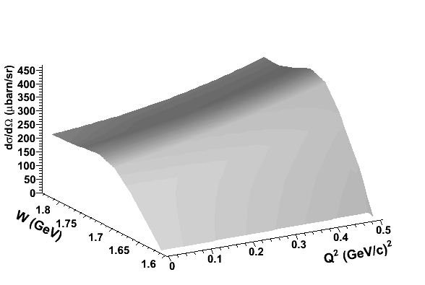
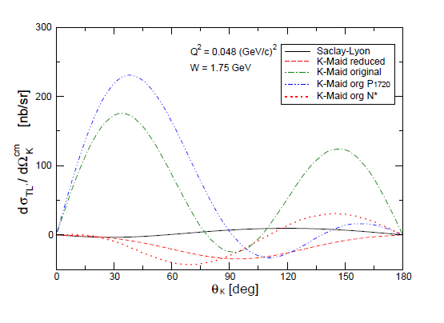
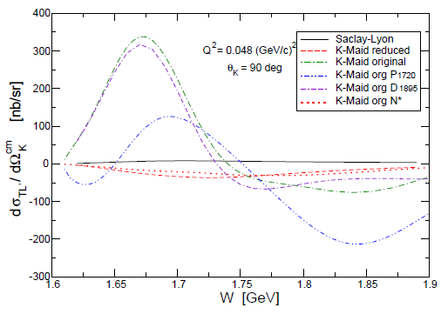
Predictions for MAMI kinematics
model for dσ/dΩ as a function of Q² and W at θ_{K} = 60° and ε = 0.5
model for dσ/dΩ as a function of cos θ_{K} at W = 1.75 GeV
[P. Achenbach et al. (A1 Collaboration), Nucl. Phys. A 881 2012)]

Slide 7
Measurements at MAMI

Slide 8
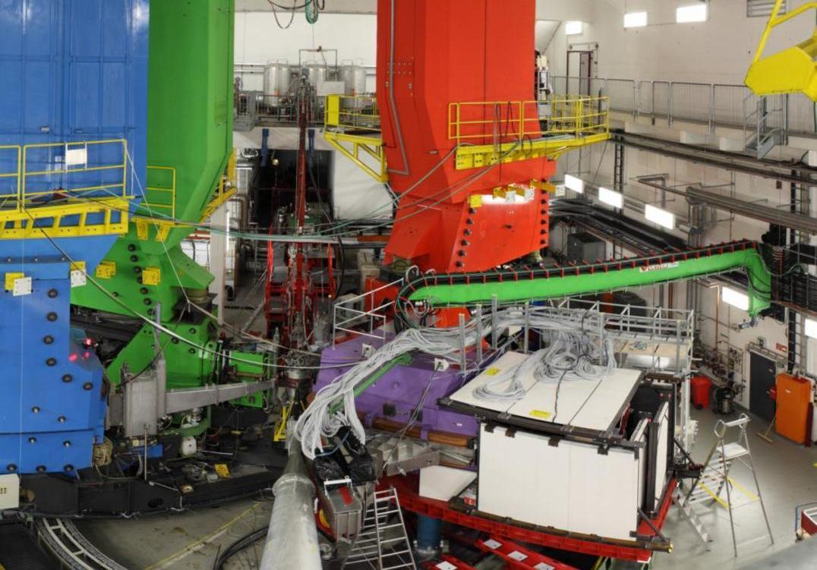
Dedicated kaon spectrometer Kaos
A
C
B
KAOS

Slide 9
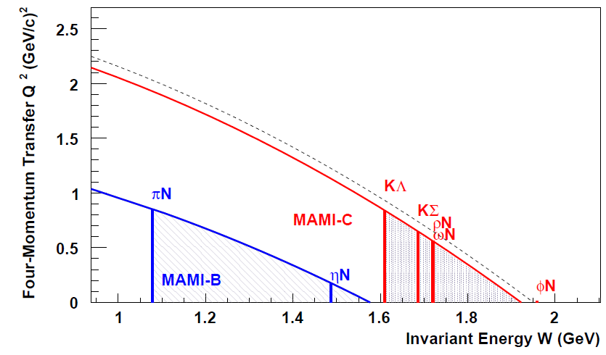
Kaon electro-production measurements at MAMI
March/April 2oo8: commissioning of the KAOS spectrometer
Sept./Oct. 2oo8: 1st campaign on kaon electroproduction
July 2oo9: 2nd campaign on kaon electroproduction
Nov. 2o11: 3rd campaign on kaon electroproduction
Q² range 0.03-0.055 (GeV/c)² not accessible at any other accelerator worldwide
W = 1650 – 1750 GeV in 3rd resonance region of the proton
[P. Achenbach et al. (A1 Collaboration), Eur. Phys. J ST 198 2011)]
strange particle and fragment production at W > 1.6 GeV

Slide 10
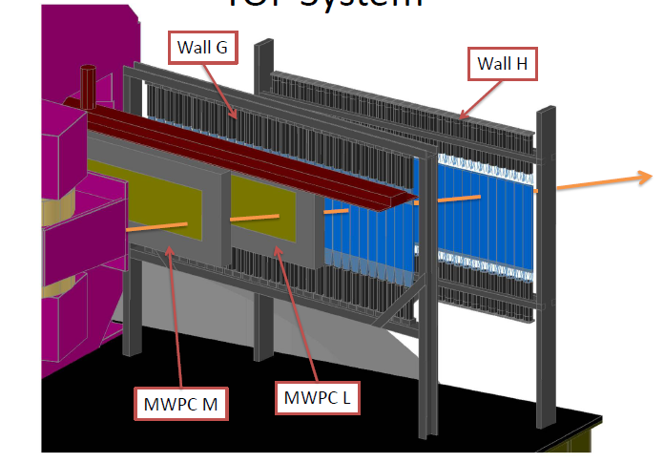
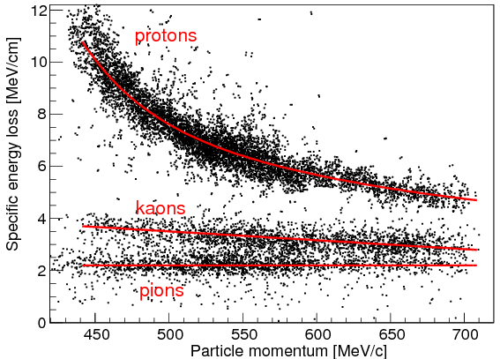
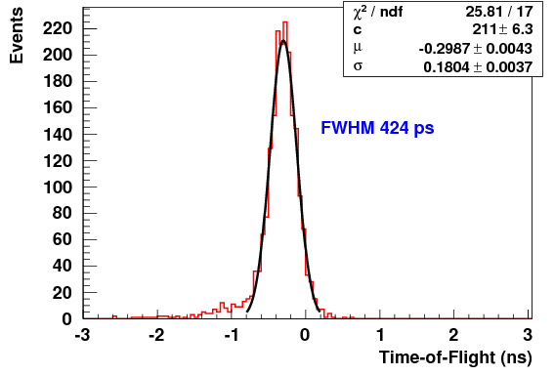
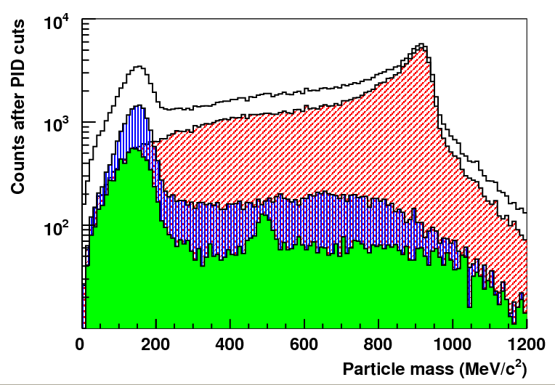
Kaon identification
with cuts on time-of-flight and missing mass
FWHM = 400 ps
time-of-flight reso-lution within Kaos
π : K : p 1 : 0.03 : 1.38

Slide 11
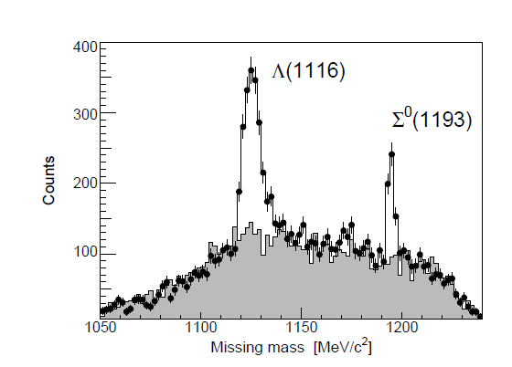
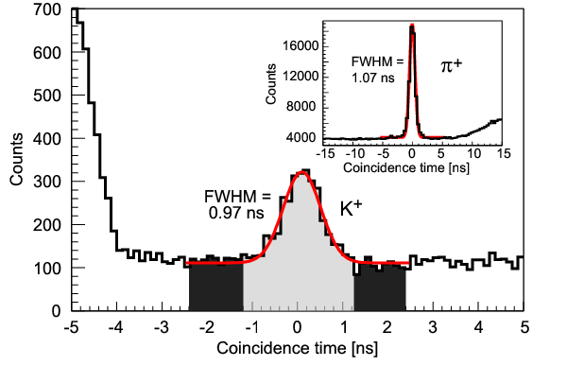
Reaction identification
with cuts on dE/dx
extraction of cross-section using background-corrected kaon-Λ yield, luminosity, acceptance, efficiencies, kaon survival, radiative corrections:

Slide 12
Unpolarized structure functions

Slide 13
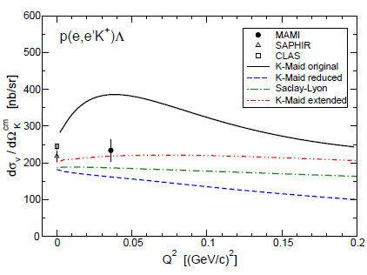
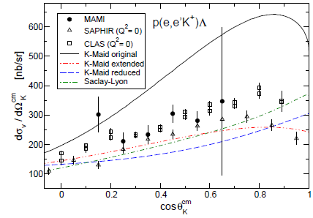
KΛ cross section at Q² = 0.036
[P. Achenbach et al. (A1 Collaboration), Eur. Phys. J. A 48 2012)]
first time measurement of cross-section at low Q²
only small differences to photoproduction data observed
original K-MAID model excluded with high significance

Slide 14
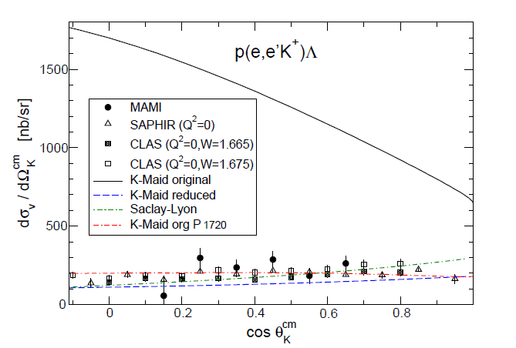
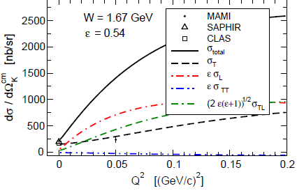
KΛ cross section at Q² = 0.05
[P. Achenbach et al. (A1 Collaboration), Eur. Phys. J. A 48 2012)]
Q² = 0.05 data confirms the observed trend
in combined data Q² extends from 0.030–0.055 (GeV/c)²

Slide 15
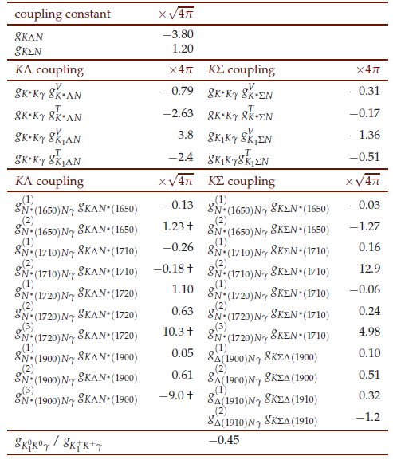
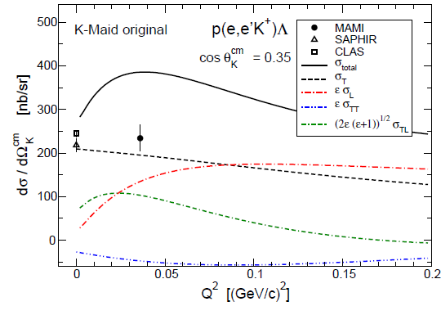
Longitudinal couplings in K-Maid
[P. Achenbach et al. (A1 Collaboration), Eur. Phys. J. A 48 2012)]
strong longitudinal coupling → steep increase of cross-section with Q²

Slide 16
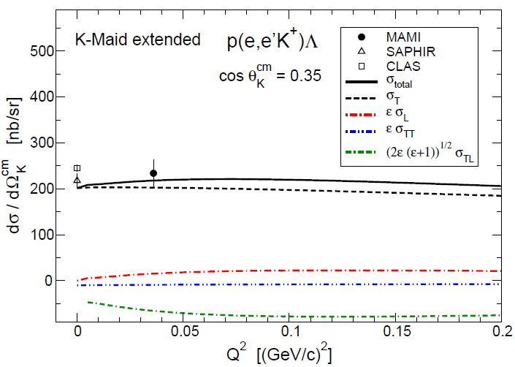
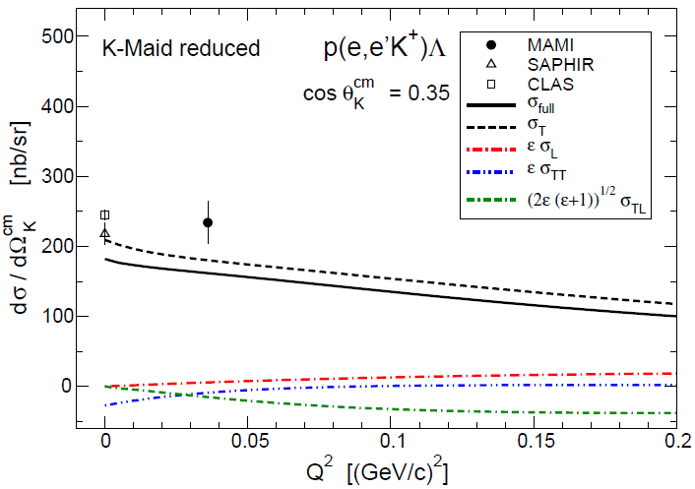
Comparison with modern isobar model variants
K-Maid extended
K-Maid reduced
[K-Maid extended: private communication with T. Mart]
[K-Maid reduced: private communication with P. Bydžovský]
modern isobar models use small or vanishing longitudinal couplings

Slide 17
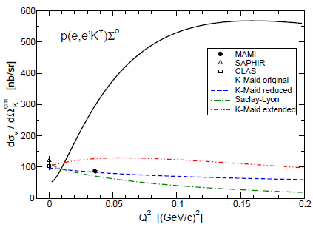
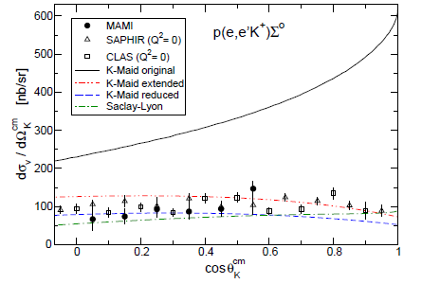
Results for the KΣ-channel
[P. Achenbach et al. (A1 Collaboration), Eur. Phys. J. A 48 2012)]
first time measurement of cross-section at low Q²
only small differences to photoproduction data observed
original K-MAID model excluded with high significance

Slide 18
Polarized structure functions

Slide 19
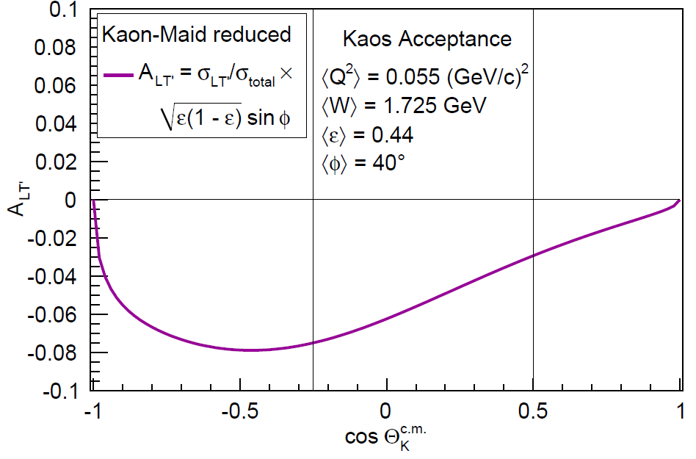
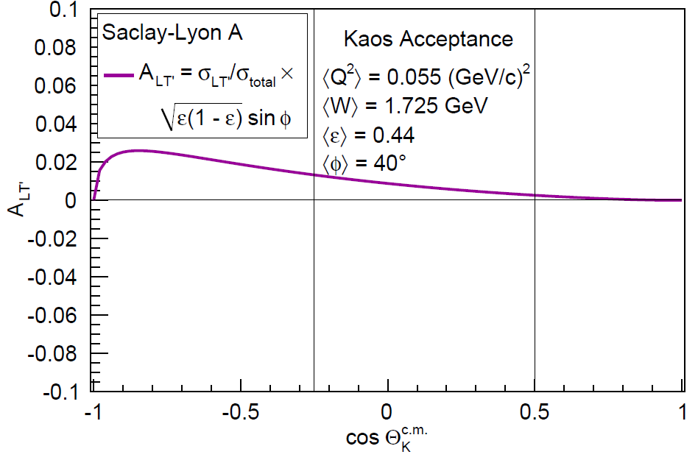
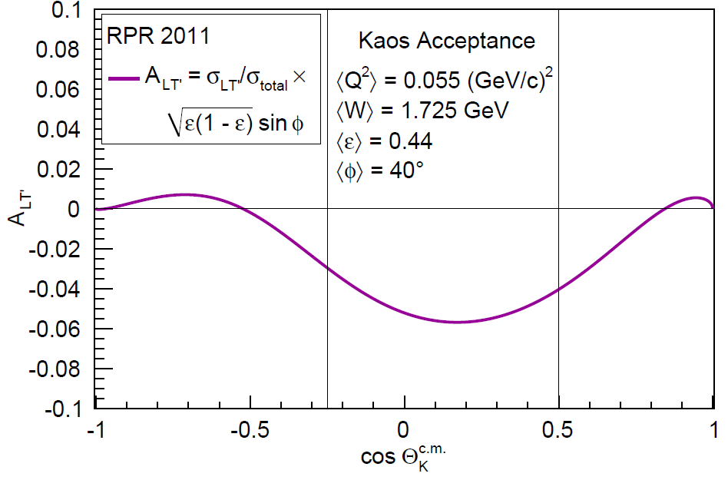
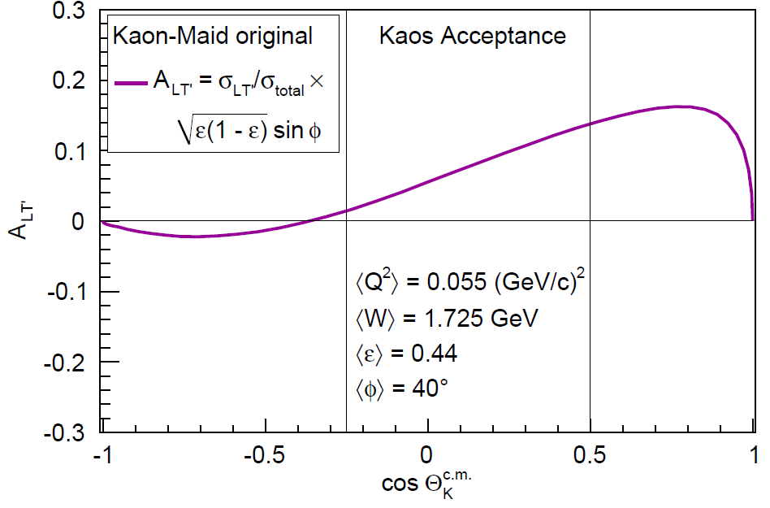
Model predictions
[Model provided by P. Bydžovský]
[Model provided by P. Bydžovský]
[Model available online]
[Model provided by P. Vancraeyveld ]

Slide 20
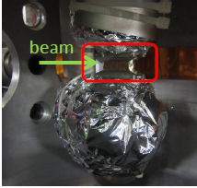
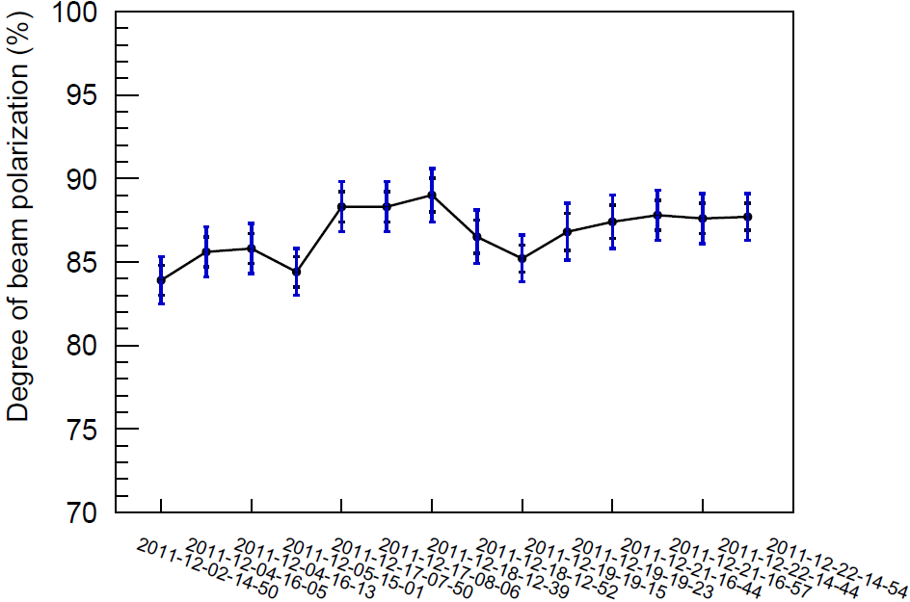
Accessing helicity asymmetries
P_{beam} ~ 87 %
target | liquid H₂
target thickness | 370 mg/cm²
beam intensity | 10 μA
MAMI delivers a stable 1.5 GeV electron beam with high polarization on high-power liquid hydrogen target

Slide 21
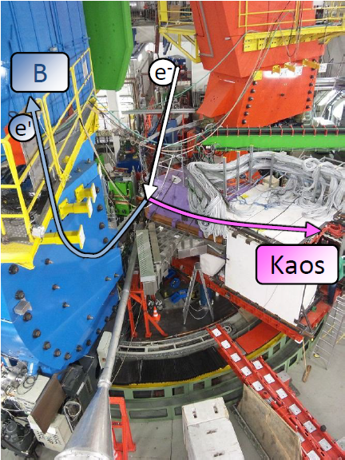
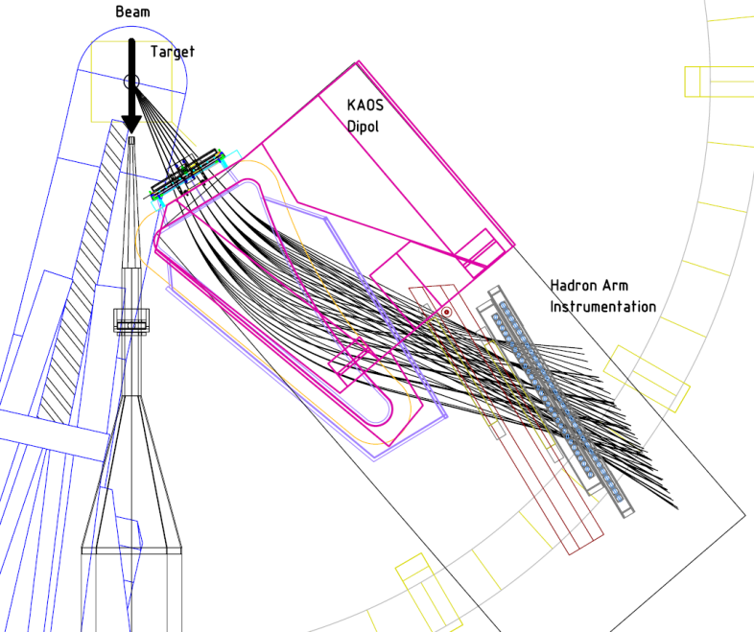
Out-of-plane setup at MAMI
Φ ~ 40°
kaon | spectrometer | Kaos
 | in-plane angle | 21 – 43 deg
 | central momentum | 0.52 GeV/c
e’ | spectrometer | SpecB
 | in-plane angle | 15 deg
 | central momentum | 0.36 GeV/c

Slide 22
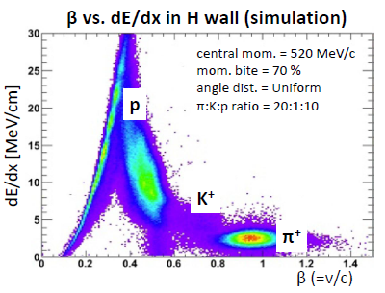
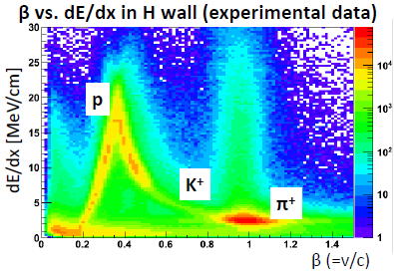
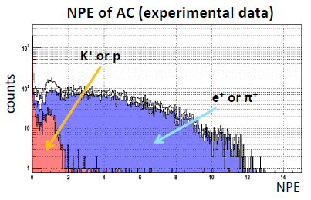
Improved background rejection
new aerogel Cherenkov detector for kaon ID
new scintillator wall for PID by single-arm TOF
new FPGA trigger with improved timing
smaller systematic errors in the simulation
much improved tracking code

Slide 23
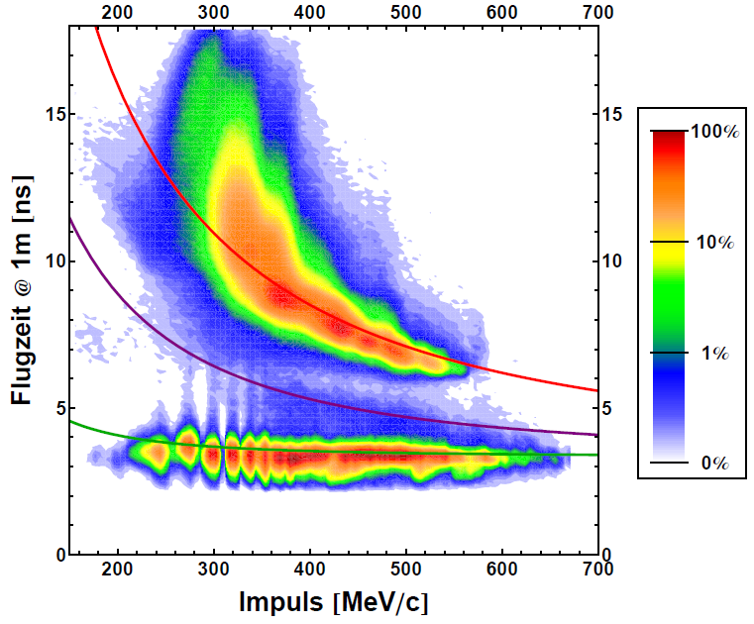
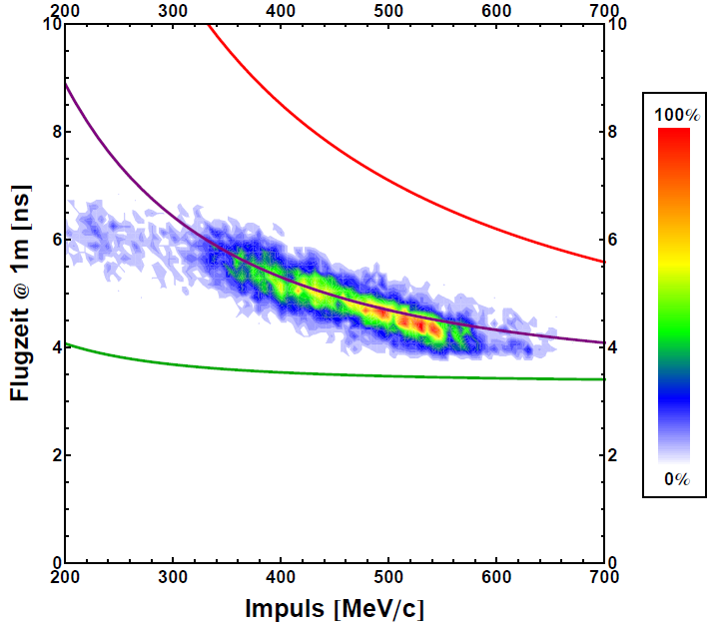
Improved kaon identification
without dE/dx cuts
with dE/dx cuts on kaons
time-of-flight [ns]
time-of-flight [ns]
momentum [GeV/c]
momentum [GeV/c]

Slide 24
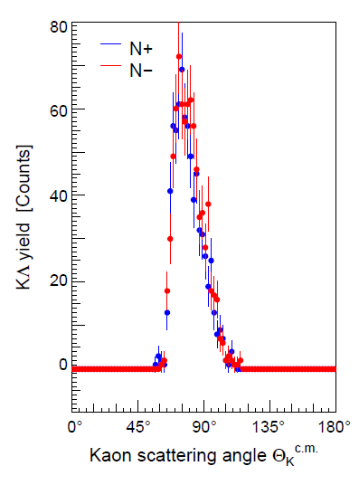
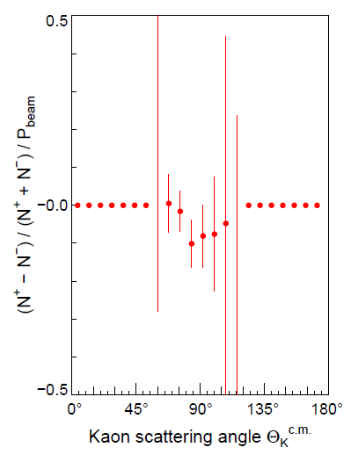
Preliminary helicity asymmetries

Slide 25
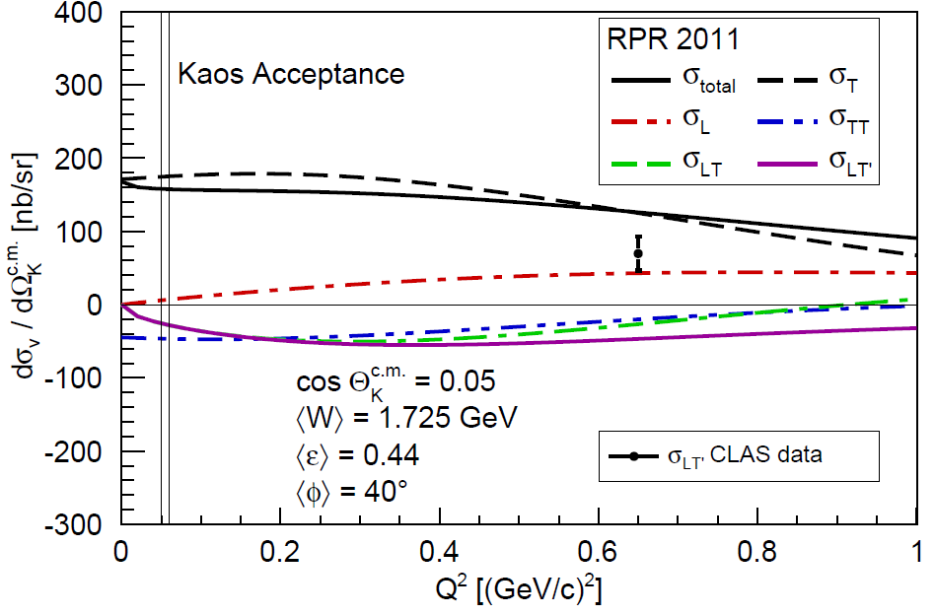
Connection to CLAS data at Q² > 0.5 (GeV/c)²
[Model provided by P. Vancraeyveld ]
[Data point from Nasseripour et al. (CLAS Collab.), Phys. Rev. C 77, 065208 (2008)]
MAMI preliminary data point without error bars

Slide 26
Conclusions
strangeness physics programme at MAMI is complementary to other laboratories (esp. Jefferson Lab)
kaon electroproduction structure functions at low Q² extracted (from 2oo8/2oo9 data)
polarized structure functions at low Q² extracted (from 2o11 data)
What can be learned:
models with large σ_{L} contributions excluded
→ more observables are needed to characterize the reaction
σ_{LT‘} is sensitive to interference terms between assumed resonances
→ non-trivial physical information on dynamics of the process
at energies ~1.7 GeV and higher Q² CLAS data shows enhancement
→ unknown resonance structure
→ more data at low Q² improves interpretation

Slide 27
Jefferson Lab results

Slide 28
Unpolarized structure functions

Slide 29
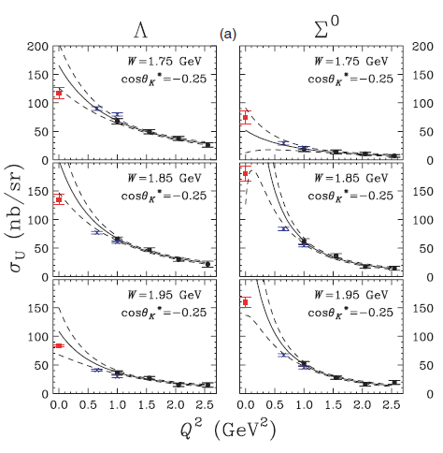
Unseparated Λ and Σ cross sections
σ_{U} = σ_{T} + ε σ_{L}
[Ambrozewicz et al., Phys. Rev. C 75 (2007) 045203]

Slide 30
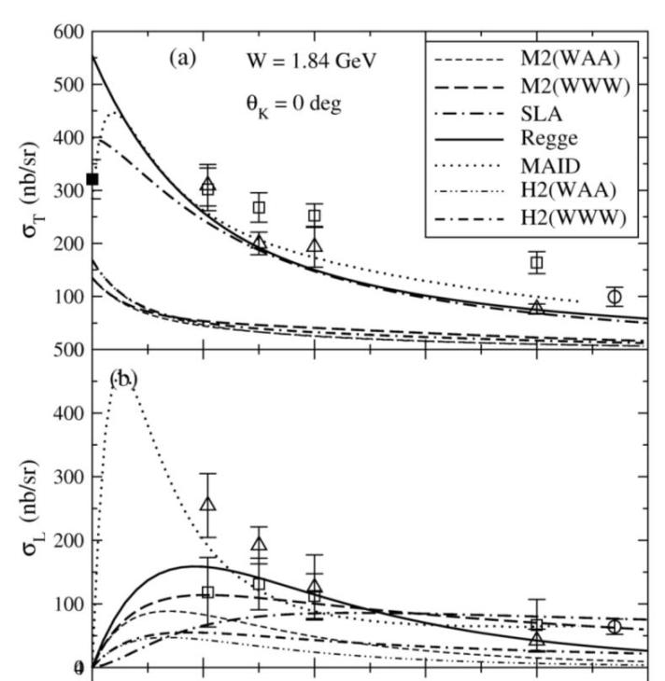
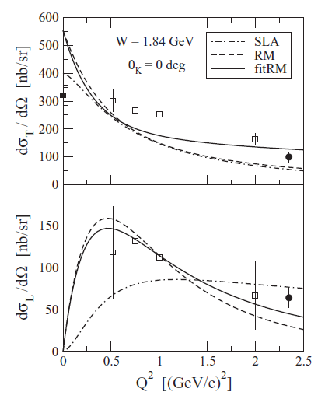
Separated Λ cross sections
1 Q² (GeV/c)²
1 Q² (GeV/c)²
[Mohring et al., Phys. Rev. C 67 (2003) 055205]
[Coman et al., Phys. Rev. C 81 (2010) 052201]

Slide 31
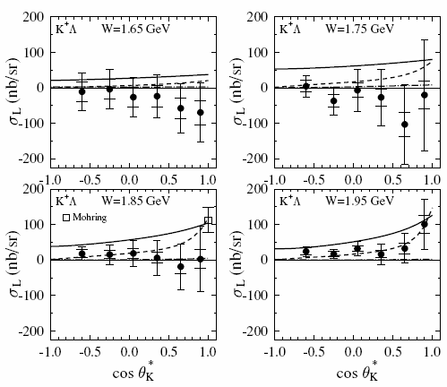
Separated Λ cross sections
CLAS data suggests vanishing longitudinal parts
[Ambrozewicz et al., Phys. Rev. C 75 (2007) 045203]

Slide 32
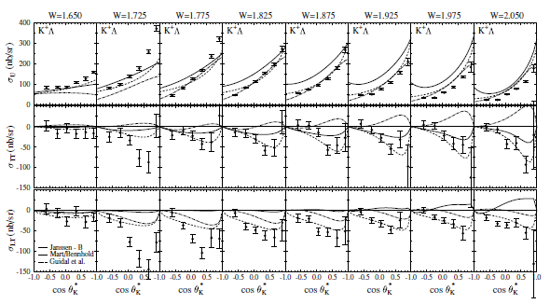
Unpolarized interference structure functions
[Ambrozewicz et al., Phys. Rev. C 75 (2007) 045203]

Slide 33
Polarized structure functions

Slide 34
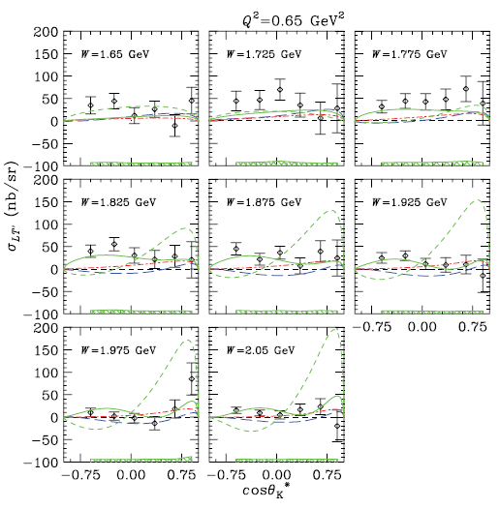
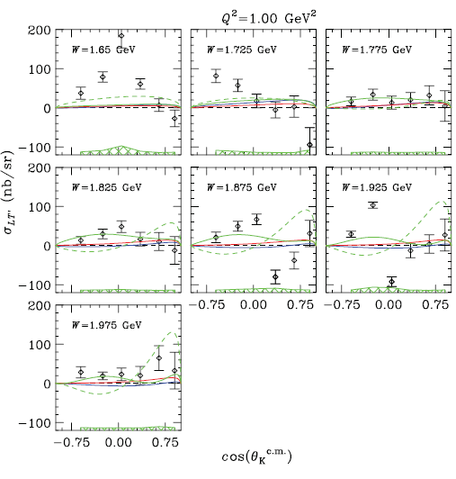
CLAS data at Q² > 0.5 (GeV/c)²
MB isobar model (blue long dashes)
GLV Regge model (red dash-dot)
Ghent RPR model including a D13(1900) state (green solid)
Ghent RPR model including a P11(1900) state (green short dashes)
[Nasseripour et al. (CLAS Collaboration), Phys. Rev. C 77, 065208 (2008)]

