Slide 1
Status and hadron physics program of J-PARC
K. Ozawa (KEK)

Slide 2
Contents
Status of J-PARC
  Effects of the earth quake
Physics program
  Penta-quark search
  KN & KNN bound state
  Meson mass in nucleus

Slide 3
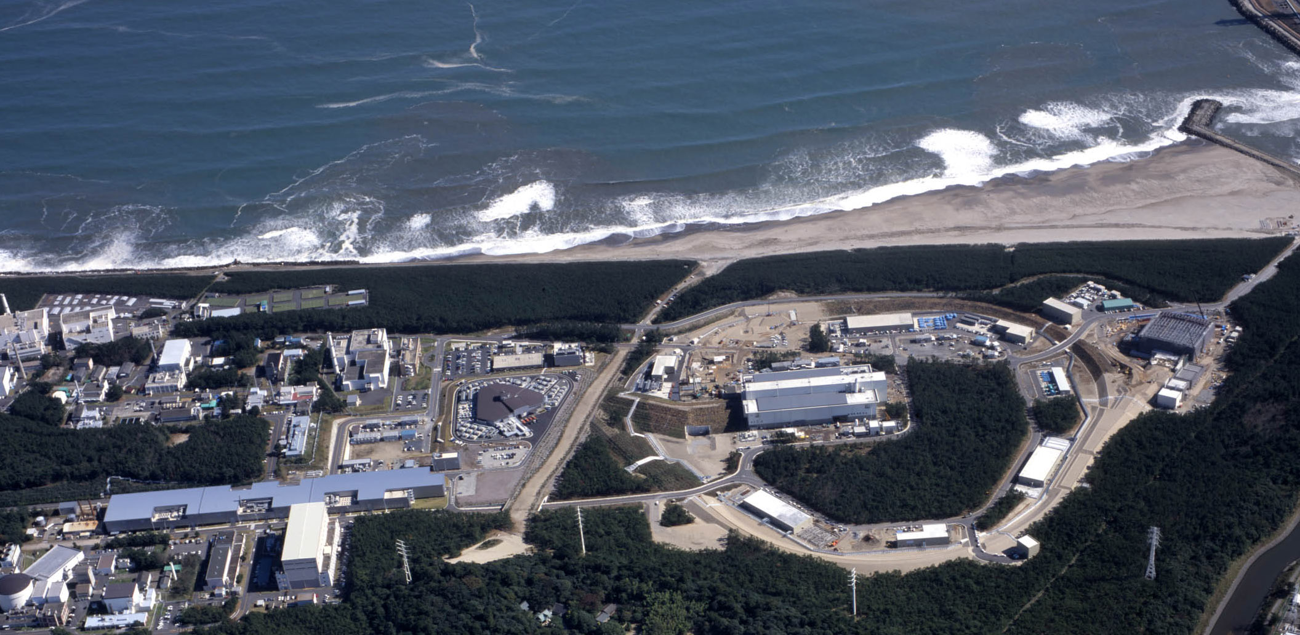
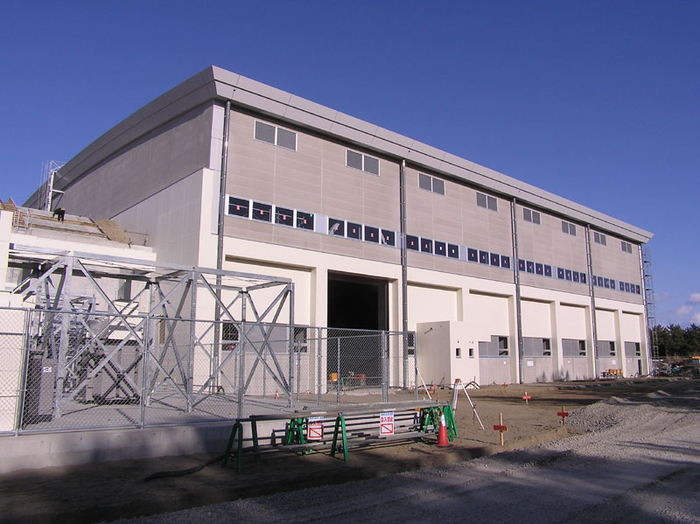
J-PARC
(Japan Proton Accelerator Research Complex)
Tokai, Japan
Material and Biological Science Facility
50 (30) GeV Synchrotron (15 μA)
3 GeV Synchrotron (333 μA)
400 MeV Linac (350m)
Hadron Hall
60m x 56m
Neutrino Facility
World-highest beam intensity : ~1 MW
x10 of BNL-AGS, x100 of KEK-PS

Slide 4
Status of J-PARC
All components are back by the last December
  The first beam after the earthquake is delivered to Neutrino on Dec 24.
Physics data are collected in February
  Penta quark search with a different beam energy
Next Physics run will start on June 9th!

Slide 5
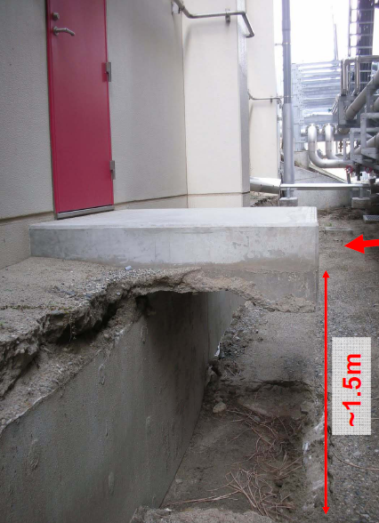
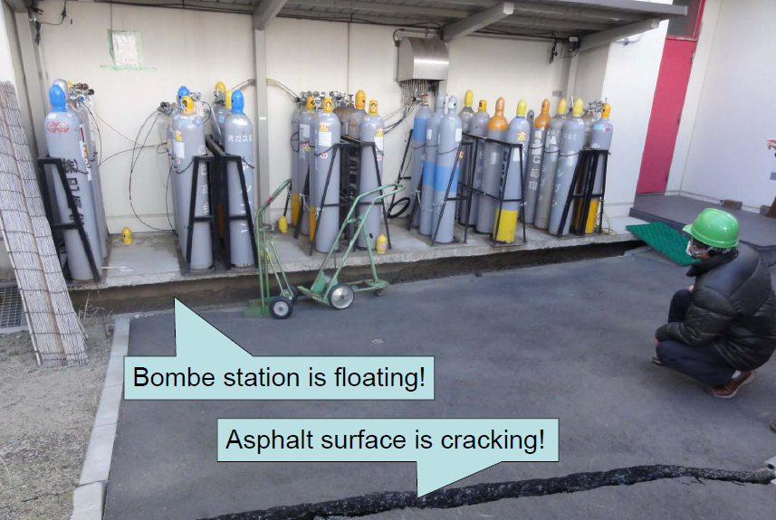
Effects of the earth quake
Building itself is almost OK, since it is fixed to a solid rock under the ground using piles.
However, ground level has large effects like these photos.
All damages are fixed.

Slide 6
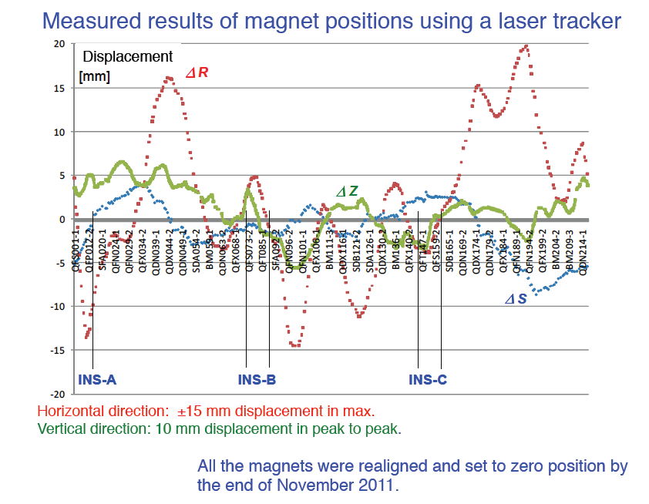
Magnets are moved – re-aligned!
Main Ring

Slide 7
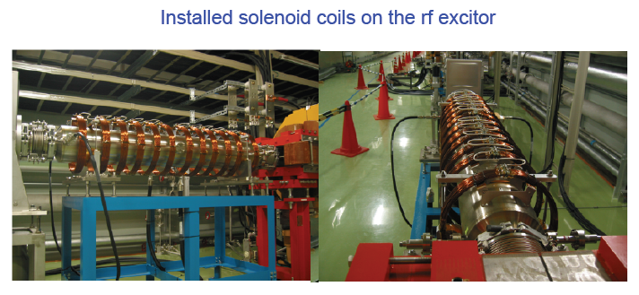
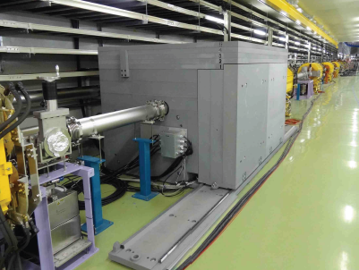
Not only recover, Improvements!
SX collimator
Solenoid coils to improve duty factor in Slow extraction.
SX collimator to localize residual activation

Slide 8
physics program

Slide 9
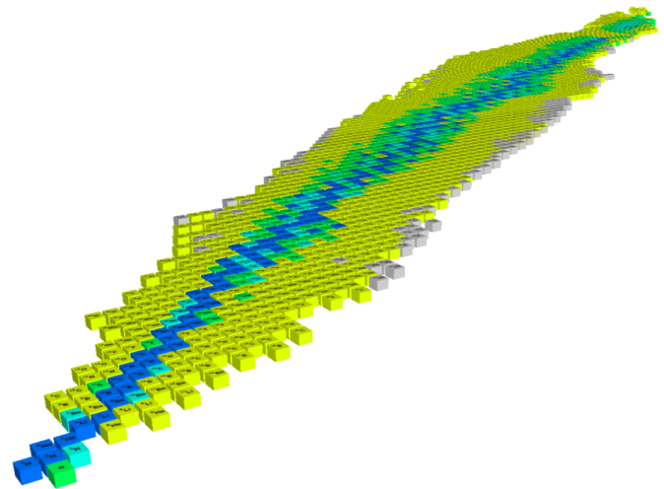
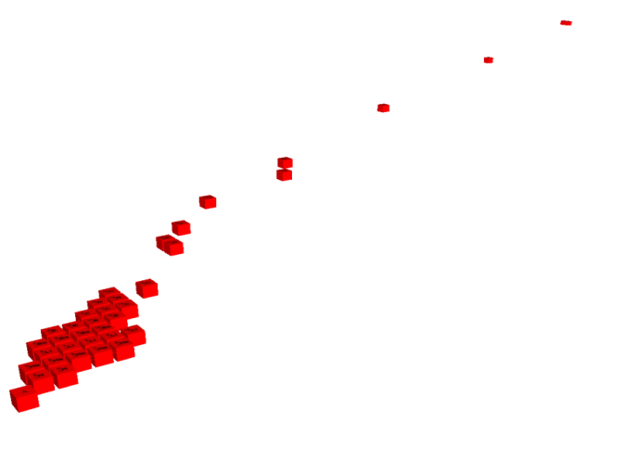
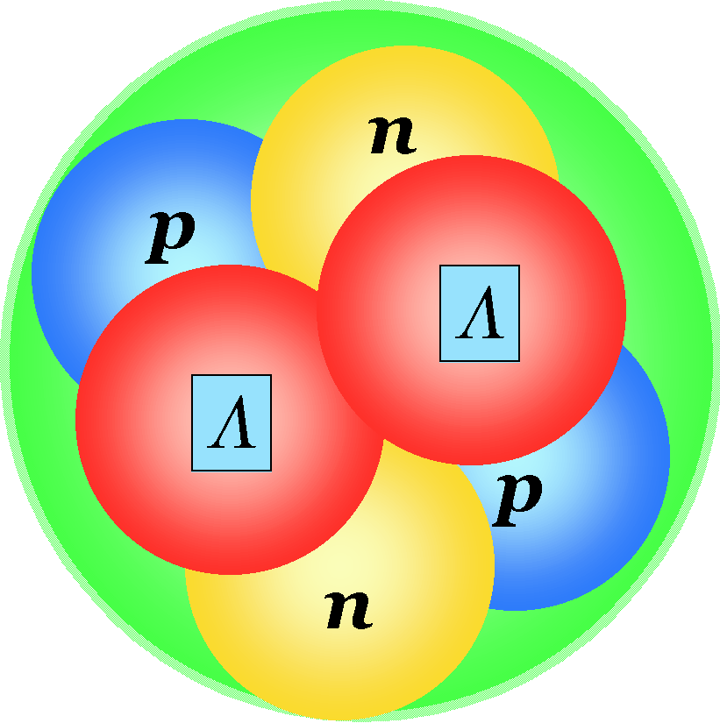

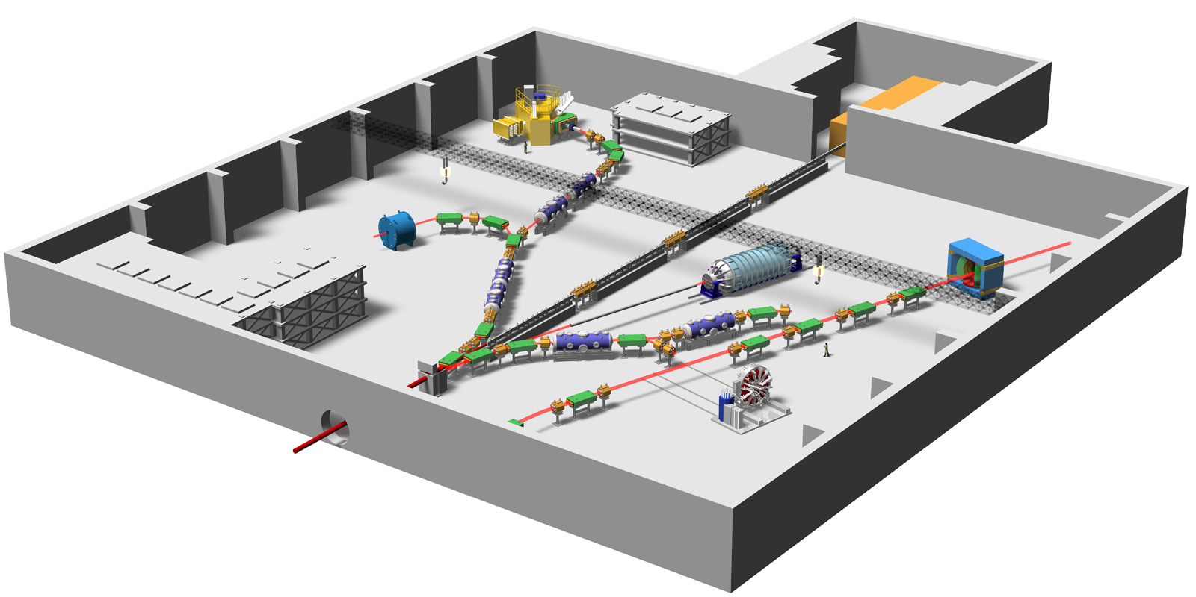
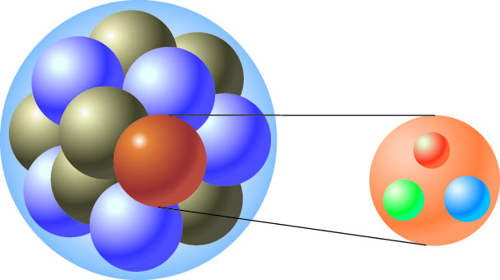
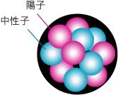
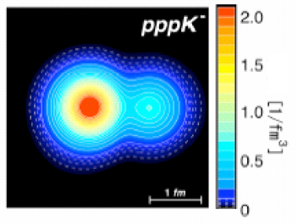
Nuclear & Hadron Physics at J-PARC
Hypernuclei
d
Strangeness
u
s
d
u
ΛΛ, Ξ Hypernuclei
_{ΛΛ}He
Pentaquark Θ⁺
Z
⁶
-2
Λ, Σ Hypernuclei
-1
Λ,Ξ
N
0
SKS
K1.8
High p (not yet)
K1.8BR
KL
K1.1
K meson
Implantation of
Kaon and the
nuclear shrinkage
K1.1BR
Quark
Ｋ⁻
Proton Beam
Free quarks
Bound
quarks
Ｘray
Why are bound quarks haevier？
Kaonic atom
Kaonic nucleus
Mass without Mass Puzzle
Notes:
On the other hand, the hadron experimental hall looks like this.
● Proton beam comes here and various kaon beam lines are prepared, where K=1.8 means kaons with momentum of 1.8 GeV/c.
● At SKS, hypernuclear spectroscopy will be performed for a variety of nuclei. ● In particular, searches for double hypernucleus and pentaquark are the highlights in here.
● In this beamline, kaon implantation is planned. When kaon is implanted inside the nucleus, there is a possibility that high density matter is created. ● Kaonic atom and kaonic nucleus will be studied.
● This beam line is the neutral kaon line to study CP violation, and ● this line is for T-violation experiment.
● Finally, this line, which is not yet completed, is dedicated to the study of chiral symmetry, namely, the mass generation mechanism of bound quarks.
9

Slide 10
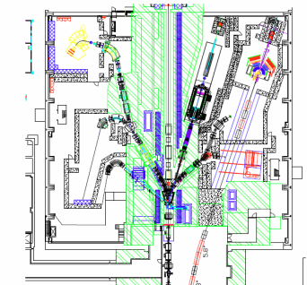
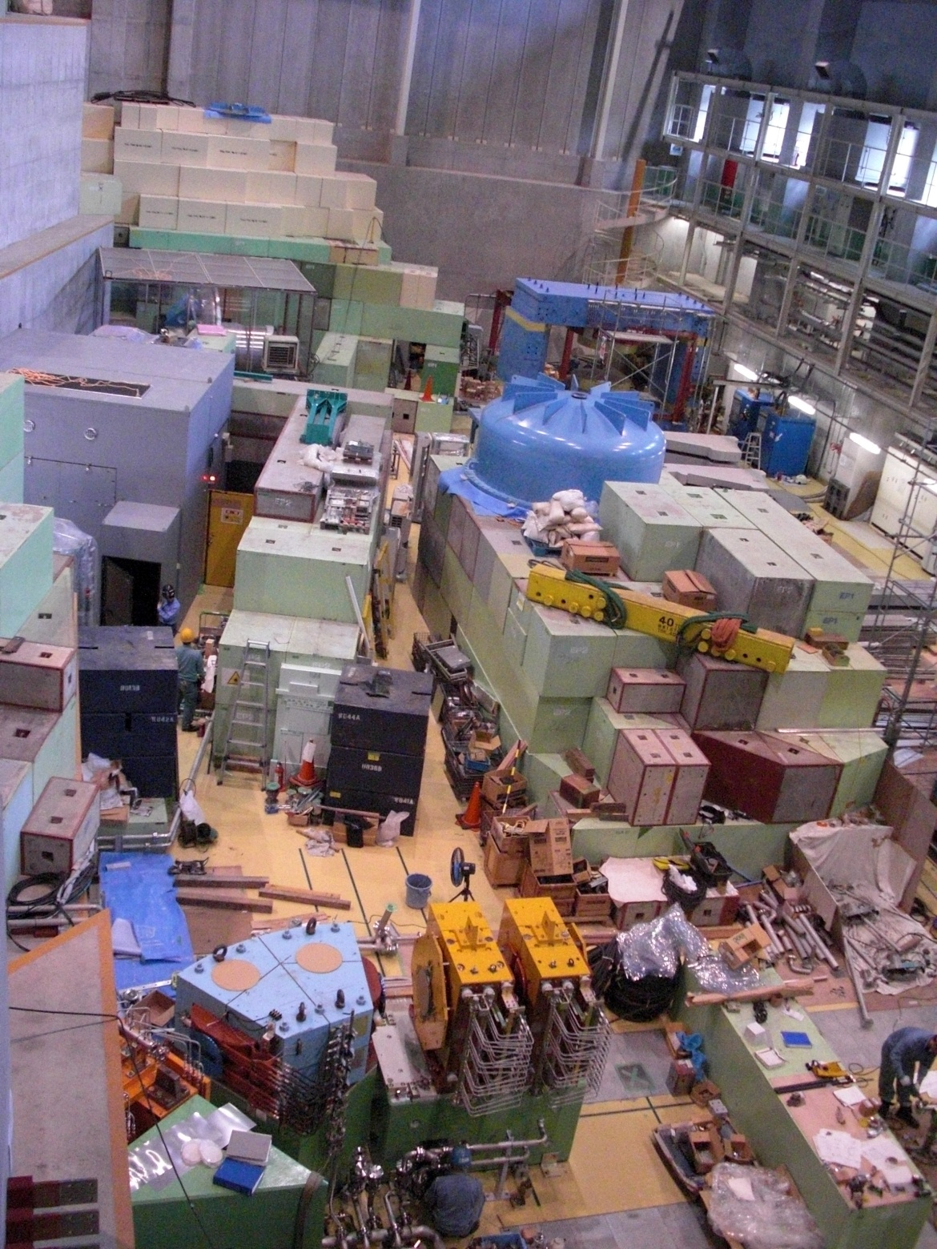
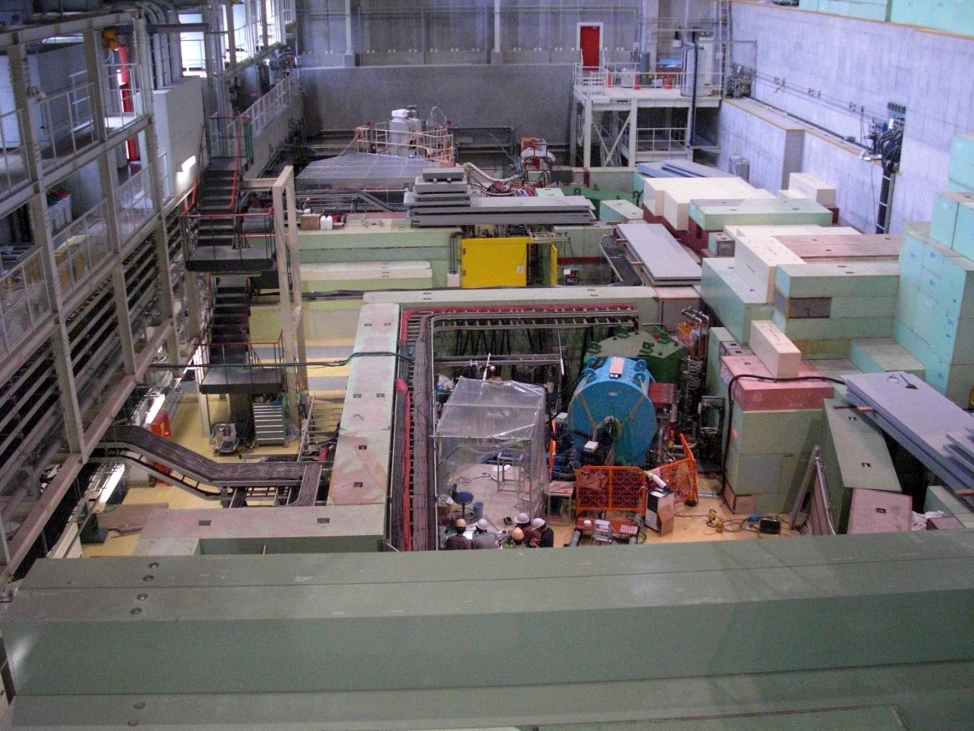
South side
North side
KL
SKS
High Momentum
K1.8BR
K1.1BR
Notes:
絵の説明
10

Slide 11
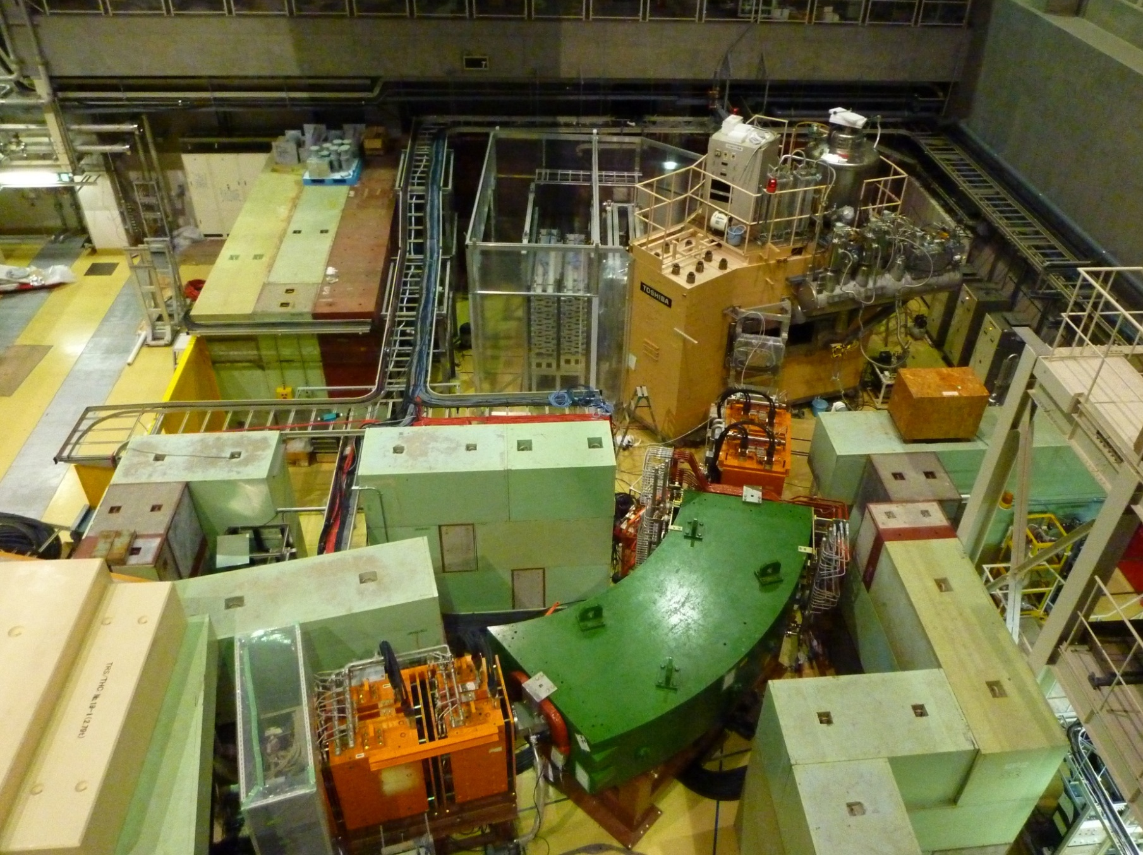
SKS Spectrometer
Q13
Q12
K1.8 Beam Spectrometer
D4
Q10
Q11
Notes:
実験エリアの現状 2009年秋からビームタイム開始
11

Slide 12
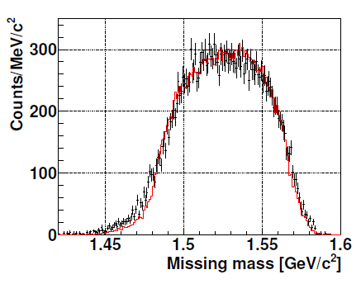
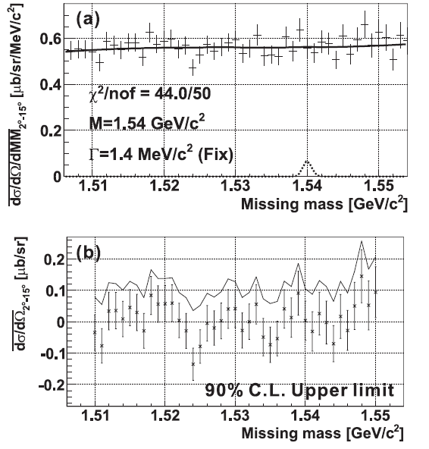
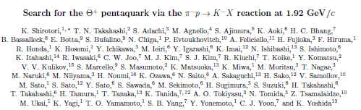
E19:Penta quark - results
2010 data
Search for the Θ⁺ via the p+π⁻→K⁻+X Reaction at 1.97GeV/c
No peak of Θ⁺ was observed.
U.L. (90%CL) 0.26μb/sr (2－14°) in 1.51－1.55GeV/c²
U.L.(90%CL) of Γ_{Θ}
0.72 MeV (1/2⁺)
3.1 MeV (1/2⁻)
arXiv:1203.3604
Submitted to PRL
Positive comment, revised version is submitted

Slide 13
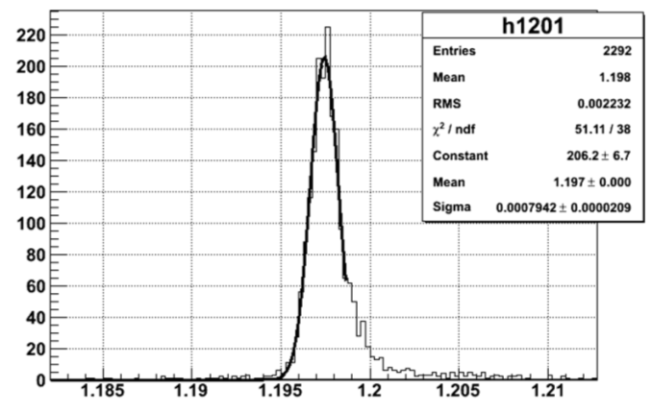
Penta quark – additional data
E19 2nd step Run at 2.0 GeV/c was completed after the earthquake.
  Beam momentum is slightly increased to have larger cross section for penta quark production
  Except for the beam momentum, experimental setup is the same as the previous run
  8.7×10¹⁰ π⁻ on Liq-H₂ with 1.7M/spill beam
  (7.8×10¹⁰, 1.1M/spill at 1.92GeV/c in 2010 RUN)
Θ⁺ RUN at 2.0 GeV/c 8.7 ⋅10¹⁰ π⁻
Σ⁺ RUN at 1.37 GeV/c 8.5 ⋅10⁸ π⁺
Σ⁻ RUN at 1.37 GeV/c 4.8 ⋅10⁹ π⁻
Σ⁻ RUN at 1.45 GeV/c 8.8 ⋅10⁹ π⁻
Σ⁻
at 1.37GeV/c
ΔM=1.87MeV/c²(FWHM)
⇔ 1.86MeV/c²(FWHM) 1st step RUN

Slide 14
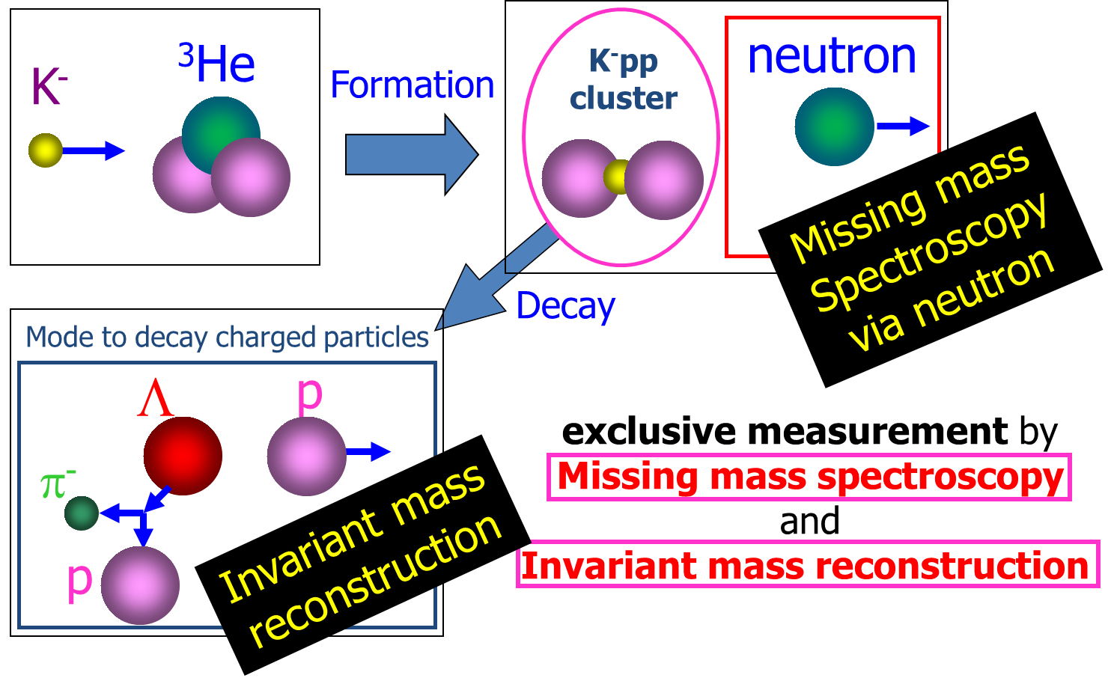
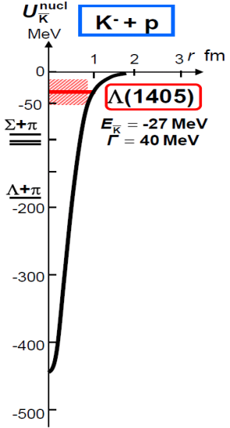
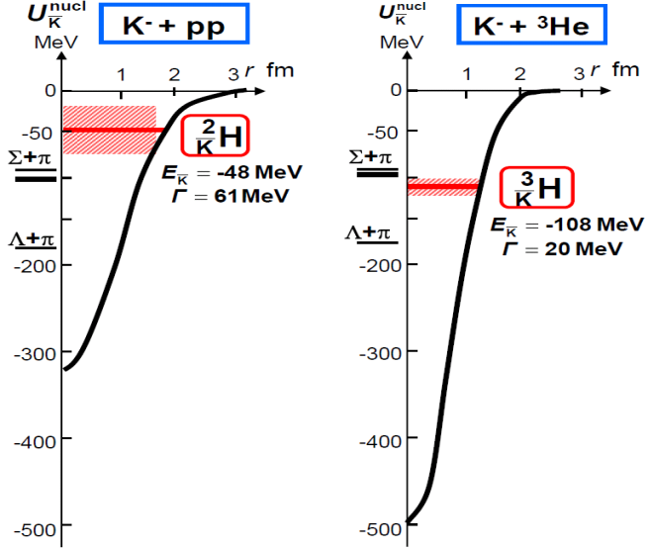
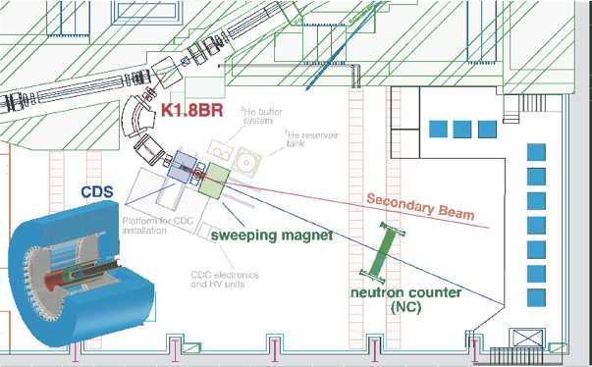
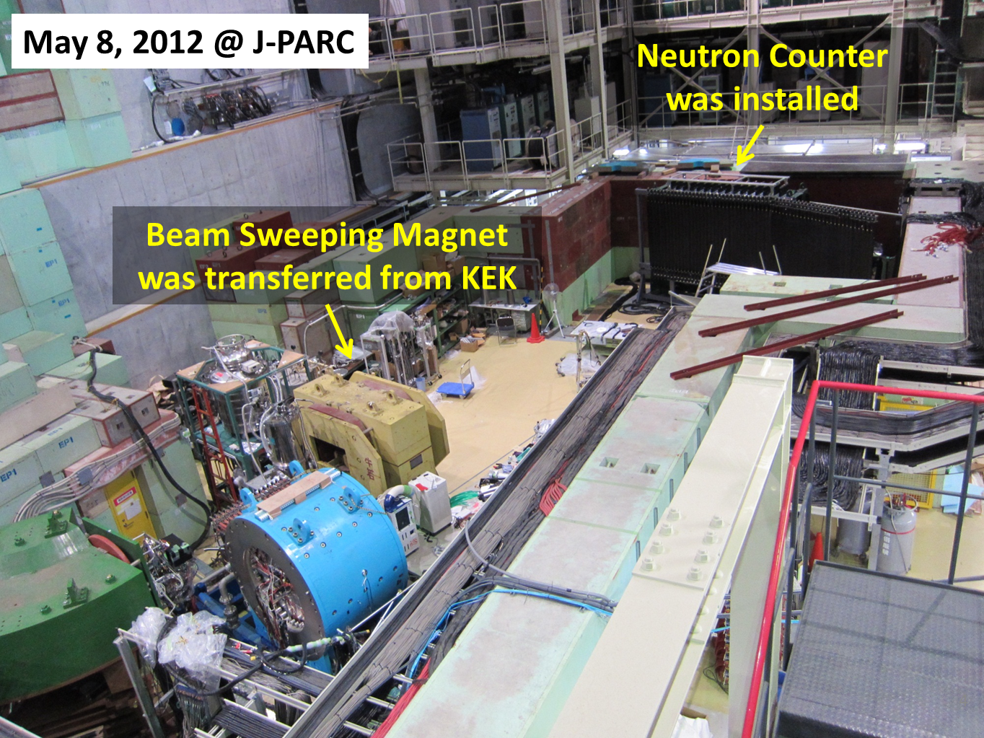
E15:KN Interaction Study by Nuclear Bound-States
Physics motivation
Experimental scheme
Experimental setup
Experiment is ready for beam

Slide 15
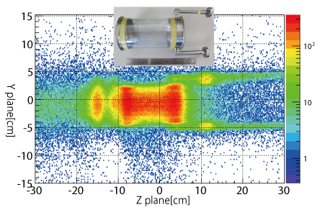
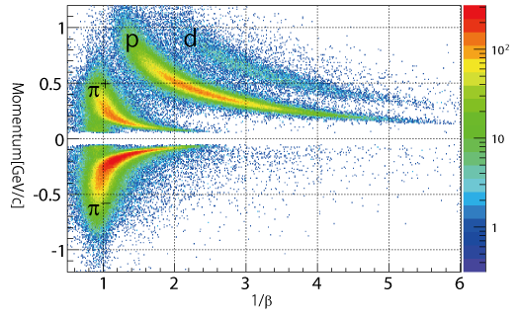
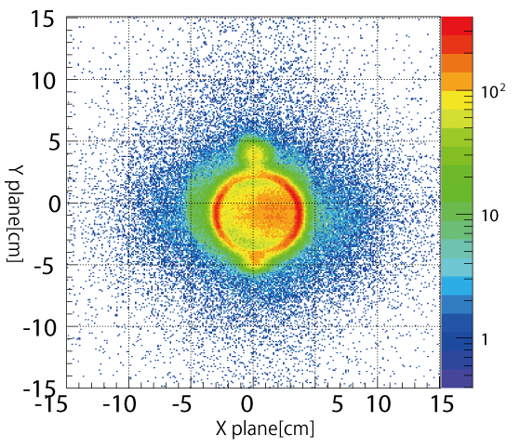
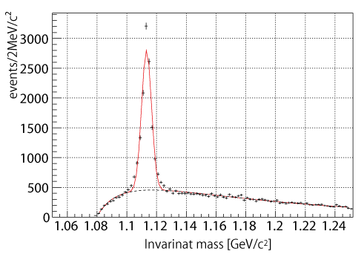
Results of the last run (Cont’d)
XY plane
YZ plane
Liquid ⁴He inside
Target-image together with material around has been reconstructed by the CDS
Charged particles from the target have been successfully identified by the CDS
pπ⁻ invariant-mass
spectra reconstructed
by the CDS
Λ
CDS and Liquid Helium target system successfully worked
Ready to explore kaonic-nuclei @ K1.8BR
~10,000 Λs have been accumulated

Slide 16
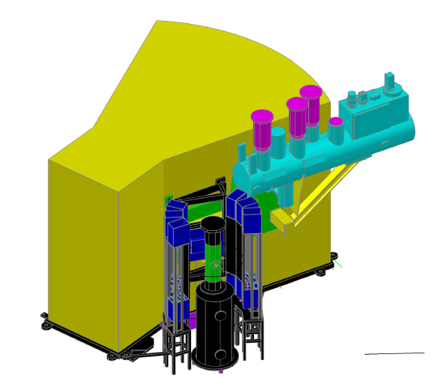
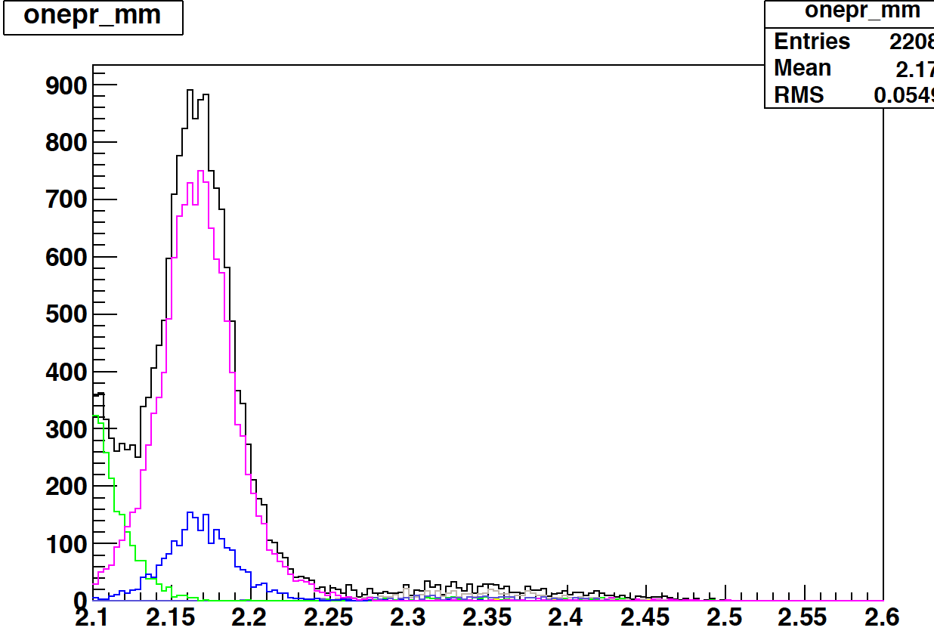
E27: Search for “K⁻pp” bound state in the d(π⁺,K⁺)X reaction
“K⁻pp” is produced through Λ* doorway in the d(π⁺,K⁺) reaction
Semi-exclusive measurement by Range
Counter Array (RCA) in order
to suppress quasi-free B.G.
  K⁻pp → Λ p₁, Λ → p₂ π⁻
  K⁻pp → Σ⁰ p₁, Σ⁰ → (Λγ) → p₂ π⁻ γ
  π⁺d → Λ* K⁺ p_{1s}, Λ* → Σ π, Σ⁺ → p₂ π⁰
Beam: 3M/spill beam
  3.6x10⁴ Λ* /day
  Assuming 1% trapping probability
  360 bound states/day ( inclusive )
  ∼45 events/10 days (exclusive)
  with ε_{RCA} ∼14% for two protons
π⁺
Λ*
K⁺
d
n
K⁻pp
p
K⁺
p
RCA
Mom_{proton}>350MeV/c
Expected point by FINUDA, DISTO
counts (/3M beam・10days )
Missing mass d(π⁺,K⁺) [GeV/c²]

Slide 17







Next: Strangeness Nuclear Physics
3D nuclear chart
→High density matter, Generalized nuclear force …
→First step to understand strangeness nuclear matter
Nu ~ Nd ~ Ns
Strangeness in neutron stars ( ρ > 3 - 4 ρ₀ )
“stable“
Strange hadronic matter (A → ∞)
Strangeness
High Density
ΛΛ, Ξ ハイパー核
(K⁻,K⁺)、E03,E05,E07
Z
-2
Λ, Σ Hypernuclei
(π⁻,K⁺)、E10、(K⁻,π⁻)、E13
N
-1
As increasing of intensity,
K beam experiment becomes feasible.
Many experiments are already approved.
0

Slide 18
Vector Meson mass in nucleus
Many measurements are already done
High energy heavy ion collisions
  SPS-NA60 (PRL 96 (2006) 162302)
    Modification of ρ meson due to hadronic effects
  RHIC-PHENIX (PRC81(2010) 034911)
    Origin of the enhancement is under discussion
Nuclear targets
  CBELSA/TAPS (Phys.Rev. C82 (2010) 035209)
    Modification of ω is not observed
  J-LAB CLAS G7 (PRL 99 (2007) 262302)
    Mass broadening of ρ due to hadronic effects
  KEK-PS E325 (PRL 96 (2006) 092301)
    Peak shift and width broadening of ρ/ω
Large uncertainty in background subtraction method
Clear measurements are required to clarify it.
Pionic atom is a good example and see Prof. Itahashi’s talk tomorrow.

Slide 19
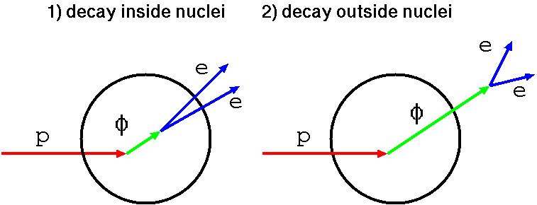
Measurements of φ meson at KEK-PS.
The only one measurement on medium modification of φ meson.
βγ<1.25 (Slow)
R. Muto et al., PRL 98(2007) 042581
Decays outside nucleus
Decays inside nucleus
Cu
meson has NO mass modification
Blue line shows expected line shape including all experimental effects
wo mass modification
meson has mass modification
Modification is shown as an Excess
e⁺e⁻ invariant mass
Indication of mass modification!

Slide 20
Target/Momentum dep.
βγ<1.25 (Slow)
1.25<βγ<1.75
Two nuclear targets:
  Carbon & Copper
  Inside-decay increases in large nucleus
Momentum bin
  Slowly moving φ mesons have larger chance to decay inside nucleus
Only one momentum bin shows a mass modification under the current statistics.
To see clear mass modification, significantly larger statistics are required.
Excess
Same as previous slide
e⁺e⁻ invariant mass

Slide 21
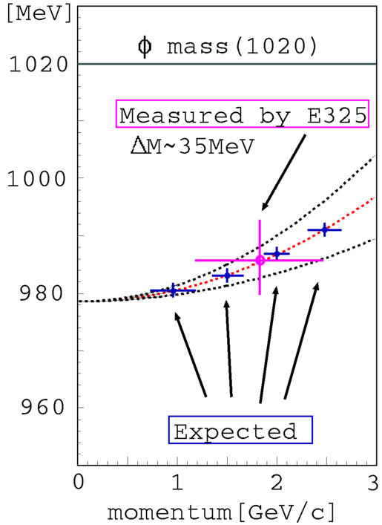
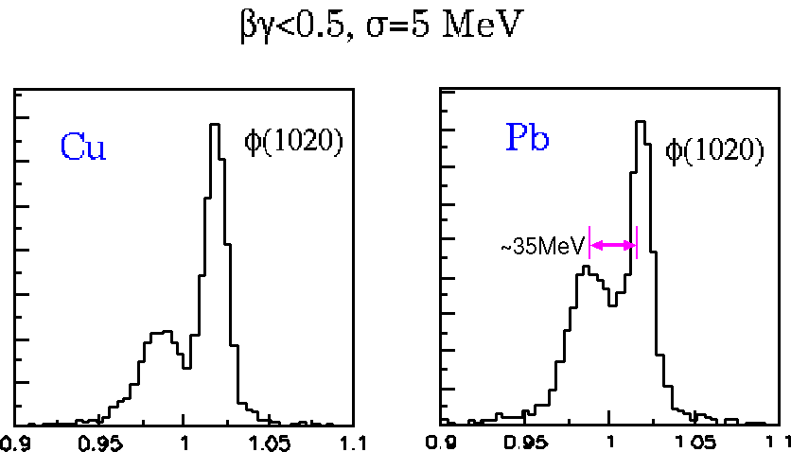

Next Goal
A clear shifted peak needs to be identified to establish QCD-originated effects
Momentum Dependence
Pb
E325 results
Proton
Extrapolate
100 times larger statistics are required.

Slide 22
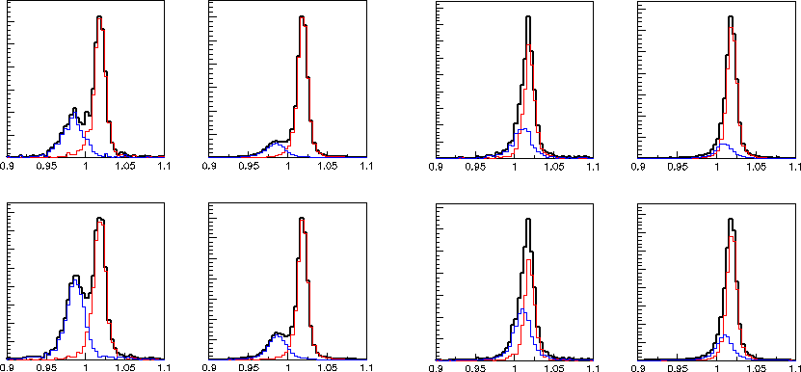
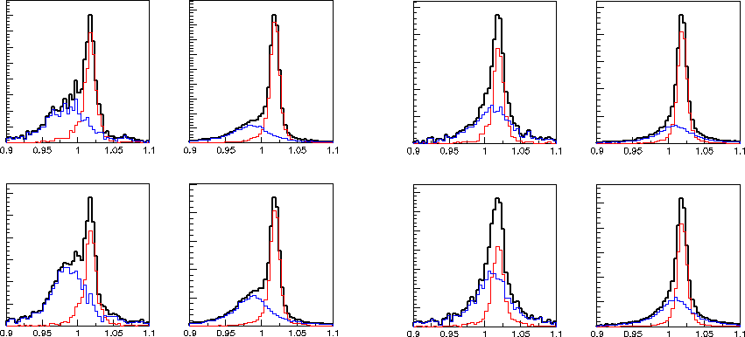
Calc. with other models
βγ<0.5 0.5<βγ<1.25 βγ<0.5 0.5<βγ<1.25
Oset, Ramos
(NPA 679, 616)
Δm : 10 MeV
Γ : 15 MeV
E325
Δm : 35 MeV
(28 ~ 41)
: 15 MeV
(10~23)
Cu
Hadronic model
cf. Hatsuda, Lee (PRC46, 34)
Δm : 12~44 MeV
Γ : not estimated
Pb
---
Δm : 35 MeV
Γ : 50 MeV
Klingle, Waas, Weise
(PLB431,254)
Δm : 10 MeV
Γ : 50 MeV
Cu
Hadronic model
Pb
blue: decays inside nuclei red: decays outside nuclei
At J-PARC, clear mass spectra in nucleus will be obtained to compare with models.

Slide 23
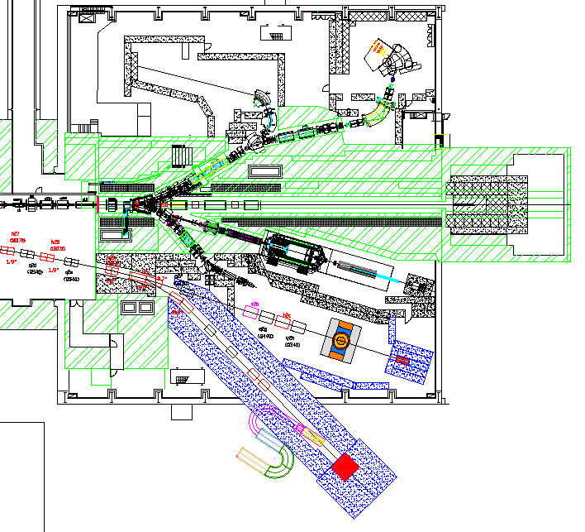
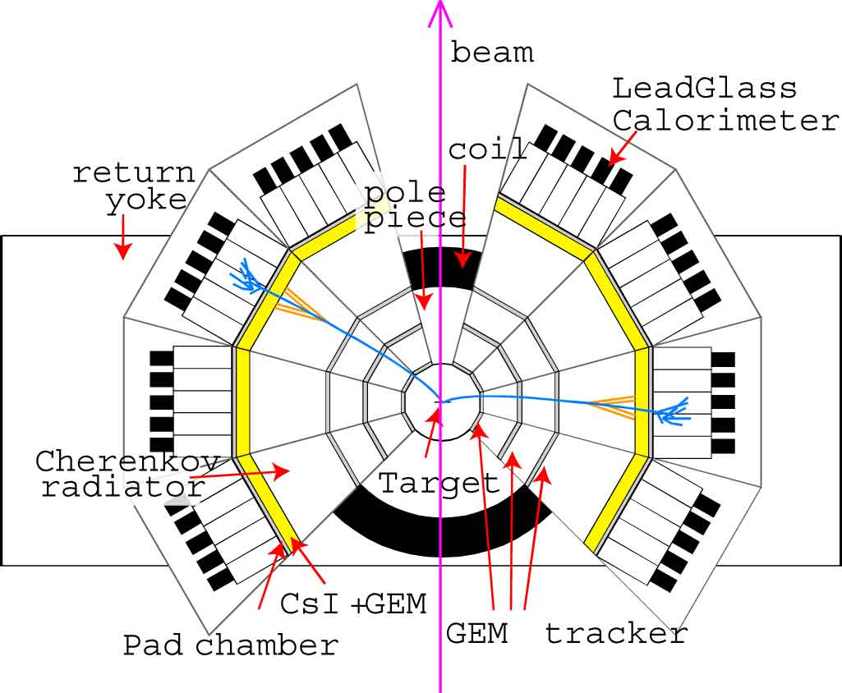
Experiment
Construct a new beam line and new spectrometer
Deliver 10¹⁰ per spill proton beam
Primary proton (30GeV) beam
Cope with 10¹⁰ per spill beam intensity (x10)
Extended acceptance (90° in vertical) (x5)
Increase cross section (x2)
New high momentum beam line

Slide 24
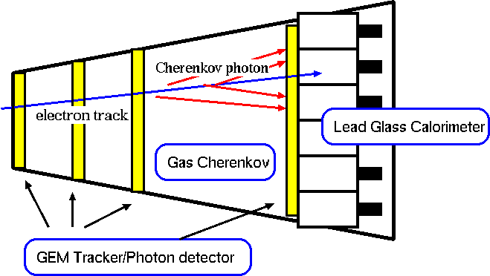
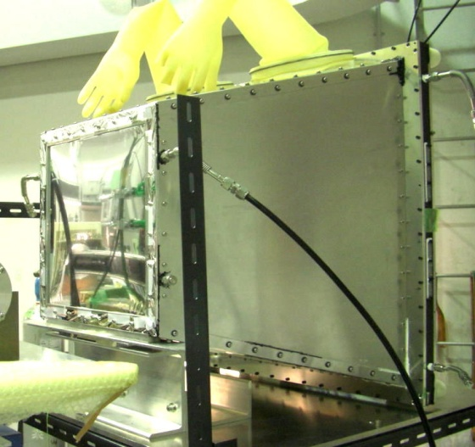
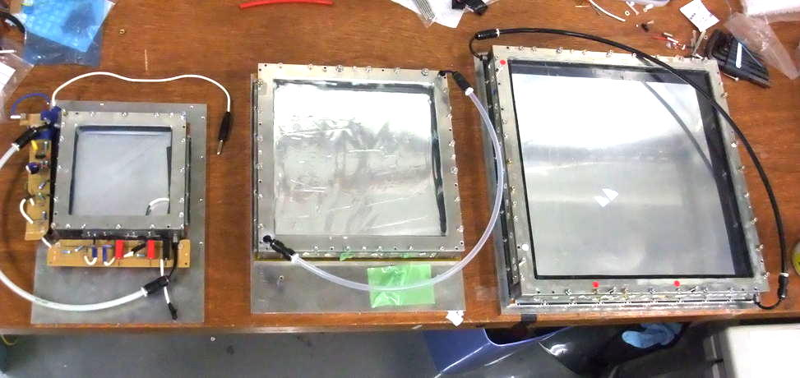
Detector components
HBD (Hadron-Blind Cherenkov detector )
GEM Tracker
100x100 200x200 300x300
Position resolution of 100μm is achieved
Key Technology:
  CsI evaporated GEM as a photo cathode
  Q.E. of 40% is achieved
Developments of detectors are almost done.
  Remaining issue is photo-electrons HBD (half of an expectation).
Read out electronics are being developed.
  Basically, combination of existing components.
The first production will be done by the next March.

Slide 25
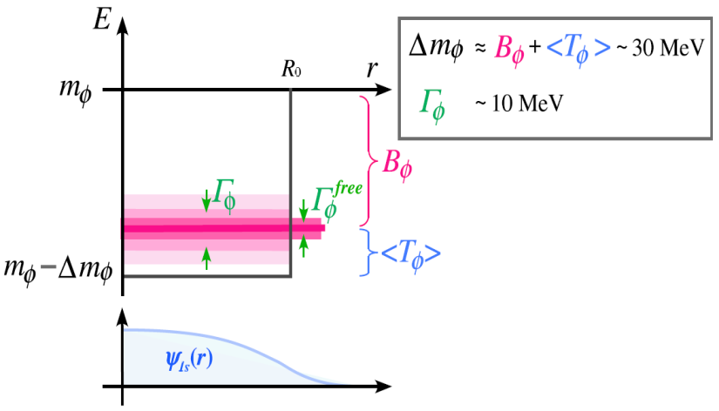
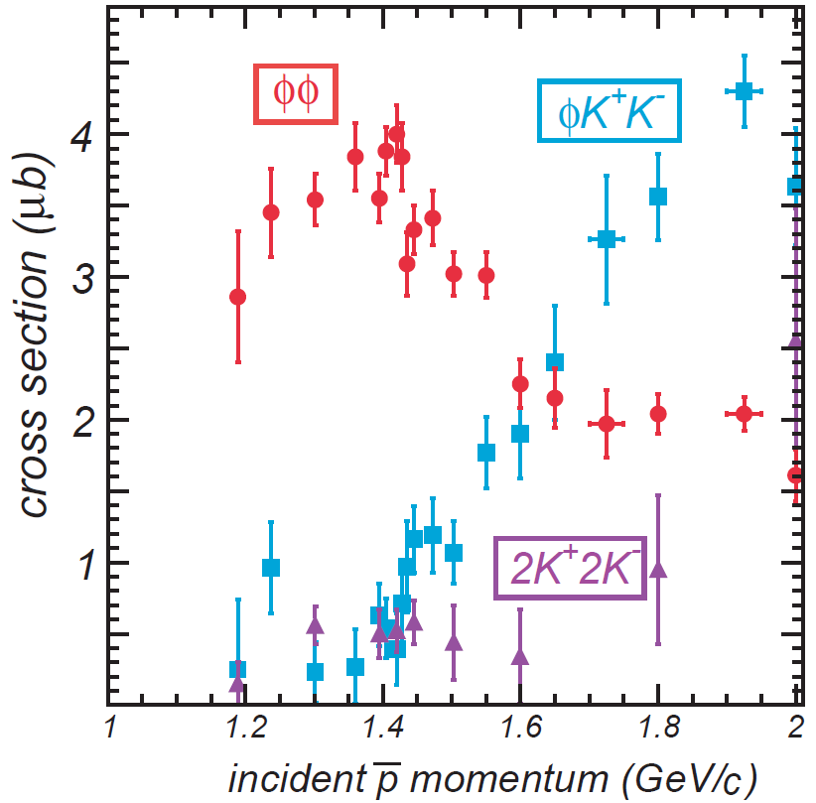
Ε29: φ bound state?
Mass shift of φ in nucleus can produce a bound state?
Production
pp -> φφ
Detection
φp -> K⁺Λ
Φ
s
s
K+
s
u
u
s
p
u
u
Λ
d
d

Slide 26


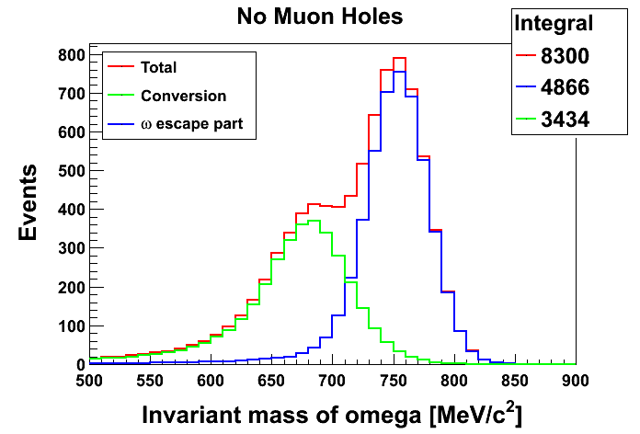
E26: Omega in nucleus
Measurements of ω meson in nucleus
  Production of ω is also measured
  Focus on low momentum ω meson
π
n
γ
H. Nagahiro et al,
Calculation for ¹²C(π⁻, n)¹¹B_{ω}
ω
π⁰
π⁻A → ω + n+X
Missing Mass
(Bound state?)
γ
π⁰γ
γ
γγ
Construct
  Neutron counter
  Gamma Detector
Beam Momentum is 2.0 GeV/c
It can be done at K1.8 and
also at new high momentum beam line
Invariant Mass

Slide 27
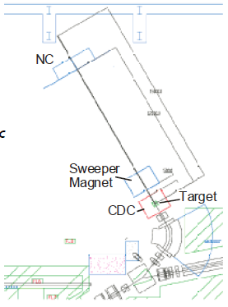
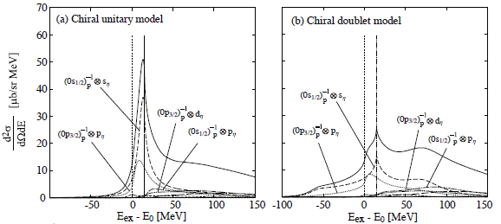

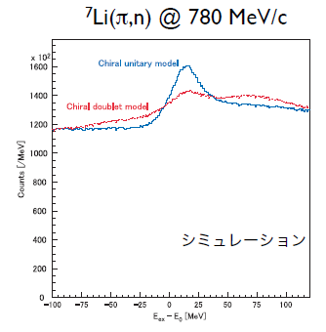
Experiment for η
LOI by K. Itahashi et. al
Calc. by H. Nagahiro, D. Jido,
S. Hirenzaki et. al
Forward neutron is detected.
missing mass distribution is measured.
Simulation
In addition, measurements of invariant mass of N* decay

Slide 28
Summary
J-PARC is recovered from damages of the earth quake.
  Thanks for your helps and efforts.
New data for penta quark search is already collected.
An experiment for K bound state search is ready and will take data in this year.
Many experiments will be done in few years including hyper nuclear physics, K-barN boundstates, mesons in nucleus, and more.

Slide 29
Back up

Slide 30
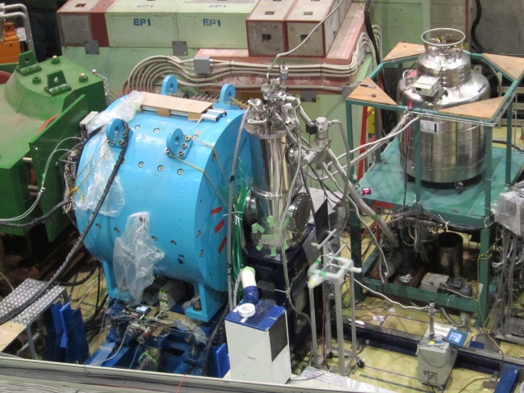
Results of the last run (Feb. 2012)
Run time: 19-22 Feb
Beam PW: 3.3kw
~ 6x10⁸ K⁻ on Target
~25M events recorded
beam-line commissioning for 1GeV/c K⁻ was completed
ESS=±250kV
[ /spill ] | 3.3kW | 10kW
beam intensity | 100k | 300k
K⁻ yield | 33k | 100k
E15 trig. rate | 700 | 2.1k
π⁻
K⁻
Yield/TM
p
expected
CM (A)
Ready to receive more than
10kW beam-power
Parameters for Kaon tune have been produced

Slide 31
Mass spectra measurements
KEK E325, ρ/ω → e⁺e⁻
Induce 12 GeV protons to Carbon and Cupper target, generate vector mesons, and detect e+e- decays with large acceptance spectrometer.
M. Naruki et al., PRL 96 (2006) 092301
ω/ρ/φ
Cu
ω→e⁺e⁻
The excess over the known hadronic sources on the low mass side of ω peak has been observed.
ρ→e⁺e⁻
m_{ρ} = m₀ (1 - α ρ/ρ₀) for α = 0.09

Slide 32

CLAS g7a @ J-Lab
Induce photons to Liquid dueterium, Carbon, Titanium and Iron targets, generate vector mesons, and detect e+e- decays with large acceptance spectrometer.
R. Nasseripour et al., PRL 99 (2007) 262302
ω/ρ/φ
γ
No peak shift of ρ
Only broadening is observed
m_{ρ} = m₀ (1 - α ρ/ρ₀)
for α = 0.02 ± 0.02

Slide 33

Contradiction?
Difference is significant
What can cause the difference?
  Different production process
  Peak shift caused by phase space effects in pA?
    Need spectral function of ρ without nuclear matter effects
  Note:
    similar momentum range
    E325 can go lower slightly
CLAS
KEK
In addition, background issue is pointed out by CLAS

Slide 34
Approved experiments
K1.8
K1.8BR
Stage 1
Stage 2
Running

Slide 35

As increasing the beam intensity,
加速器部と協力してビーム強度を増強する！
これからが新たな成果が出てくる時期！
ニュートリノとビームタイムを分け合って実験を行う。

