Slide 1
Hypernuclear spectroscopy in Hall C at
Jefferson Lab
Brad Sawatzky / JLAB
Acknowledgements to Liguang Tang
Hampton University/JLAB
MESON 2012 • Krakow, Poland

Slide 2
Introduction
Goals:
  To understand YN and YY interactions
  To study short range interactions in baryonic media
  (OPE is absent in ΛN interaction)
  To better explore nuclear structure using Λ as a probe (not Pauli blocked by nucleons)
    Model the baryonic many body system
    Study the role and the single particle nature of Λ in various nuclear medium and density
Shell Model with Λ-N Effective Potential (p_{N}s_{Λ})
V_{ΛN}= V₀(r)+V_{σ}(r)s_{N}⋅s_{Λ}+V_{Λ}(r)L_{NΛ} ⋅s_{Λ}+V_{N}(r)L_{NΛ} ⋅s_{N}+V_{T}(r)S₁₂
Additional Contribution: Λ-Σ coupling
—
Radial Integrals Coefficients of operators
V
Δ
S_{Λ}
S_{N}
T
ΛΣ
Notes:
Hyperon-nucleon interaction is poorly understood, we’re trying to understand the short range interactions on a more general level beyond the u/d quarks
YN interactions are inherently short range – there is no one pion exchange piece in lambda-N in particular (long range potential)
- lambda-N interaction single pion interaction prohibited by isospin conservation [lamda(0), pion(1), N(1/2)]
- leading interaction is short range, gives access to the short range piece that is shadowed by the long-range potential in NN interactions
Lambda can serve as a unique deep-probe of the nuclear medium
- no Pauli blocking, relatively long lifetime, it can form unique states that informs us about the interior nuclear structure
The lambda is a unique single particle within the nuclear medium – can give us some insight into the question: how does the nuclear medium effect/distort the quark-structure of the hyperon?
- something we explore elsewhere: short-range correlations, EMC effects, etc
Traditional shell model potential that models the hyperon sitting in an effective potential representing the rest of the nucleus (core) [ effective two-body interaction]
- central potential
- spin-spin interaction
- spin-orbit (lamda spin)
- spin-orbit (same orbit, but core-spin)
- tensor interaction
Fit this to real data and extract the associated coefficients that should then describe the lamba-N interaction for all cases
- need lots of data, precision data are important to confine these coefficients (lead in to next slide)
lambda-sigma interaction is important too: significant contribution to the repulsive core but doesn’t really fit within the effective potential model, associated correction is made later to computed binding energies (for example)
----- Meeting Notes (6/3/12 21:55) -----
lambda-sigma coupling:

Slide 3
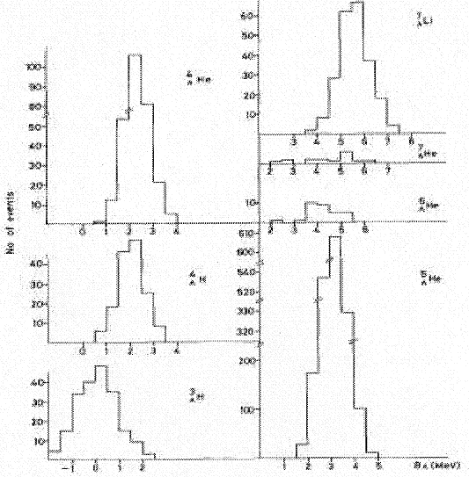
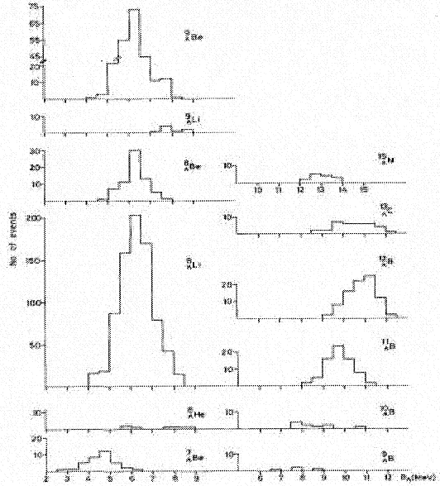
Reliability of Emulsion Results
Using (K⁻_{stop}, π⁻) Reaction
⁷_{Λ}Li
⁹_{Λ}Be
⁴_{Λ}He
⁹_{Λ}Li
⁷_{Λ}He
⁸_{Λ}Be
¹³_{Λ}N
⁶_{Λ}He
¹³_{Λ}C
⁵_{Λ}He
⁸_{Λ}Li
¹²_{Λ}B
⁴_{Λ}H
¹¹_{Λ}B
³_{Λ}H
⁸_{Λ}He
¹⁰_{Λ}B
⁷_{Λ}Be
⁹_{Λ}B
B_{Λ} (MeV)
Important source of data
but lack statistics and resolution
Reliability: Questionable
Notes:
17:00
Basics are there, but statistics and resolution are limited.
- less than 10 events in several of these peaks
Broad peaks, coarse binning hides substructure needed to really tune the models
- extracting the missing mass then determining ground state to pull out the missing mass of an excitation is very difficult
- these data are the foundation for existing models, ground state determinations may be unreliable

Slide 4
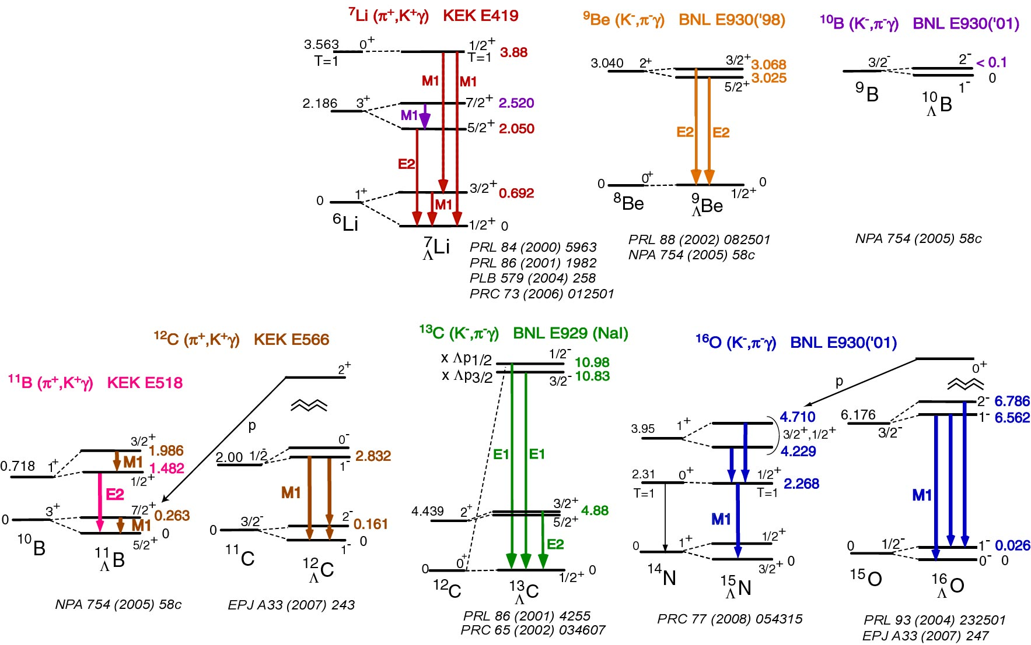
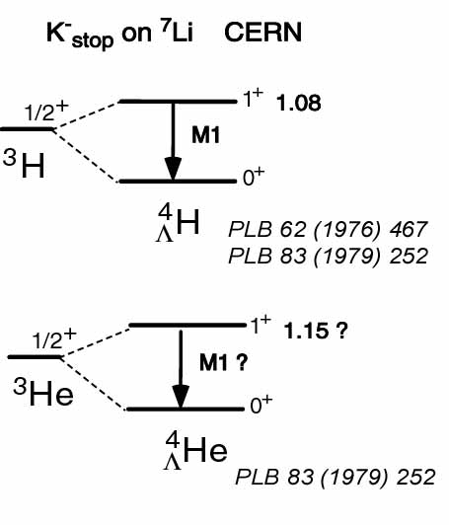
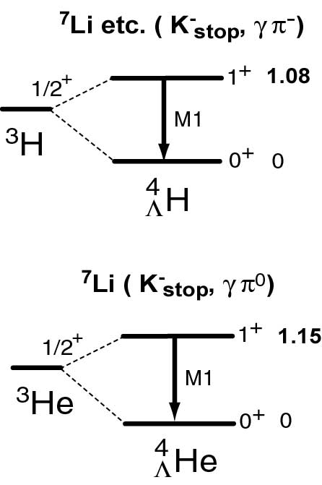
Achievement of Gamma Spectroscopy
22 Gamma transitions were so far observed
Missing predicted gamma ray
Notes:
23:30
1990s, early 21st century saw a new technique
Statistics somewhat poor, few thousand production events * the efficiency of the Germanium detector measuring the decay gamma but resolution is really great
22 gamma transitions for p-shell light hypernuclei
- compare with theory and assign the observed gammas to best-guess transitions
Gamma spectroscopy is very precise (2—3 keV resolution) but is standing on the ground state energies established by the the emulsion method
- you measure the gamma energy very precisely, but you only measure these level transitions
- you can’t measure the binding energy directly, you need to use some guess-work to assign the observed gamma transitions to a given model’s set of excited states

Slide 5
Theory: Doublets of p-Shell Hypernuclei
Δ = 0.430MeV S_{Λ} = -0.015MeV S_{N} = -0.390MeV T = 0.030MeV
(ΛΣ strength is solved and calculated by other means)
Contributions in keV
ΛΣ Δ S_{Λ} S_{N} T ΔE^{th}
72 628 -1 -4 -9 693
74 557 -32 -8 -71 494
-8 -14 37 0 28 44
J^{p}_{u} J^{p}_{l} ΔE^{exp}
⁷_{Λ}Li 3/2⁺ 1/2⁺ 692
⁷_{Λ}Li 5/2⁺ 3/2⁺ 471
⁹_{Λ}Be 3/2⁺ 5/2⁺ 43
However, they need to be modified for heavier hypernuclei
Δ = 0.330MeV S_{Λ} = -0.015MeV S_{N} = -0.350MeV T = 0.0239MeV
Contributions in keV
ΛΣ Δ S_{Λ} S_{N} T ΔE^{th}
56 339 -3 -10 -80 267
61 424 -3 -44 -10 475
61 175 -12 -13 -42 153
65 451 -2 -16 -10 507
-33 -123 -20 1 188 23
92 207 -21 1 -41 248
J^{p}_{u} J^{p}_{l} ΔE^{exp}
¹¹_{Λ}B 7/2⁺ 5/2⁺ 264
¹¹_{Λ}B 3/2⁺ 1/2⁺ 505
¹²_{Λ}C 2⁻ 1⁻ 161
¹⁵_{Λ}N 3/2⁺₂ 1/2⁺₂ 481
¹⁶_{Λ}O 1⁻ 0⁻ 26
¹⁶_{Λ}O 2⁻ 1⁻₂ 224
Notes:
28:30
Can test your model by looking at doublets in p-shell hypernuclei
Fit your model using one set of doublet, then see how it does against other data sets
For example, start with the 3/2+ to ½+ transition on Li-7 hypernuclei
does pretty well (line 1)
However, these coefficients that should be uniquely describing the lamda-N interaction change by 20—30% if fit to a heavier hypernuclei
One possible explanation is that the data under-constrain the model – some transitions dominated by different pieces of the potential
Spin-spin contribution is dominating these transitions – really very insensitive to the other pieces
Look up john millener’s publication nucl. Phys a from last month p-shell hypernuclei (this and next slide)
Shell-model calculations for p-shell hypernuclei Original Research Article
Nuclear Physics A, Volume 881, 1 May 2012, Pages 298-309 D.J. Millener

Slide 6
Calculated Contributions to Ground State B_{Λ}
(Examples)
Contributions in keV
J^{p}(g.s.) ΛΣ Δ S_{Λ} S_{N} T Sum
⁷_{Λ}He 1/2⁺ 101 1 0 176 0 278
⁷_{Λ}Li 1/2⁺ 78 419 0 94 -2 589
⁹_{Λ}Li 3/2⁺ 183 350 -10 434 -6 952
⁹_{Λ}Be 1/2⁺ 4 0 0 207 0 211
¹¹_{Λ}Be 1/2⁺ 99 2 0 540 0 641
¹⁰_{Λ}B 1⁻ 35 125 -13 386 -15 518
¹¹_{Λ}B 5/2⁺ 66 203 -20 652 -43 858
¹²_{Λ}B 1⁻ 103 108 -14 704 -29 869
¹³_{Λ}B 1/2⁺ 130 197 -6 621 -57 885
¹³_{Λ}C 1/2⁺ 28 -4 0 841 -1 864
¹⁵_{Λ}N 3/2⁺ 59 40 12 630 -69 726
¹⁶_{Λ}N 1⁻ 62 94 6 349 -45 412
JLAB
Mass spectroscopy and level structures with precise binding energy measurement is very important
Agreement between theory and limited experimental results is not consistently good (~15-20%)
Notes:
31:00
Note that ground state contributions are dominated by the nucleon spin-orbital coupling, different from the gamma-spectroscopy data
It is interesting to note that the different hypernuclei ground states have very different contributions coming from different terms in the potential
By measuring a broad range of binding energies and using that data set to fit the models we can get a much better constraint on all the pieces of the potential
Can actually select a system to focus on a particular contribution
For example (black boxes) all contributions are the same, but for the nucleon spin-orbital coupling (35:00)
Jlab has measured these (red box) hypernuclei

Slide 7
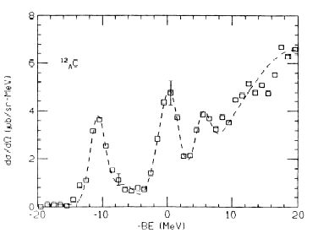
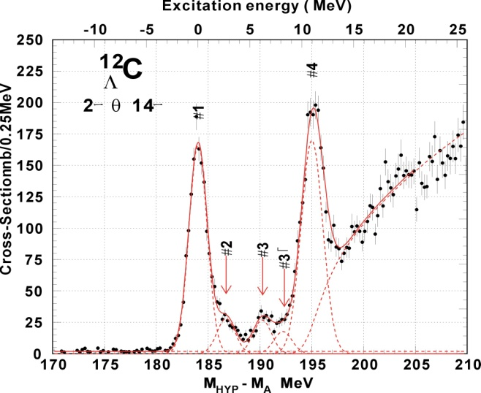
Importance of resolution and mass calibration example: ¹²C(π⁺,K⁺)¹²_{Λ}C mass spectra with meson beam
BNL 3 MeV(FWHM)
KEK E369 1.5 MeV(FWHM)
High resolution, high yields, and systematic study is essential. These are the “keys” to unlock the “gate”.
Meson beam lacks absolute mass calibration (no solid neutron target)
KEK336 2 MeV(FWHM)
Notes:
36:00
Slide shows the importance of resolution
BNL with 3MeV FWHM showed two peaks
KEK with only 2MeV FWHM (modest improvement), but look now you can resolve 4—5 states
KEK upgrade to 1.5 MeV can now start to see excited core states with the lamda excitations sitting on top
Even modest improvements in resolution can open new doors
One difficulty of the meson beam program (relative to electro-production) is that you lack an absolute mass calibration
Uncertainties in straggling corrections, etc can shift this spectrum around a little
Corrections and ground state energies get cross checked against the old emulsion data (which may be somewhat uncertain)
Electroproduction can improve on some of these weaknesses

Slide 8
Electro-production using CEBAF Beam
High quality primary beam allows high precision mass spectroscopy on Λ-hypernuclei
Producing Λ and Σ⁰ from proton simultaneously allows absolute mass calibration – precise binding energy
Mirror and neutron rich hypernuclei comparing those from (π⁺,K⁺) reaction
Spectroscopy dominated by high spin-stretched spin-flip states
Results are important in determining ΛΣ , S_{N} and V₀ terms from Λ_{s} states and S_{Λ} term from states with Λ at higher orbits
Notes:
42:00
Primary beam very well understood
Simultaneous production of both a lambda and a sigma off protons allows an absolute mass calibration of the detector system allows for very little ambiguity in binding energy
Extractions
- We know the lambda mass and the sigma mass – the difference calibrates the experimental mass scale very precisely
- Jlab production is dominated by the high spin-stretched spin-flip states (virtual photon is spin-1, significant momentum transfer)
This is different than the gamma-spectroscopy and meson beam data – new data set with some unique differences, very complimentary to the the other data sets
Allows flexibility to access states dominated by particular terms in the potential model
----- Meeting Notes (6/3/12 21:55) -----
mirror and neutron-rich hypernuclei? "compared to"?

Slide 9
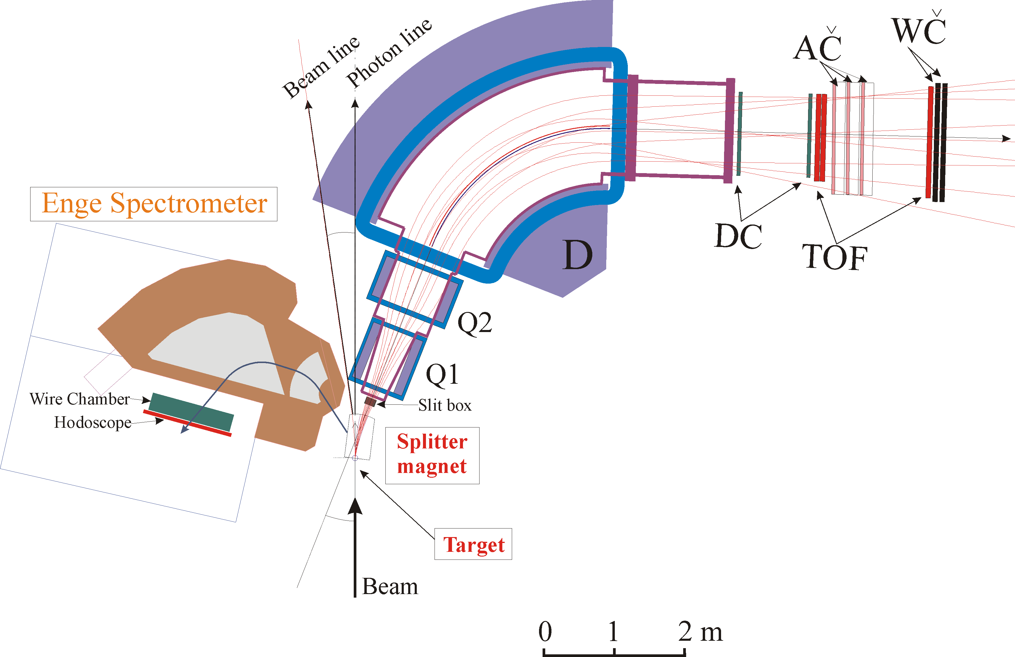
Hall C technique in 6GeV program
Common Splitter Magnet
K
+
Side View
_
Target
Phase I
E89-009
D
D
K⁺
Q
Top View
e’
+
_
Q
Electron
K
D
D
Beam
(1.645 GeV)
Phase II
E01-011
Target
Focal Plane
( SSD + Hodoscope )
Beam Dump
0
1m
Zero degree e’ tagging
High e’ single rate
Low beam luminosity
High accidental rate
Low yield rate
A first important milestone for
hypernuclear physics with electro-
production
New HKS spectrometer → large ΔΩ
Tilted Enge spectrometer → Reduce e’
single rate by a factor of 10⁻⁵
High beam luminosity
Accidental rate reduced by factor of 4
High yield rate
First possible study beyond p shell
Notes:
46:00
Basic technique is a common splitter (dipole) to separate the extreme forward angle scattered electrons (almost zero degree)
Kaons measured in SOS, electrons measured in ENGE
Very high rate, but problem with high accidental rate
Managed by dropping beam current -> low luminosity, low yields
Phase 2
Replace the kaon arm with the HKS, large solid angle, better match to ENGE
Tilted the ENGE out of the plane of moller, bremsstrahlung backgrounds
Reduced electron singles rate by 5 orders of magnitude,
Took a hit in solid angle mismatch between electron and kaon arms, but accidental rates dropped significantly
Overall was a big improvement in the signal:noise and able to increase luminosities and overall yields
Luminosities increased by ~200x
Improved yields allowed study of excitations beyond the p-shell

Slide 10
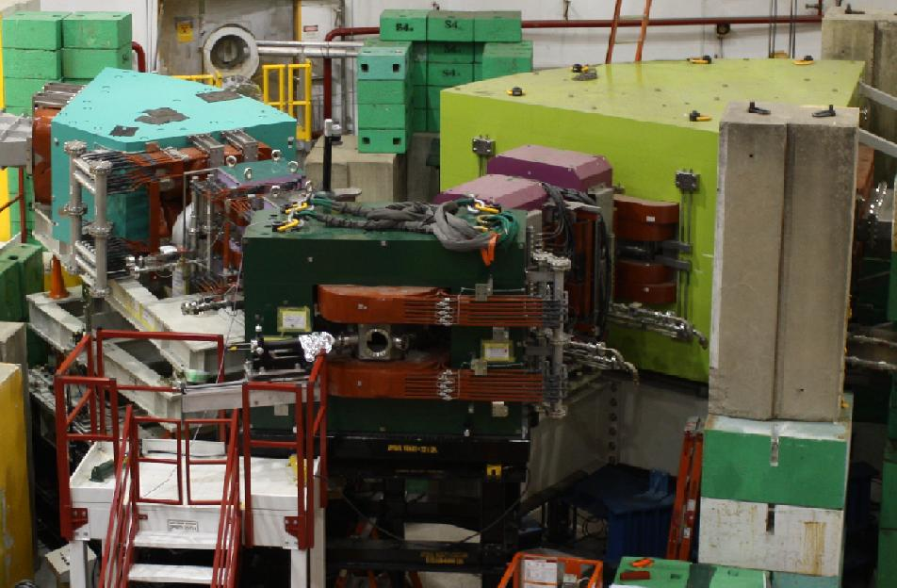
Hall C technique in 6GeV program
e’
Common Splitter Magnet
Phase III
E05-115
New HES spectrometer → larger ΔΩ
Same Tilt Method
High beam luminosity
Further improves accidental rate
Further improves resolution and
accuracy
High yield rate
First possible study for A > 50
Beam
2.34 GeV
K⁺
e
γ
Notes:
48:20
2009 – remove ENGE and replace with a larger, more capable electron arm: HES
- Now yields are such that exploration of medium heavy nuclei like Chromium-52 is possible

Slide 11
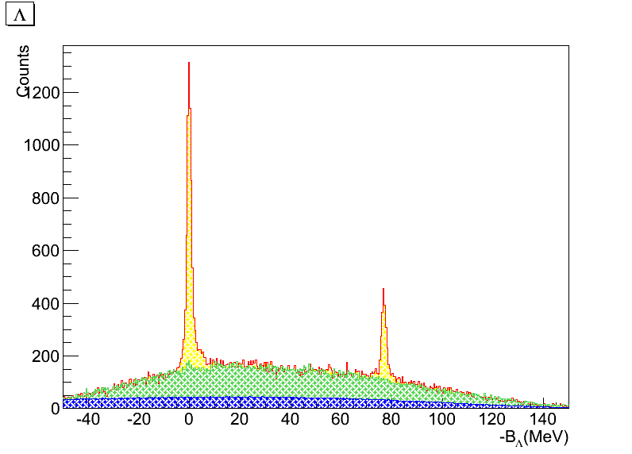
6GeV Program Highlights
p(e, e’K+)Λ and Σ⁰ (CH2 target)
Λ
Allowing precise calibration
of mass scale
Σ⁰
Notes:
50:00
Show some example data
These data allow precise calibration of the mass scale
Can run CH2 to get data off the proton + Carbon
Run on pure carbon in hydrogen kinematics to get the quasi-free from Carbon background (green)
Blue is the accidentals
Result is very precise absolute energy calibration of the system
Allows precise calibration of the kinematics

Slide 12
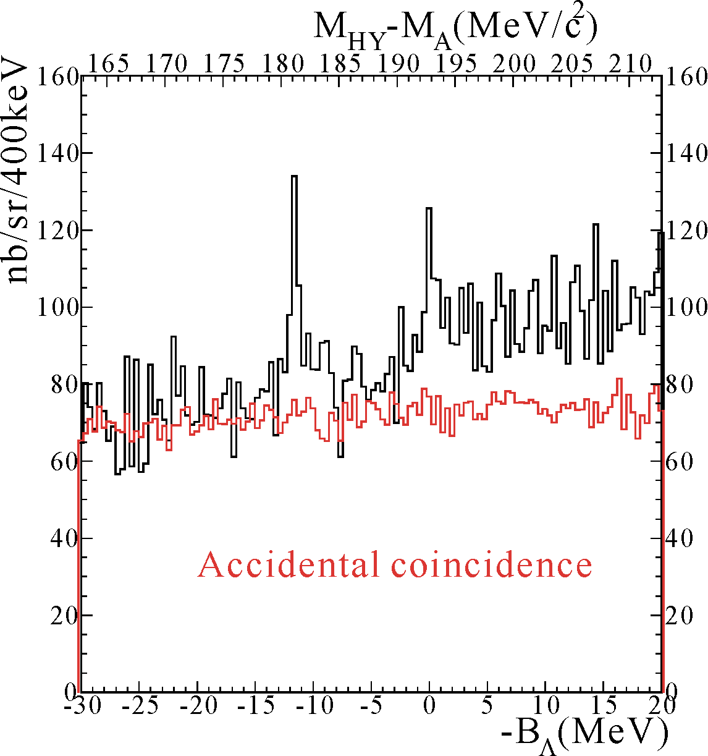
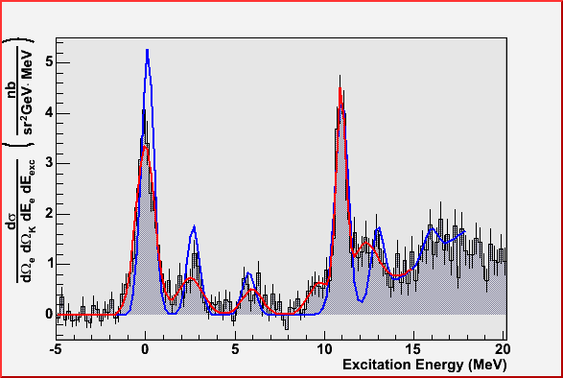
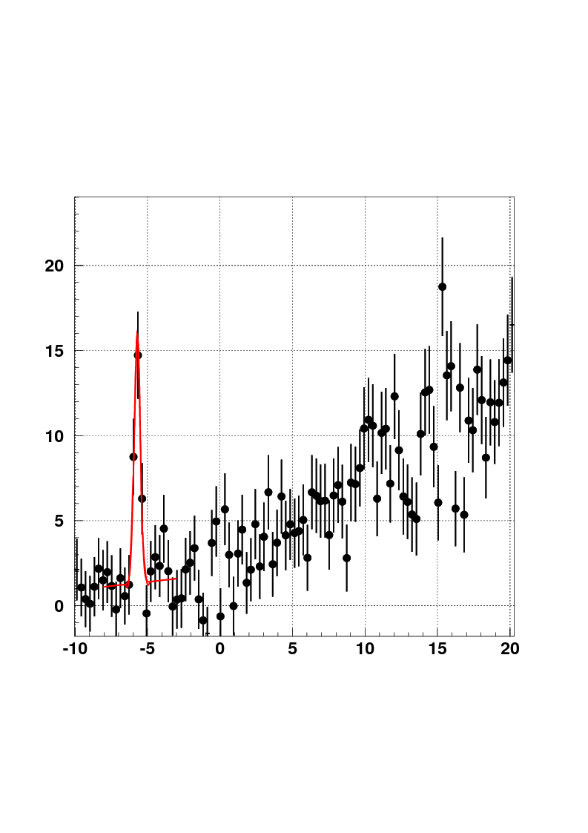
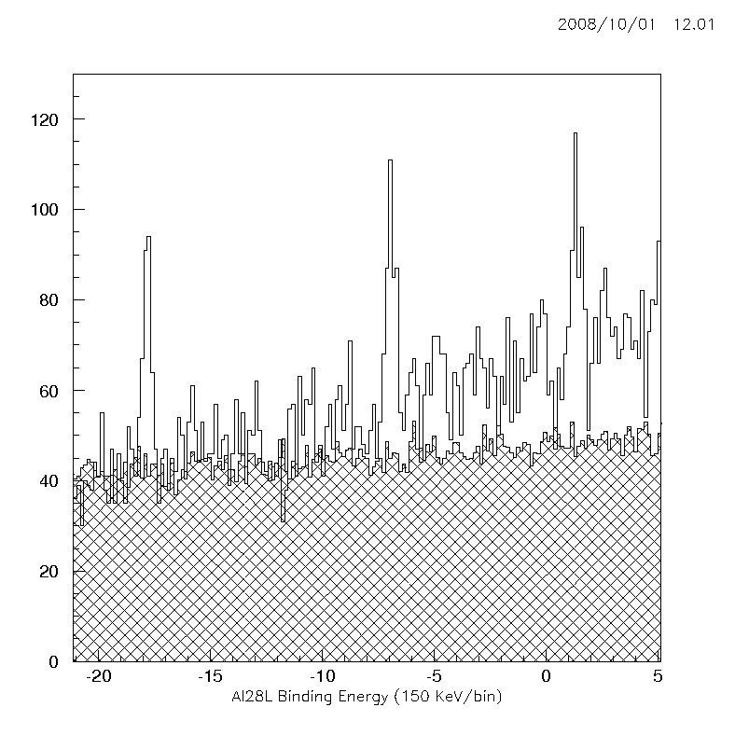
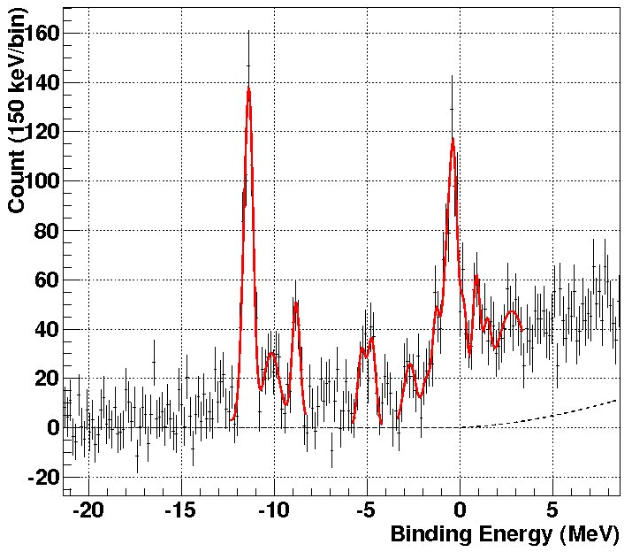
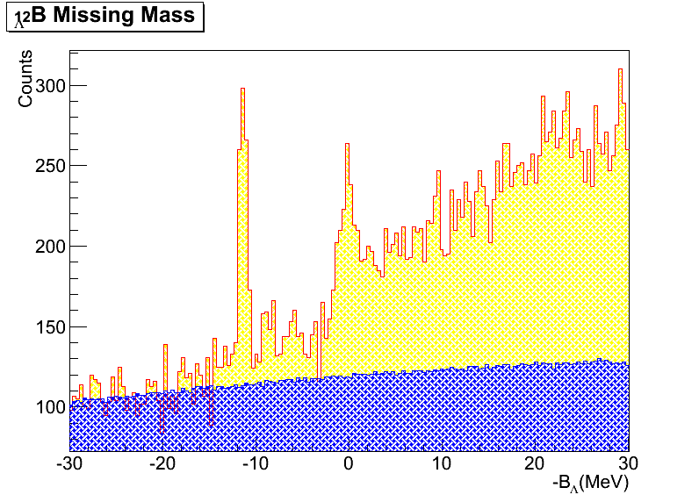
6GeV Program Highlights– Cont.
Phase I in Hall C (E89-009)
E94-107 in Hall A (2003 & 04)
Phase II in Hall C (E01-011)
~800 keV
FWHM
~635 keV
FWHM
E89-009 ¹²_{Λ}B spectrum
⁷_{Λ}He
HNSS in 2000
Λ_{s}
(2⁻/1⁻)
¹²_{Λ}B
-6.68±0.02 ±0.2 MeV from αΛnn
Λ_{p}
(3⁺/2⁺’s)
Λ_{s}
Λ_{p}
K⁺
Core Ex. States
²⁸Si(e, e’K⁺)²⁸_{Λ}Al (Hall C E01-011)
²⁸_{Λ}Al
HKS
JLAB
Λ_{p}
Λ_{d}
K⁺
1.2GeV/c
Λ_{s}
_
D
Local Beam Dump
Phase II in Hall C (E01-011)
Phase III in Hall C (E05-115)
Counts (150 keV/bin)
HKS in 2005
~500 keV
FWHM
Λ_{s}
Λ_{s}
Λ_{p}
-B_{Λ} (MeV)
Λ_{p}
¹²_{Λ}B
Accidentals
B_{Λ} (MeV)
Notes:
52:00
He-7 lambda hypernuclei binding energy has now been precisely determined for the first time (data from the phase 2 measurement), paper will be out soon
Emulsion has only 13 events spread over 6 MeV, very poor binding energy determination (never actually given)
Here, clearly observed ground state with precise absolute measured binding energy for the first time
Matters because it is part of an isospin A=7 triplet:
Be-7 lambda has I=1 (more protons: 4p + 2n + lambda)
Li-7 lambda has I=0 (3p + 3n + lambda)
He-7 lambda has I=-1 (more neutrons: 2p + 4n + lambda)
The set of binding energies, precisely determined, allows one to tease out the isospin dependence of nuclear interaction, but only if you have the He-7 ground state binding energy
56:00
A=12 Boron-12 lambda
Note the core excited states
Consistency between Hall A and Hall C – very reliable, consistent results
Hall A was not able to measure an absolute energy scale, hence they published results in terms of excitation energy w/ arbitrarily alignment of first peak to 0 MeV
Consistent “modest” improvement in resolution makes a big difference
Complementary to the mirror nucleus carbon-12 lambda data taken by other labs
58:00
Al-28-lambda: very preliminary data but note the resolution: 150 keV/bin!
Demonstrates clear s-shell, p-shell, d-shell nuclear bound states with resolutions well below an MeV
In between are core-mixing states
Hall A N-16-lambda result too
Theory and data did very well on this nuclei

Slide 13
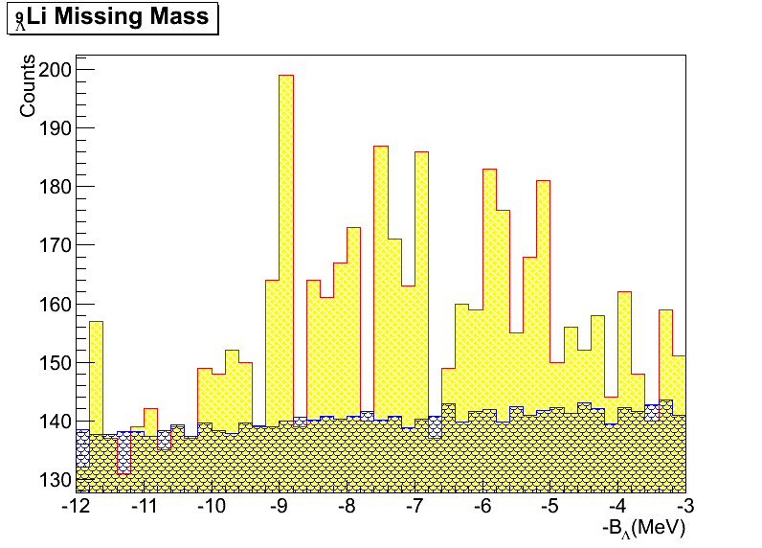
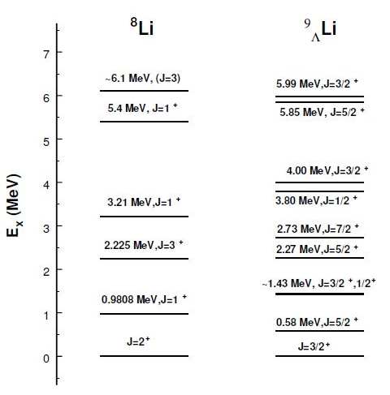

6GeV Program Highlights – Cont.
(Phase iii experiment E05-115)
⁹_{Λ}Li spectrum, Hall C HKS E01-115 (2009)
Hall C HKS
E05-115
Very preliminary
~4.6
~4.0
~3.6
Λ_{s}
~ 2.6
Λ_{s}
~1.6
Λ_{s}
~0.8
Λ_{s}
Ex: 0.0
Sotona and Millener
Saclay-Lyon model for elementary process
B_{Λ} = -9.8± 0.3
B_{Λ} = -8.53±0.18
(emulsion, average over
only 8 events)
Notes:
58:00
1:03:33
Same optics, same analysis framework as B-12-lambda data which agreed with prior data to better than 50 keV
Note 1 MeV difference in lambda-s binding energy vs historical emulsion data– very strange
All s-shell lambda connected to p-shell core

Slide 14
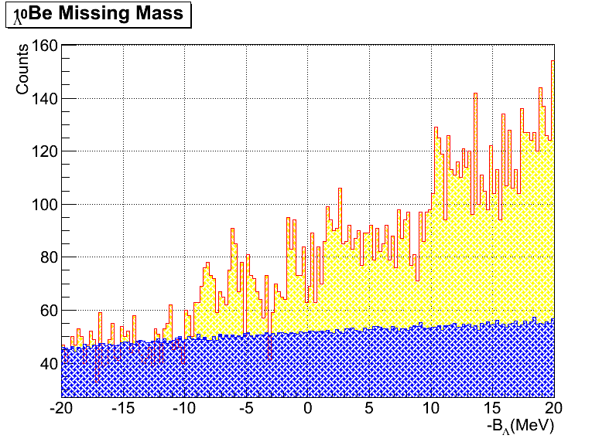
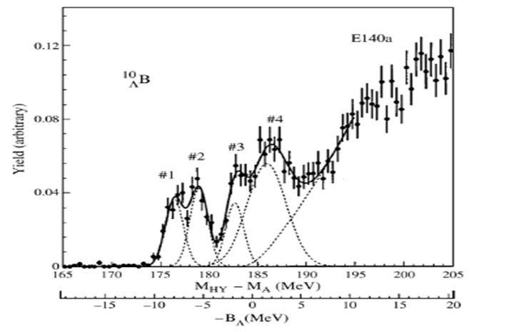
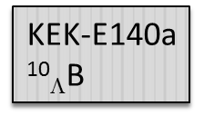
6GeV Program Highlights – Cont.
(Phase iii exp. E05-115 in which ⁵²_{Λ}V has not yet analyzed )
Very preliminary
4⁻
11.28
7/2⁻
11.53
Λs
3⁻
10.93
7.94
5/2⁻
6.76
9/2⁺
4⁻
6.38
7/2⁻
6.51
3⁻
Λs
6.43
5.59
3/2⁻
4.70
3/2⁺
3.04
5/2⁺
1/2⁻
2.59
2.78
3⁻
2.43
5/2⁻
Λs
2⁻
2.48
1.68
1/2⁺
0.11
0.00
3/2⁻
2⁻
Λs
1⁻
0.00
Low Lying ⁹Be
Level Structure
¹⁰_{Λ}Be
Theory
(< 0.1)
E05115
Notes:
1:05:00
KEK data have 2 MeV resolution, Phase III data are sub-MeV
- Be-10 to compare to mirror nuclei B-10 from KEK – interesting that all the same structure is there
General features line up, but now we can start to resolve more structure, spin-orbit splitting, etc
S-shell lambda + p-shell core states

Slide 15
6GeV Program Technique Summary
Hall A experiment (Pair of Septums + two HRS)
  Advantage: Almost no accidental background and be able to study elementary process at low Q² at forward angle
  Disadvantage: Low yield rate and cannot study heavier hypernuclei
Hall C experiment (Common Splitter + HKS + HES/Enge)
  Advantage: High yield rate and high precision in binding energy measurement
  Disadvantage: High accidental background and solid targets only
Future program: Combination

Slide 16
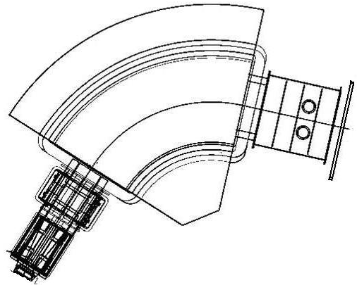
Experimental Layout If in Hall C
Drift Chamber
HES - Electrons
Enge - Pions
Hodoscope
Lucite Č
π⁻
22mg/cm²
K⁺
64mg/cm²
Is there enough
space between SHMS and HMS?
HKS - Kaons
Trigger I: HKS(K) & Enge(π) for Decay Pion Spectroscopy Experiment
Trigger II: HKS(K) & HES(e’) for Mass Spectroscopy Experiment
Notes:
Target moved outside the splitter magnet, moller, brem backgrounds don’t pass the septum
New thin foil target upstream of primary target for decay pion spectroscopy (two experiments at once)
Decay pion experiment gives access to very precise measurement of light hypernuclei ground state measurements

Slide 17
Experimental Layout If in Hall A
22mg/cm²
64mg/cm²
HRS - Electron
K⁺
π⁻
Is there scheduling problem?
Are there sufficient utilities?
HES - Pions
HKS - Kaons
Trigger I: HRS(K) & Enge(π) for Decay Pion Spectroscopy Experiment
Trigger II: HRS(K) & HRS(e’) for Mass Spectroscopy Experiment

Slide 18
Technical Features of Future Program
High quality with low background
High precision on binding energy and high resolution
High yield rate which leads to wide range of physics:
  Elementary production at forward angle
  Detailed and precise level structure of light and medium heavy hypernuclei (shell models)
  Precise shell structure of heavy hypernuclei (single particle nature and field theory)
High efficiency and productivity:
one exp. ≈ 4—5 6GeV experiments
New physics: Decay pion spectroscopy (Light Hypernuclei)
  Precise ground state B_{Λ}
  Determination of ground state J^{p}
  Search for neutron rich limit (high Isospin states → ΛΣ)
Notes:
- Forward angle elementary lamda production (low-Q2, near real photon) had discrepancy between models and measurement
- Heavy hypernuclei can give access to study mean field theories: does the hyperon maintain its single particle nature
- Neutron-rich, high isospin states important to understanding the lamda-sigma coupling (important to neutron star calculations)

Slide 19
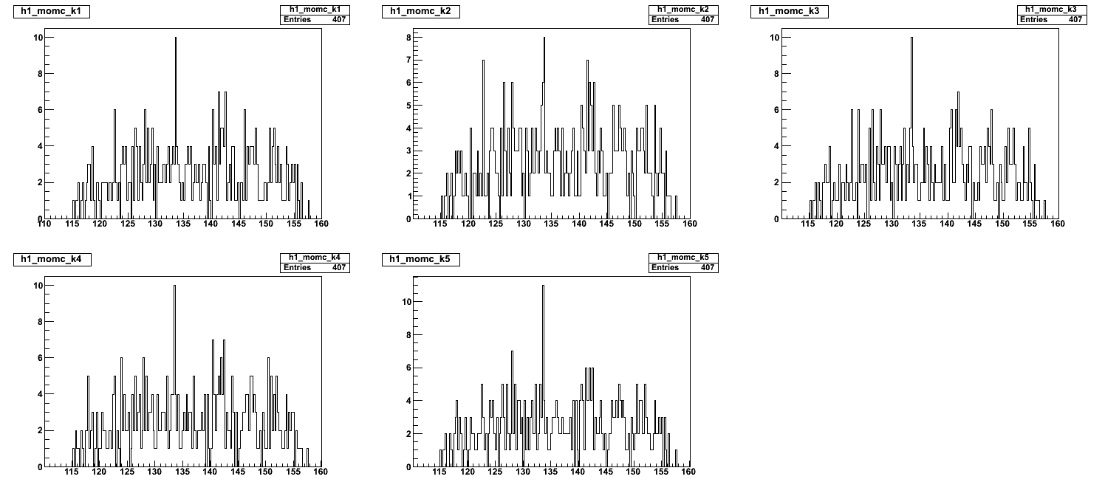
MAMI-C Short Test Run on Decay Pion Spectroscopy
110 ~ 160 MeV/c
110.05 ~ 160.05 MeV/c
110.1 ~ 160.1 MeV/c
110.15 ~ 160.15 MeV/c
110.2 ~ 160.2 MeV/c
•Possible observation
⁴_{Λ}H ground state
•Different histograms have different binning; central peak remains
Central Mom. : 133.5 MeV/c → B_{Λ}(⁴_{Λ}H) : ~ －1.60 MeV
Width : 97 keV/c FWHM
Target straggling loss was not corrected
Spec-C momentum calibration was not yet done

Slide 20
Summary
Hypernuclear Physics is an important part of nuclear physics
Program with CEBAF beam is the only one that provides precise B_{Λ} and features
Precision mass spectroscopy
Future program will be highly productive
High yields, low backgrounds
Simultaneous pion decay measurement
Notes:
1:15:00
Decay spectroscopy focused on non-bound, highly excited quasi-free region
Can convert a core, s-shell proton to a hyperon and produce a hole deep in the nucleus
Lambda goes with one of the fragments producing light hypernuclei, often highly neutron rich
Fragment will stop in the thin foil target then cascade to its ground state, at its ground state then hyperon can weak decay and kick out a pion
Measure pion momentum and you measure the binding energy of the the fragment’s core nuclei (which is now at rest in the foil)
Goal is to get binding energies of bound states with resolutions at 100 keV level
Only the ground states will weak-decay and emit a pion
General location of the ground state is known, so we can identify the parent fragment is identified by the general location of the peak

