Slide 1
Recent Results from RHIC
Steve Vigdor
MESON 2012, Kraków
June 1, 2012
RHIC Facility Status & Recent Upgrades
Science Goals and Accomplishments: Examples of Greatest Hits, Fresh Results, Next Steps – small selection!
The Path Forward: Planning for RHIC’s 2nd and 3rd Decades

Slide 2
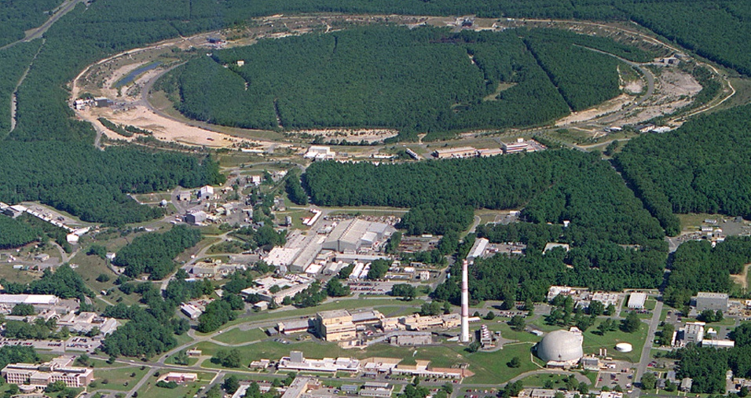
RHIC’s First Decade: A Discovery Machine
(PHOBOS)
10:00 o’clock
Polarized Jet Target
12:00 o’clock
(BRAHMS)
2:00 o’clock
RHIC
PHENIX
8:00 o’clock
RF
4:00 o’clock
STAR
6:00 o’clock
LINAC
NSRL
EBIS
Booster
BLIP
AGS
Tandems
RHIC hallmarks:
Pioneering – 1st facility to clearly see transition to quark-gluon matter; world’s only polarized collider
Productive ->300 refereed papers, >20K citations, >200 Ph.D.’s in 1st 10 years, many more in pipeline, no rate falloff in sight
Versatile - wide range of beam energies and ion species ⇒ string of definitive discoveries in both hot and cold QCD matter
Notes:
2

Slide 3
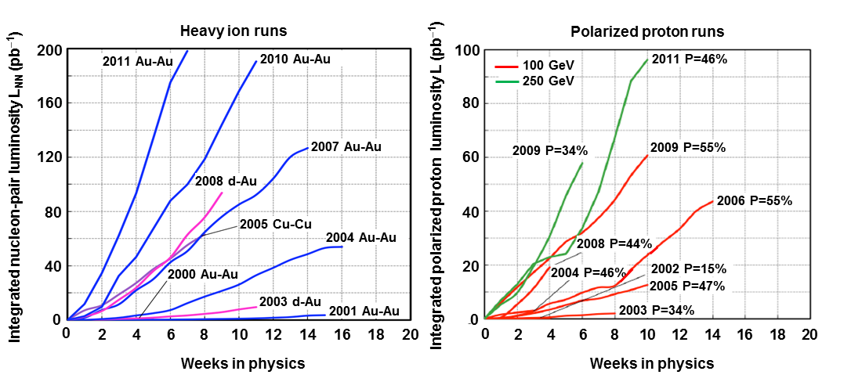
Incremental Upgrades ⇒ Steadily Improving Performance
Polarized proton runs
160
2012 P=52%
200 GeV
500/510 GeV
120
P = Polarization
2011 P=48%
Integrated polarized proton luminosity (pb⁻¹)
80
2012 P=59%
2009 P=34%
2009 P=56%
40
2008 P= 44%
2006 P=55%
2005 P=47%
0
2003 P=34%
0
2
4
6
8
10
12
14
16
18
20
Weeks in physics
Collision partners | Beam energies (GeV/nucleon) | Peak pp-equivalent luminosities achieved to date, scaled to 100 GeV/n^{b)}
Used to date
Au+Au | 3.85, 4.6, 5.75, 9.8, 13.5, 19.5, 28, 31, 65, 100 | 195 × 10³⁰ cm⁻²s⁻¹
d+Au^{a)} | 100 | 100 × 10³⁰ cm⁻²s⁻¹
Cu+Cu | 11, 31, 100 | 80 × 10³⁰ cm⁻²s⁻¹
p↑+p↑ (polarized) | 11, 31, 100, 205, 250, 255 | 150 × 10³⁰ cm⁻²s⁻¹ at 250 GeV
Considered for future
Au+Au | 2.5, 7.5
Cu+Au^{a)} | 100 | Running in May 2012
U+U | 96 | Running in April-May 2012
2 new colliding beam species in 2012

Slide 4
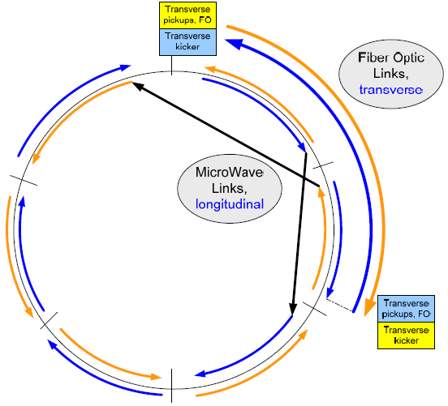
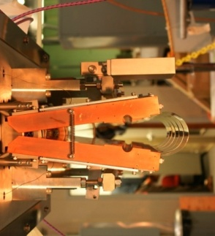
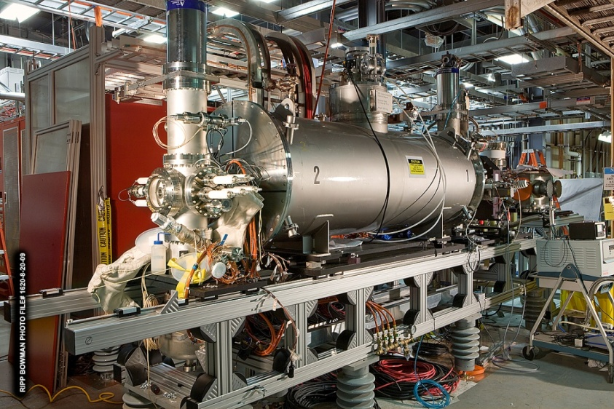
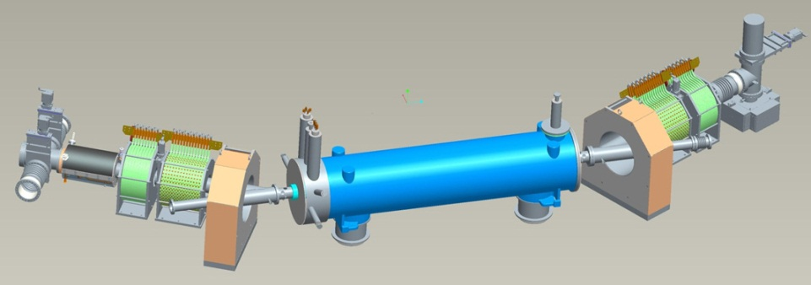
Recent and Ongoing Machine Upgrades
Y h+v pickups
RHIC breakthrough in bunched-beam stochastic cooling facilitates ~x10 improvement in heavy-ion collision rates, 4 years earlier and at ~1/7 the cost envisioned in 2007 NP Long Range Plan, saving ~$80M
Most (6 planes of pickups & kickers) of the new system commissioned during 2010-12, rest anticipated for 2014 run.
B h+v kickers
Horiz. Kicker (open)
Measure deviations from central moment-um in pickups, correct with kickers
Y h+v kickers
B h+v pickups
Electron lenses to be installed for 2013 run to improve polarized pp luminosity by factor ~2
EBIS
Electron lens
New Electron Beam Ion Source (EBIS, 2012) expands range of ions available (e.g., U) and enhances cost-effectiveness of operations
Notes:
4

Slide 5
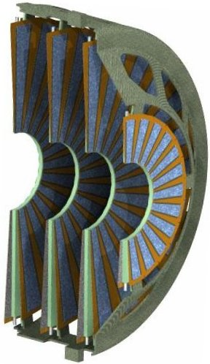
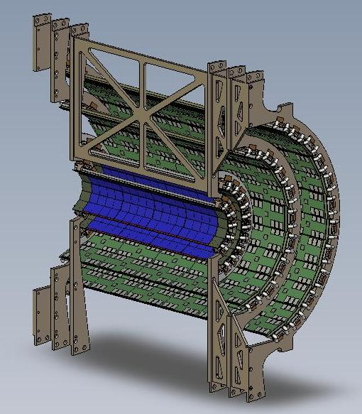
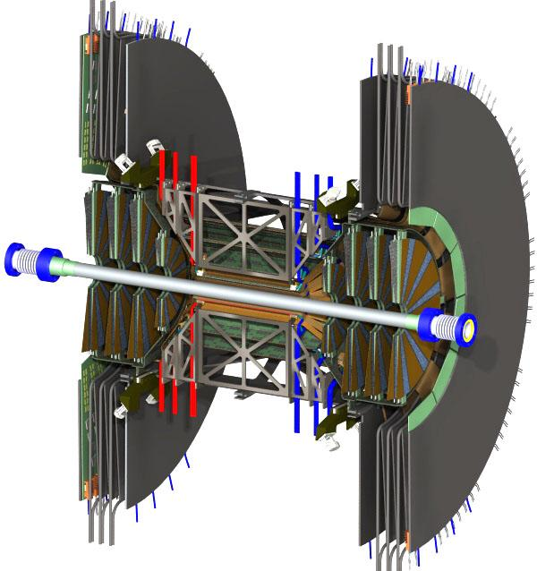
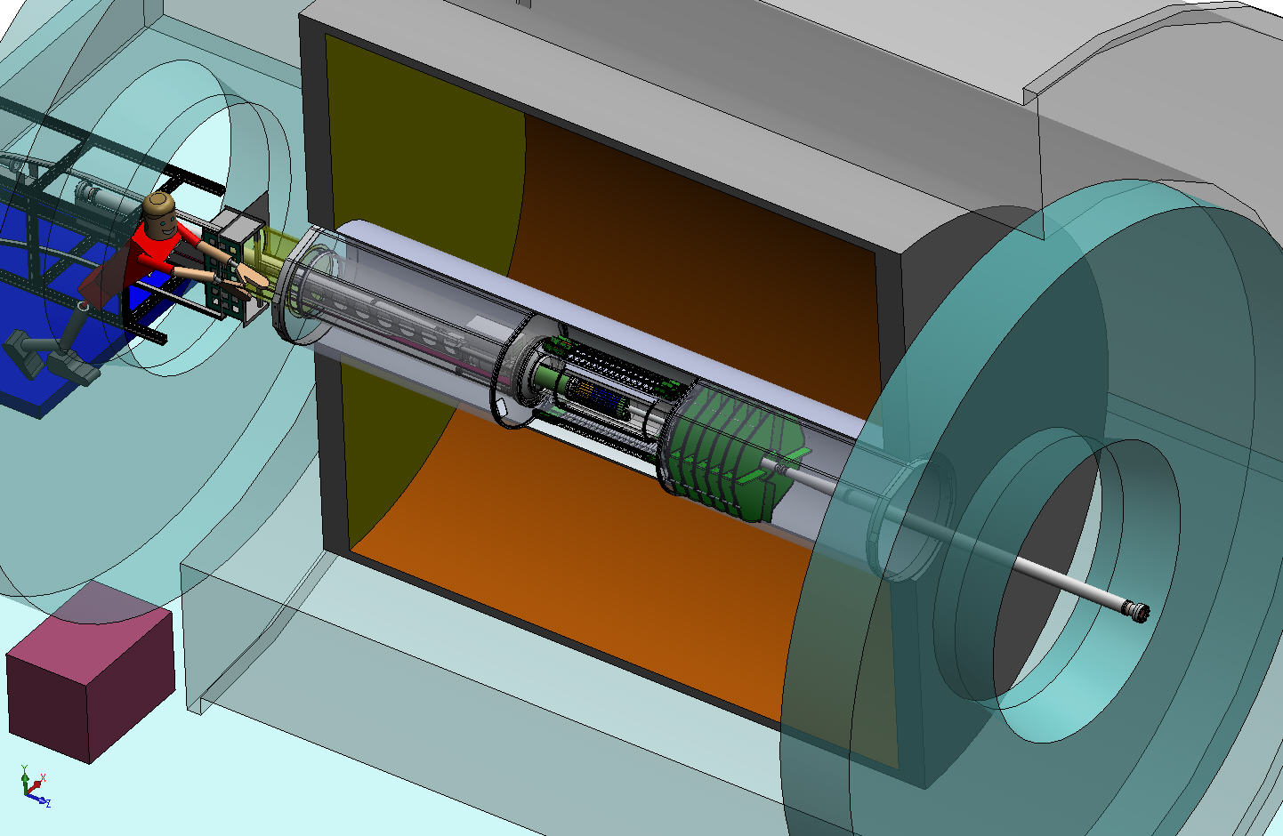
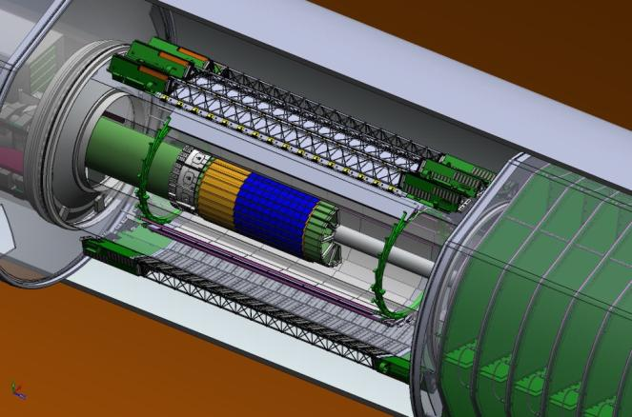
A Suite of Ongoing Detector Upgrades
PHENIX VTX & FVTX upgrades greatly improve vertex resolution, heavy flavor ID
μ trigger upgrade installed in FY10-11 enhances W prod’n triggering for spin program.
FVTX
VTX
Install for Run 12
Install for Run 11
A_{L} for W±
Ready for Run 12
STAR Heavy Flavor Tracker receives CD-2/3 review in 2011. Will permit topological recon-struction of charmed hadrons.
STAR Forward GEM Tracker to be installed for Runs 12 and 13, will enhance forward tracking, W charge sign discrimination.
STAR Muon Telescope Detector (Run 14) to improve quarkonium
SSD
IST
PXL
FGT
HFT
Identify heavy flavor hadron directly
Precision measurement HF hadron energy loss and collectivity
Ready for Run 14-15
Notes:
5

Slide 6
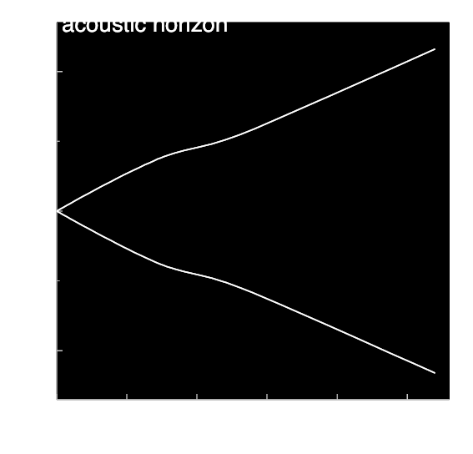
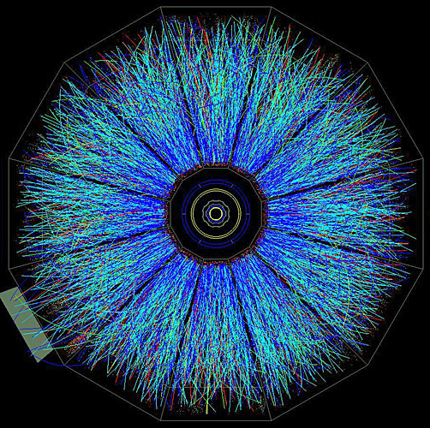
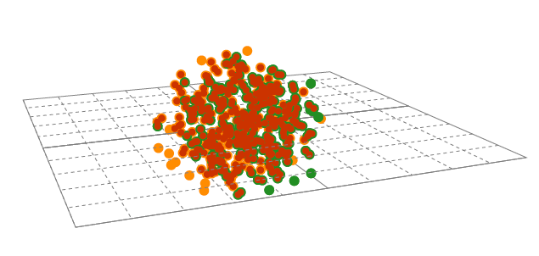
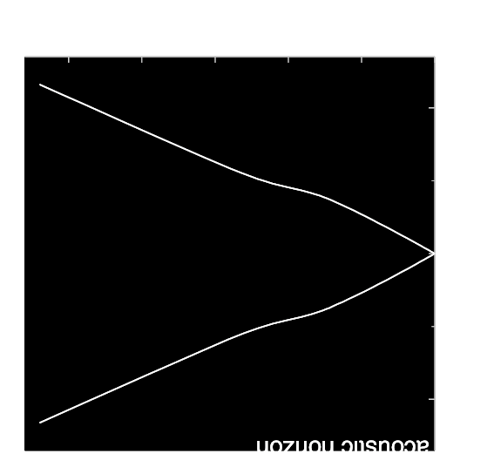

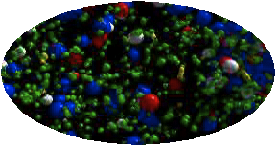
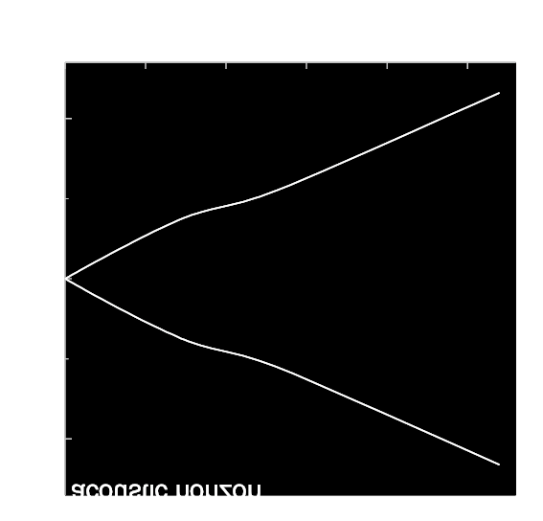
Expansion of the little bang:
RHIC Has Pioneered Lab Study of Condensed QCD Matter
Challenges:
How to pump/probe matter that lives ~10⁻²³ seconds?
What are unique emergent QCD phenomena?
How do they influence early universe evolution?
What roles do quantum fluctuations play?
Are there lessons for EW matter?
distributions and correlations of produced particles
kinetic
freeze-out
QGP Phase Boundary
lumpy initial energy density
QGP phase
quark and gluon degrees of freedom
graphic from Paul Sorensen to illustrate parallels between evolution of the “mini-universe” created in each RHIC collision and evolution of the real universe.

Slide 7
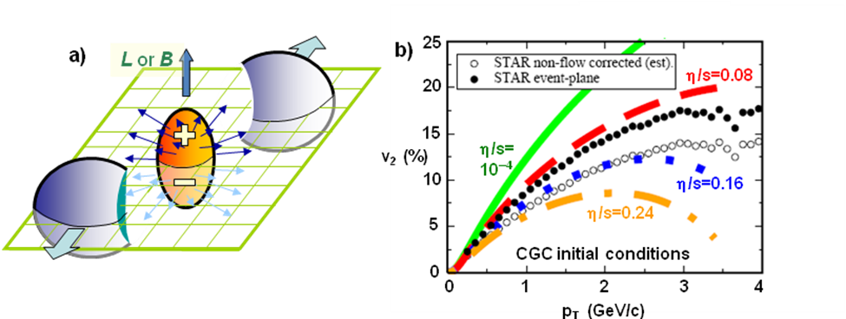
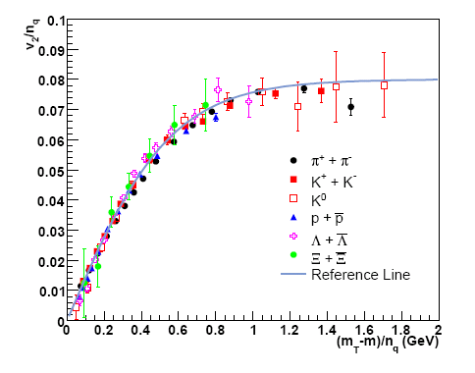
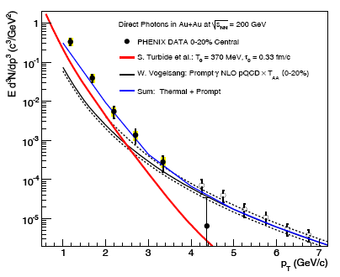
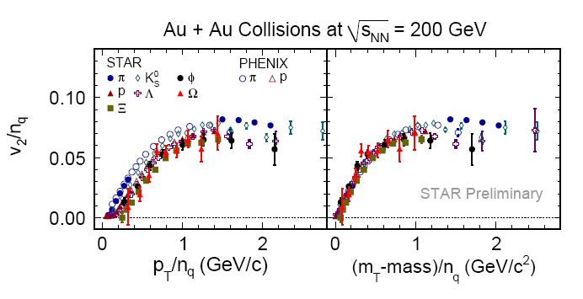
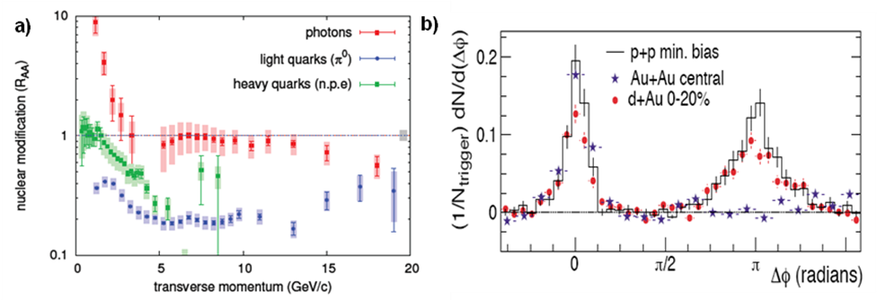
RHIC Past: Hot QCD Discoveries
Near-perfect liquid nature of early universe matter – revealed via elliptic flow v₂ – markedly different from anticipated ideal gas
Shear viscosity near lower quantum limit predicted via String Theory work on black holes
v₂ / n_{q}
Scaling with # valence quarks
b)
Direct γ in Au+Au, √s_{NN}= 200 GeV
a)
•
1
PHENIX DATA 0-20% Central
10⁻¹
S. Turbide et al: T₀=370 MeV, τ₀=0.33 fm/c
Collective flow established at quark level via n_{q} scaling
Matter first equili-brates ~4×10¹² K, well above max. allowed temp. for hadron gas
10⁻²
W. Vogelsang: Prompt γ NLO pQCD × T_{AA}(0-20%)
10⁻³
Sum: Thermal + Prompt
STAR data extend scaling to φ and Ω
10⁻⁴
10⁻⁵
1
2
3
4
5
6
7
KE_{T} / n_{q}
p_{T} (GeV/c)
QGP is ~opaque to quarks and gluons, but transparent to photons
Bottom Line: RHIC collisions produce deconfined QGP that behaves as inviscid fluid

Slide 8
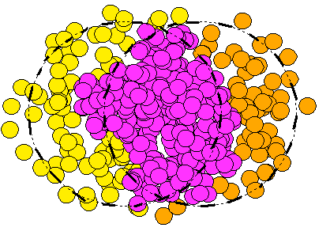
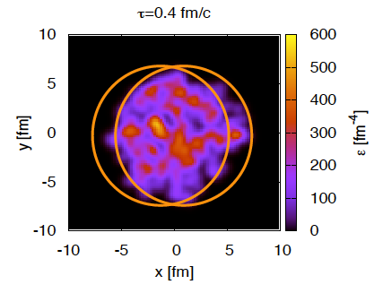
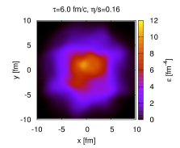
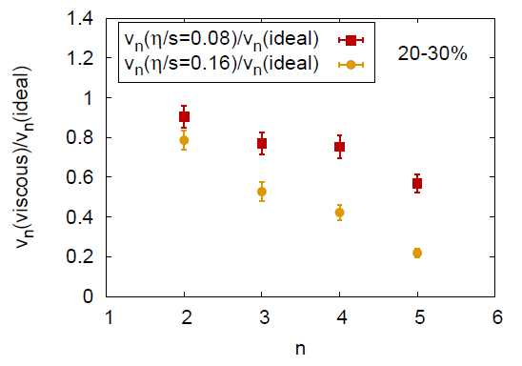
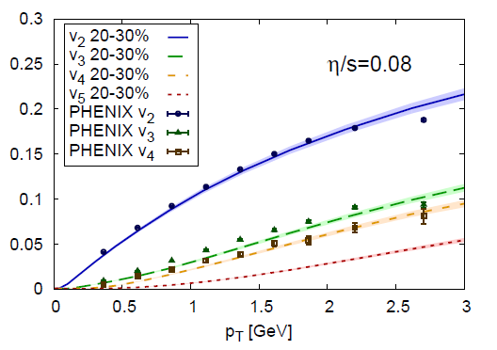
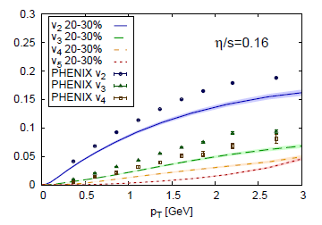
v₂
Beyond v₂ to Quantify Near-Perfection
Small shear viscosity of QGP permits lumpiness & asymmetry in initial density to seed higher than quadrupole patterns in emerging particle momenta
Recent v_{n} measurements and 3+1-D event-by-event viscous hydro calcs. ⇒ path to quantifying η/s
v₃
v₄
Higher multipoles more rapidly damped
B. Schenke et al., 2011
Comparison to new PHENIX data for v_{2,3,4} ⇒ η/s very close to lower quantum bound !
at quantum limit
twice quantum limit

Slide 9
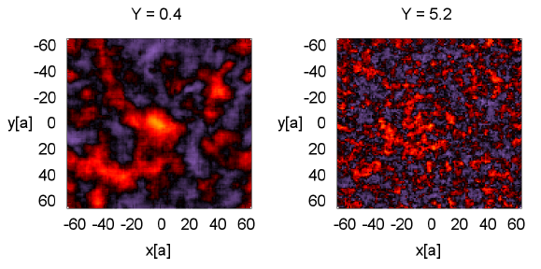
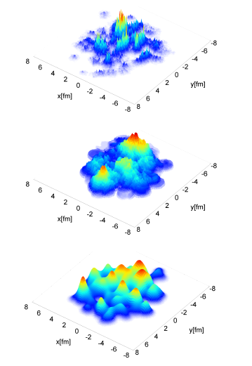
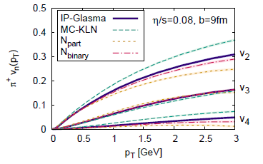
Next Steps: Constraining Initial Fluctuations
Initial density fluctuations influence RHIC collision evolution, just as inflation-era quantum fluctuations seed universe’s large-scale structure.
Is it just initial nucleon positions, or also color charge (i.e., gluon field) distributions, that fluctuate? The two yield different characteristic length scales and rapidity dependence.
Central rapidity
Forward rapidity
Impact parameter dependent gluon saturation
MC KLN – N pos’ns only
A. Dumitru et al., PL B706, 219 (2011)
B. Schenke et al., arXiv:1202.6646
Fluctuations can be constrained by odd vs. even flow har-monics, as fcn. of rapidity, & for asym. vs. symm. beams
Must be done together with pinning down η/s
MC Glauber – N pos’ns only

Slide 10
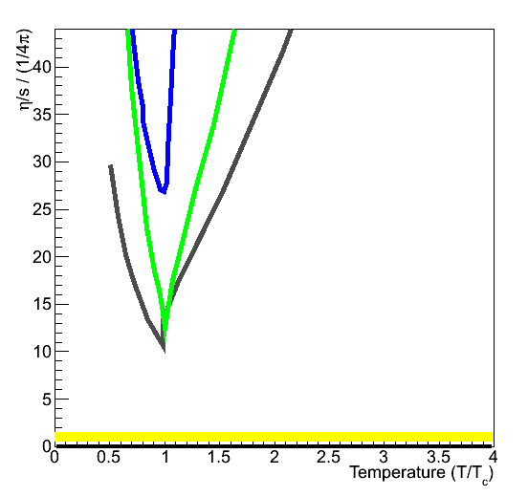
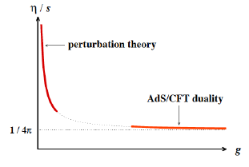
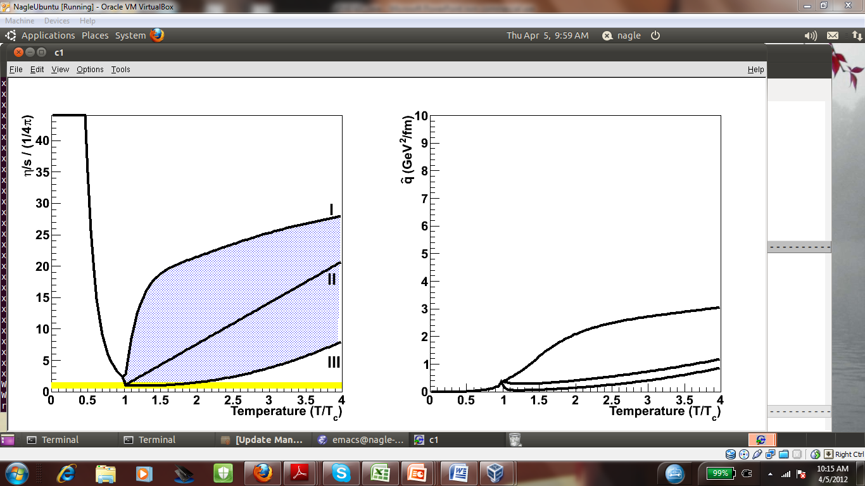
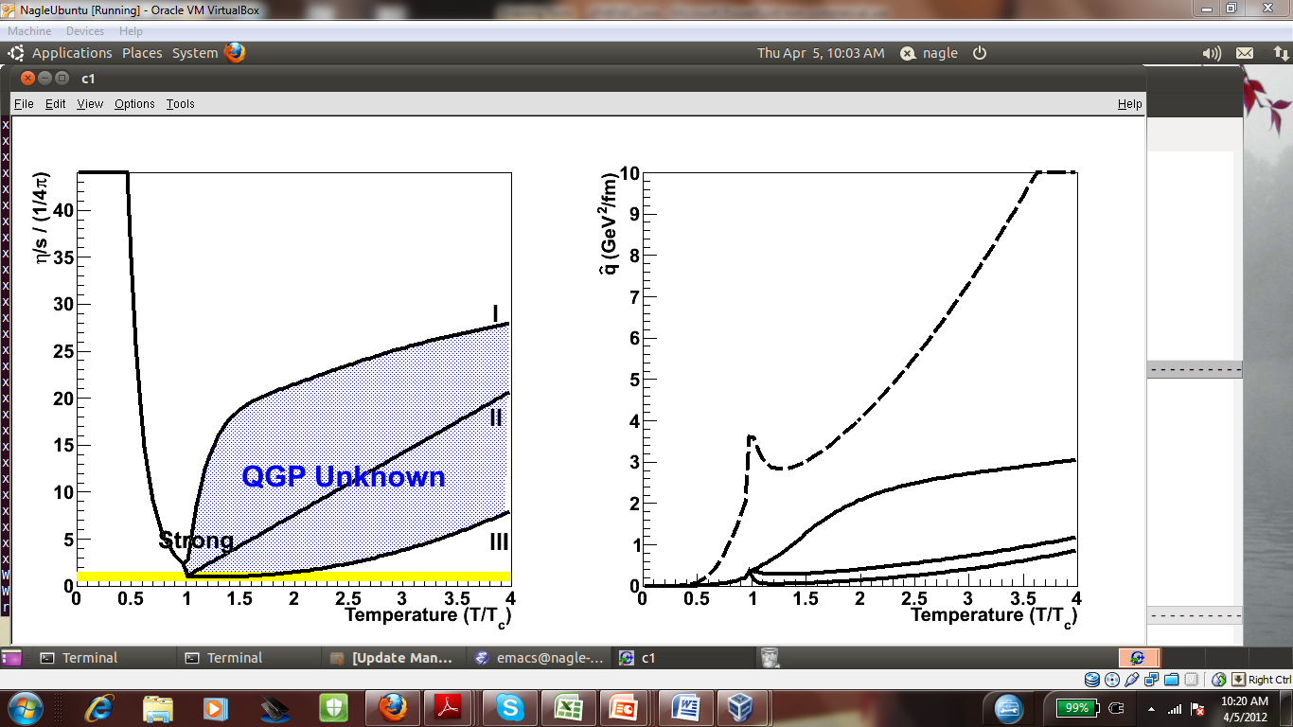
Next Steps: QCD Transport Properties vs. Temp.
40
Many common fluids exhibit η/s minima at or near phase transitions – does QGP?
How does strongly coupled liquid emerge from asymptotically
Policastro, Son, Starinets, 2001
30
η/s / (1/4π)
20
Water (100 MPa)
Nitrogen (3.4 MPa)
Helium (0.1 MPa)
10
String Theory Bound
0
1
0
2
3
4
Temperature (T/T_{c})
free theory?
Is QGP shear viscosity correlated with parton energy loss?
Measure vs. √s:
Flow power spectrum for η/s
Di-jet asym. for q-hat (parton p_{T}² loss/length)
Requires RHIC + det. upgrades
“Small Shear Viscosity Implies Strong Jet Quenching”
A. Majumder, B. Muller, X.N. Wang, PRL (2007).
Scenario #1 (x10)
reveals peak in q !
^

Slide 11
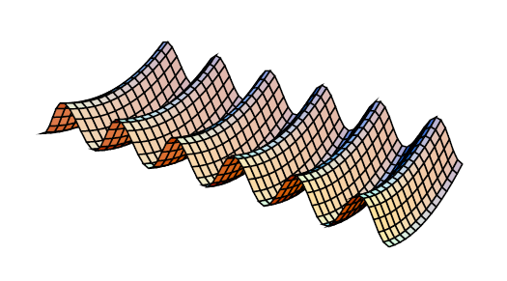
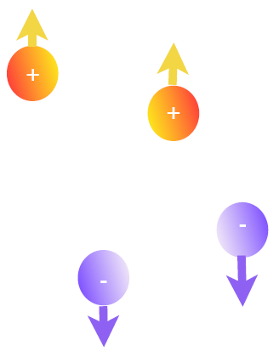
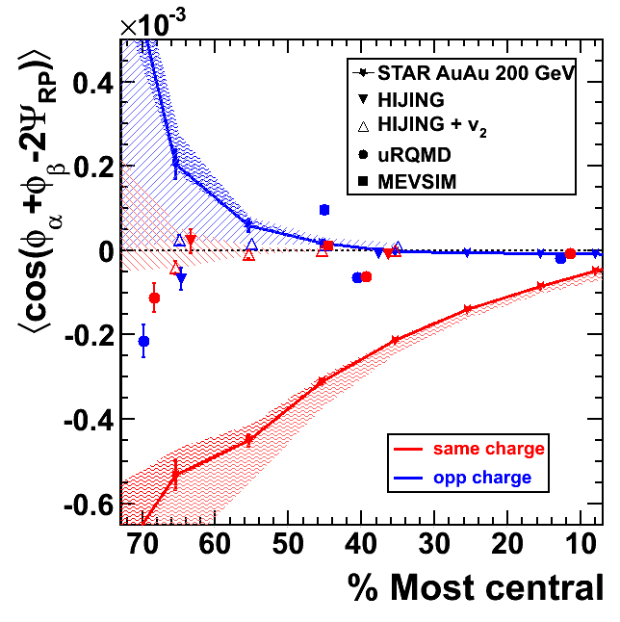
Do We See Excited QCD Vacuum Fluctuation Effects?
QCD sphalerons ⇔ leftward or rightward “twists” in gluon field ⇒ local chiral imbalance (analogous to EW sphalerons as possible source of baryon-antibaryon imbalance in universe)
Energy of gluon field
Coupling with very strong magnetic field (~10¹⁷ G) ⇒ Chiral Magnetic Effect ⇒ event EDM (D. Kharzeev et al.)
Charge separation can survive passage through chirally restored QGP
N_{CS} = -2 -1 0 1 2
B
instanton
sphaleron
R-handed fermions in a “bubble” with Q_{T} = N_{R}−N_{L} > 0
STAR; PRL103, 251601(09); 0909.1717 (PRC)
EDM sign can differ from bubble to bubble, event to event ⇒ event asymmetry, but no global CPV
STAR finds P-, CP-even, but EDM-like, charged-particle correl’ns ~predicted effect
Local Parity Violation (LPV)
L or B

Slide 12
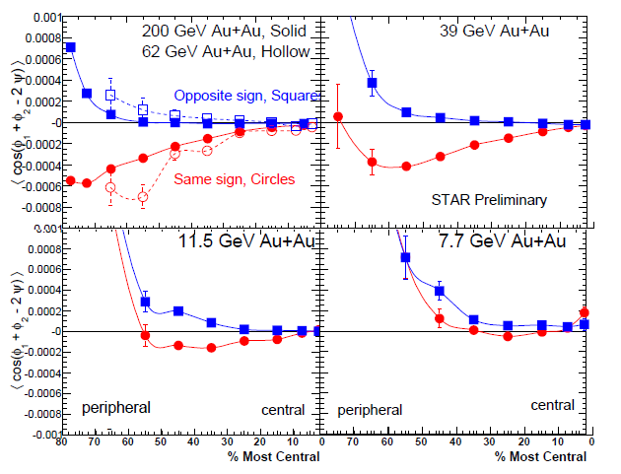
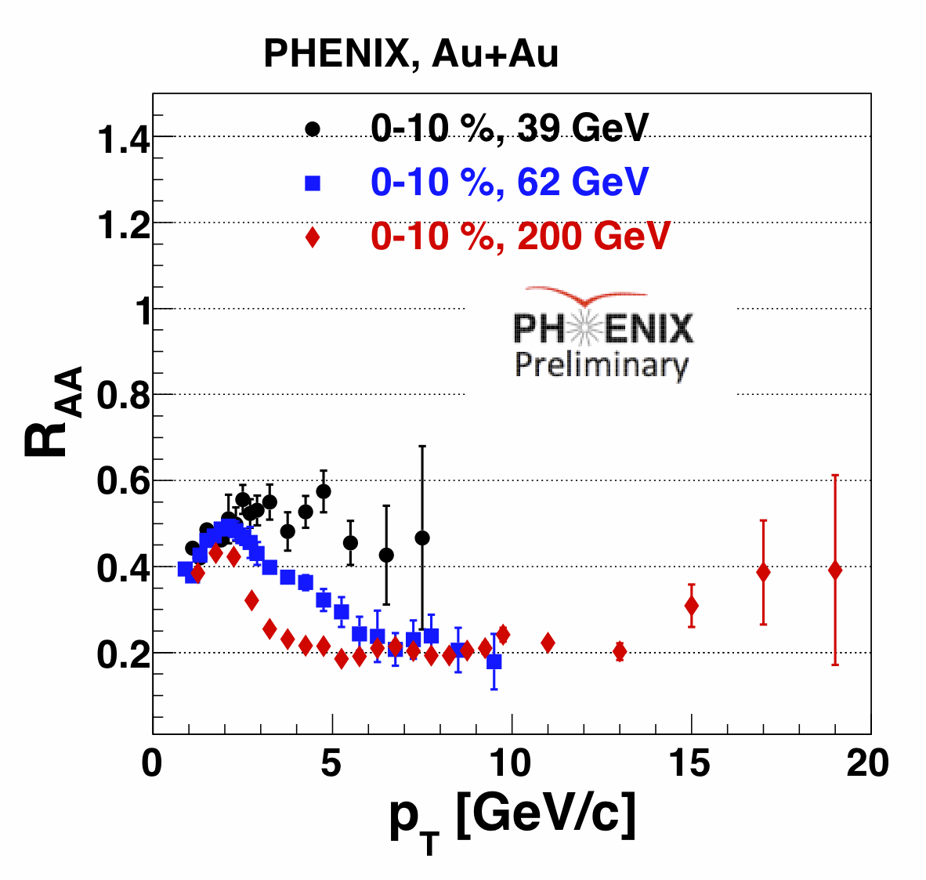
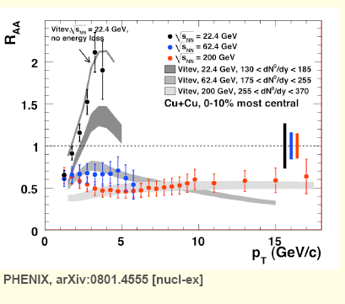
RHIC Beam Energy Scan: Onset of Deconfinement?
ALICE/LHC LPV results ~ identical to STAR 200 GeV, despite ×14 in √ s_{NN}
But STAR measurements during 2010 RHIC beam energy scan show rapid vanishing of charge- dependent correl’n < 39 GeV
Consistent with onset of chiral symm. restoration & deconfinement within RHIC range, but need other signals to rule out flow-related LPV bkgds.
.008
200 GeV Au+Au, Solid
62 GeV Au+Au, Hollow
39 GeV Au+Au
.004
Opposite sign
0
−.004
Same sign
−.008
STAR Preliminary
Charged-particle azimuthal correlation (⊥ plane − || plane)
.008
11.5 GeV Au+Au
7.7 GeV Au+Au
.004
0
−.004
Blue-red sensitive to event EDM
−.008
peripheral central
peripheral central
80
60
40
20
0
60
40
20
0
% Most Central Collisions
Other signals also suggest QGP onset @ RHIC, e.g., disappear-ance of high-p_{T} hadron suppression from parton E loss, deviations from n_{q} scaling of elliptic flow
“Sweet spot” @ RHIC?
22.4 GeV theory, no E loss
PHENIX, Cu+Cu, 0-10%
22.4 GeV
62.4 GeV
200 GeV
•
•
•
Hadron suppression above 39 GeV → hadron enhancement by 22 GeV!

Slide 13
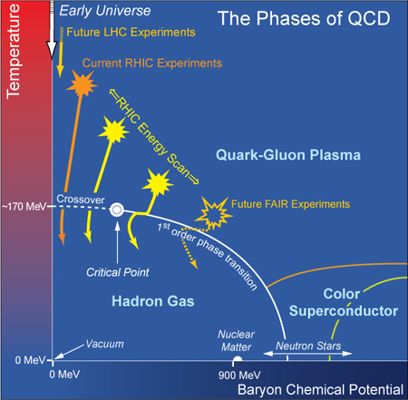
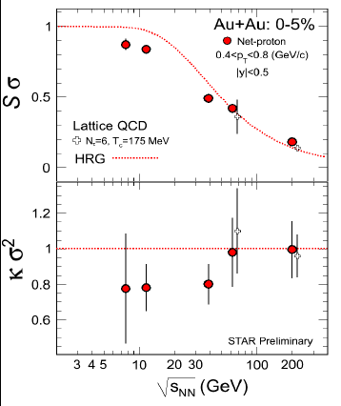
Energy Scan: Critical Point (CP) in the QCD Phase Diagram?
At near zero net baryon density probed at top RHIC energy and LHC, LQCD ⇒ smooth crossover transition
At higher μ_{B}, theoretical arguments suggest 1st-order phase transition, but LQCD MC sampling invalid
Critical point would be unique fixed point in QCD landscape
LHC Experiments
Full-energy RHIC Experiments
~155 MeV
Net-proton moments
Search for a QCD Critical endpoint via low-energy scan in RHIC-II era
Expect non-Gaussian fluctuations in event-by-event distributions of conserved quantities: charge, baryon #
Higher moments depend more strongly on correlation length ξ
2 more energies being analyzed
Early STAR results for 3rd & 4th moments consistent with Hadron Resonance Gas and LQCD at higher energies – stay tuned, new results expected summer 2012!
STAR Preliminary

Slide 14
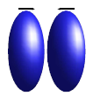
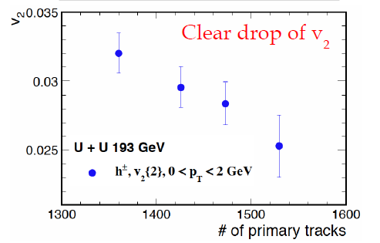
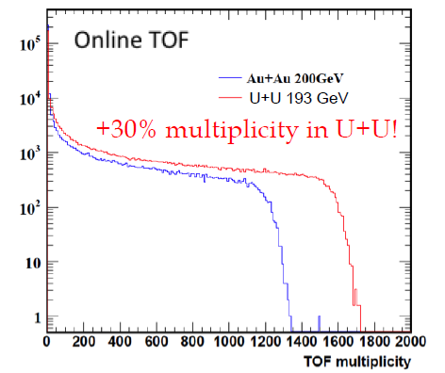
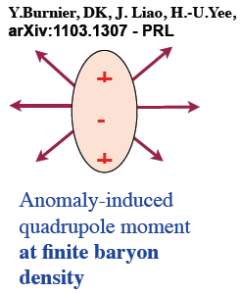
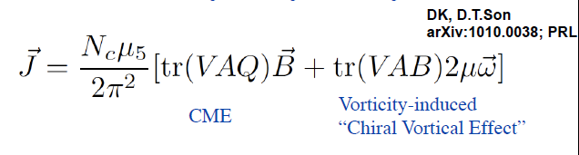
Next Steps for Quantum (Sphaleron) Snapshots
STAR
anticipated vari-ation from body-body to tip-tip
1% most central events
Enhance bkgd. contributions via deformed U+U collisions, where ~central body-body
2012: 1st U+U run w/ EBIS – online data ⇒ see expected growth in multiplicity
configurations give rise to enhanced flow with reduced magnetic field
Search for related effects from QCD triangle anomaly in hydrodynamic system, predicted by Kharzeev et al.
A baryon current correlated with charge current when baryochemical potential ≠ 0
e.g., Λ’s should be preferentially correlated with π ⁺ and Λ’s with π⁻, normal to reaction plane, @ √ s_{NN} = 39 GeV

Slide 15
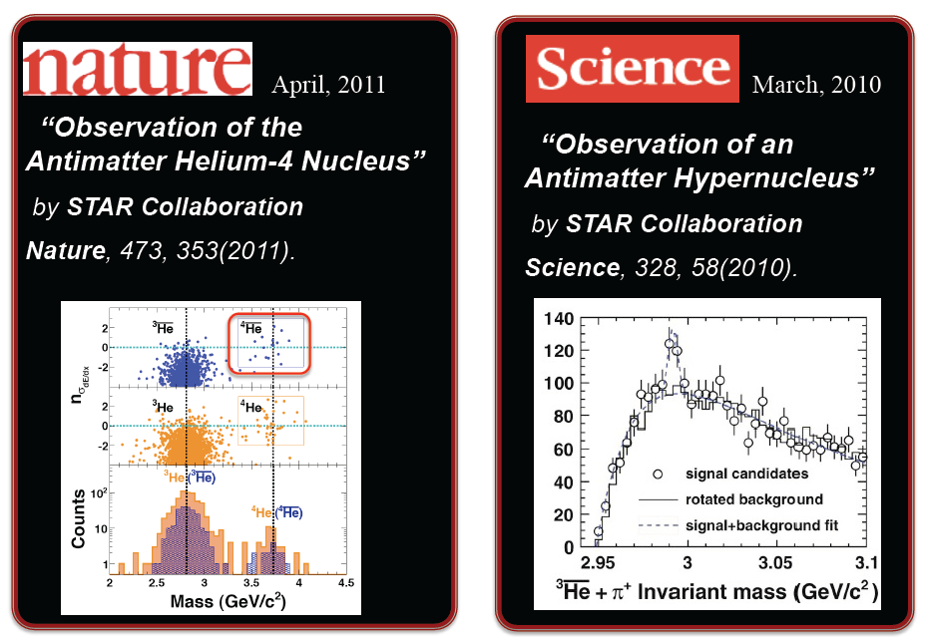
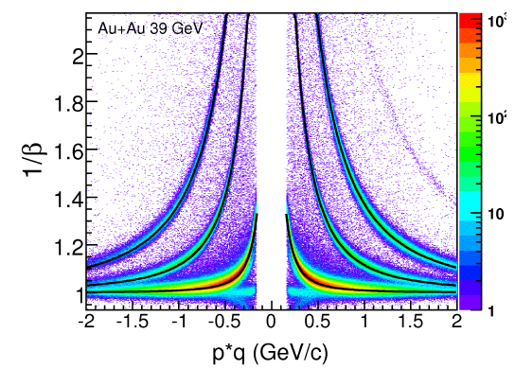

Searching for Exotica Among QGP Debris
Excellent PID capability supports 2010-11 discoveries of heavy antinuclei…
Observed rate of falloff in production cross section with increasing mass is consistent with statistical coalescence, provides baseline for AMS search for anti-α in cosmic rays.
But also suggests a very long wait before mass-6 antinuclei could be found in laboratory…

Slide 16


Unanticipated Intellectual Connections
RHIC results have established ties to other forefront science:
String Theory studies of black hole behavior led to prediction of quantum lower bound on η/s
Ultra-cold atomic gases, at temperatures 19 orders of magnitude below QGP, can also be “nearly perfect liquids”
Similar liquid behavior seen and studied in a number of strongly correlated condensed matter systems
Symmetry-violating bubbles in QGP analogous to speculated cosmological origin of matter-antimatter imbalance in universe
Power spectrum of flow analogous to power spectrum of cosmic microwave background, used to constrain baryon acoustic oscillations & dark energy.
Organic super-conductors
Trapped ultra-cold atom clouds
CMB fluctuations

Slide 17



Cold QCD Matter: Do Gluon Densities Saturate?
Gluon densities must saturate @ low x & moderate Q² to avoid unitarity violation
Color Glass Conden-sate (CGC) regime has weak coupling but high gluon occu-pancy ⇒ intense, ~classical gluon field
Seen at light speed (as RHIC beams see each other), ordinary matter is dominated by gluons.
Coherent effects in nuclei ⇒ precocious onset of saturation
Forward hadron production, sensitive to gluon density at low x, is suppressed in d+Au collisions @ RHIC, as seen in early BRAHMS results
Forward di-hadron coincidences probe very asymmetric parton collisions, involving low-x gluon from one beam
In CGC regime, expect 2→2 parton scattering to be replaced by scattering from a coherent gluon field ⇒ “mono-jets,” consistent w/ new PHENIX (left) & STAR results
J/ψ, 0-20%
h+π⁰, 60-88%, PHENIX Preliminary
h+π⁰, 0-20%, PHENIX Preliminary
1
Hadron suppression factor
0.1
√s = 200 GeV d+Au/p+p
10⁻³
10⁻²
10⁻¹
Inferred momentum fraction of sampled gluons

Slide 18



Cold QCD Matter: Where is the Missing Proton Spin?
DIS ⇒ only ~30% of spin from q spins
RHIC spin program exploits pQCD interaction dominance in hard p+p collisions, with strong sensitivity to gluon helicity preference ΔG(x)
Best results so far from inclusive jet prod’n ⇒ ΔG small > 0, but extrapola-tion to x < 0.05 highly uncertain
Use W± prod’n to cleanly probe Δu(x) vs. Δd(x), sensitive to p χral structure
Black pts. = 2009 preliminary results
1st STAR and PHENIX W asyms. publ. in PRL106 (2011)

Slide 19


2nd Decade: Exploit √s “Sweet Spot” + RHIC’s Versatility and Upgrades for Quantification & Further Discoveries
  How perfect is the near-perfect liquid, as fcn. of temp.?
  How do fluctuations (both initial density & excited QCD vacuum) affect evolution of “mini-universe”?
  Is there a critical endpoint in the QCD phase diagram?
  How do quarks and gluons lose energy in the QGP, as fcn. of quark flavor (including c,b) and temperature?
  Where is the “missing” proton spin?
Degrees of freedom and behavior of QCD matter change rapidly at QGP transition, but approach asymptopia very slowly above critical temperature.
Understanding parton E loss requires comparison of jet quenching characteristics @ LHC vs. RHIC ⇒ need PHENIX central upgrade
Hadron Gas: maximum T
scaled energy density, ε/T⁴
F. Karsch, arXiv:0711.0656 [hep-lat]
Region Covered by RHIC
Figure from: Kolb, P. & Heinz, U. in QuarkﾐGluon Plasma 3
temperature, T [MeV]
Notes:
How perfect is the near-perfect liquid?
Fourier power spectra for collective flow, above & below deconfinement transition (energy “sweet spot” @ RHIC)
How do fluctuations affect “mini-universe” evolution?
Initial density fluctuations: Odd vs. even flow for symmetric & asymmetric (e.g., Cu+Au) collisions; quantum fluctuations in gluon field?
Excited QCD vacuum fluctuations: Further tests of event-by-event CP violation, including U+U collisions
Is there a critical endpoint in the QCD phase diagram?
Critical fluctuations in conserved quantity distributions vs. √s
How do quarks and gluons lose energy in QGP?
Jet quenching vs. √s, parton flavor, system size, orientation
Where is the “missing” proton spin?
Di-jet, W and Drell-Yan prod’n in polarized pp

Slide 20





RHIC’s 3rd Decade: Reinvention as eRHIC ⇒ Path Forward for Cold QCD Matter
Probe onset of gluon saturation in nuclei
A high-resolution femtoscope for cold gluon-dominated matter:
2010 INT program report @ arXiv:1108.1713
nuclear “oomph”
Gluon occupancy >> 1
0.4
Existing e+p range
Existing p+p range
Current best fit
Current fit uncertainty
Uncertainty w/ EIC
Gluon momentum fraction × helicity distribution
eRHIC @ BNL: add e⁻ Energy Recovery Linac in RHIC tunnel
EIC Science White Paper will be available in Summer 2012
0.2
Search for missing spin among soft gluons
0
10⁻⁵
10⁻⁴
10⁻³
10⁻²
10⁻¹
1
Inferred momentum fraction of sampled gluons
Design allows easy staging (start w/ 5-10 GeV, upgrade to ~20 GeV e⁻). Tech & cost reviews in 2011-12. Synergy with other accel. R&D @ BNL ⇒ cost reduction opportunities.
Proton tomography via exclusive reactions
x ~
x < 0.1
x ~ 0.3
x ~ 0.8

Slide 21
Summary
RHIC’s high productivity & broad impact continue as we learn how to quantify properties of early-universe QCD matter, as degrees of freedom transition from quarks/gluons to hadrons.
With cost-effective upgrades RHIC is poised to address more pointed science questions raised by its 1st-decade discoveries.
Strong connections to other physics forefronts have provided unanticipated intellectual enrichment and visibility to the field.
RHIC-LHC complementarity enhances understanding of condensed QCD matter, allowing measurements over a broad range of temperature and outgoing jet and hadron momenta.
We envision adding a 5-10 GeV e⁻ Energy Recovery Linac for RHIC’s 3rd decade ⇒ e+A and polarized e+N exp’ts to constrain the nature of gluon-dominated cold QCD matter.
The 2007 LRP for U.S. NP outlined ambitions for budget doubling. Present outlook much less rosy ⇒ urgent “reprioritization” exercise in progress, report due 1/2013. “Everything is on the table.”

Slide 22
Backup Slides

Slide 23

RHIC’s Future Science Themes: Cold QCD Matter
Complete determination of gluon and sea-antiquark contributions to p spin
  jet (hadron), di-jet (di-hadron) and W production asymmetries in RHIC p+p; but need e+p @ EIC to constrain low-x contributions
  Test QCD understanding of transverse spin asymmetries
    compare p+p Drell-Yan @ RHIC to semi-inclusive e+p DIS @ HERMES, COMPASS, EIC
    Make pioneering measurements of nucleon’s electroweak structure fcns.
      charged-current DIS in e+N @ EIC
    Image transverse parton spin, momentum, spatial structure in nucleons
      semi-inclusive DIS and deep exclusive e+N reactions @ EIC
      Map initial gluon distributions in cold nuclei, as seen by colliding beams at RHIC & LHC
        start with d+A and p+A @ RHIC, LHC; but quantify with e+A DIS @ EIC
        Study transition from dilute partonic matter to saturated gluonic matter and test understanding in critical non-linear QCD regime
          full-energy e+A program @ EIC, including novel gluonic form factors of nuclei via diffractive vector meson production
An Electron-Ion Collider is needed to study gluon-dominated cold matter quantitatively.
Notes:
23

Slide 24

What Will EIC Have That HERA Didn’t?
Heavy-ion beams to take advantage of coherent contributions of many nucleons to gluon density, provide more cost-effective reach into gluon saturation regime when QCD coupling is still weak.
nuclear “oomph”
Gluon occupancy >> 1
Constraints from RHIC spin data to date
Polarized proton and ³He (for neutron), as well as electron, beams to pursue search for gluon contributions to nucleon spin down to very soft gluons, and map spin-momentum correlations of quarks and gluons inside nucleons.
Constraints from projected EIC data
Notes:
24

Slide 25



The Five Illustrative Questions
How can we pump/probe the fleeting matter to measure its response?
Does asymptotic freedom ⇒ high-density (of color charge) ideal Quark-Gluon Plasma gas?
Does rich topological structure of QCD vacuum ⇒ local symmetry violation from high-temp. “sphaleron” fluctuations near QGP transition, analogous to EW transition sphalerons as possible site of baryon-antibaryon imbalance?
Is there a unique Critical Endpoint in the QCD phase diagram?
Do gluon self-interactions ⇒ “universal” saturated gluon matter at the heart of all hadrons/nuclei viewed at light speed?
Energy of gluon field
N_{CS} = -2 -1 0 1 2
instanton
sphaleron

Slide 26

v₂
Beyond v₂ to Quantify Near-Perfection
v₃
v₄
Low η/s ⇒ asymmetry or lumpiness in initial event density distribution can seed higher flow multipoles, including odd ones.
Near-side ‘ridge’
Away-side ‘Mach cone’
All RHIC & LHC exp’ts confirm that full flow power spectrum, esp. n = odd, accounts ~ fully for the “ridge” and “Mach cone”
Higher n more rapidly damped, as per new 3+1-D event-by-event viscous relativistic hydro ⇒ path to quantify η/s precisely, plus other QGP transport properties, & to test fluctuation models (nucleon arrangements? Gluon field?)
B. Schenke et al., 2011

Slide 27




Searching for Critical Point Fluctuations
Expect non-Gaussian fluctuations in event-by-event distributions of con-served quantities: charge, baryon #
Higher moments depend more strongly on correlation length ξ
~ ξ^{4.5}
~ ξ⁷
Early STAR results consistent with both Hadron Resonance Gas and LQCD at higher energies – stay tuned!
Net-proton moments
2 more energies being analyzed
Prefactor in ξ⁷ dependence changes sign near critical point
STAR Preliminary
M. Stephanov, 1104.1627

Slide 28



More Recent Evidence from RHIC
pp data
dAu peripheral
Forward di-hadron coincidences probe very asymmetric parton collisions, involving low-x gluon from one beam
In CGC regime, expect 2→2 parton scattering to be replaced by scattering from a coherent gluon field ⇒ “monojets”
Uncorrelated Coincidence Probability (radian⁻¹)
dAu central
J/ψ, 0-20%
h+π⁰, 60-88%, PHENIX Preliminary
h+π⁰, 0-20%, PHENIX Preliminary
New STAR & PHENIX data confirm disappearance of away-side jet in central d+Au forward-forward di-hadron coinc.
CGC + offset, C. Marquet 2007
1
Hadron suppression factor
0.1
√s = 200 GeV d+Au/p+p
10⁻³
10⁻²
10⁻¹
Inferred momentum fraction of sampled gluons

Slide 29
RHIC Remains Essential to Pursue Upcoming Science
Spans the energy “sweet spot” where transition to QGP appears to set in, permitting study of early universe matter above and below transition
  Can’t be done at LHC, where injection energy is well above top RHIC E
Flexibility in colliding beam species + dedicated heavy-ion focus permits systematic unraveling of various sensitivities of QGP behavior
  Magnet design and pp focus makes this very challenging at LHC
In combination with LHC, provides very large energy lever arm to constrain how quarks and gluons interact inside QGP
RHIC detectors best suited for measurements related to QGP temperature determination
RHIC is world’s only polarized proton collider, yielding unique spin program
  Polarized protons extraordinarily difficult technically at LHC energies, and would not yield sizable quark spin preferences
Provides cost-effective path to a future polarized Electron-Ion Collider identified in 2007 Nuclear Physics Long Range Plan as highest priority next-generation facility for study of quarks and gluons in matter
Maintains critical collider R&D capabilities in U.S., where RHIC is now only operating collider

Slide 30




Best Probe of Soft Gluon Densities is e+A Collider
In low-x e+A DIS, when γ* coherence length L ~ (2m_{N}x)⁻¹ > nuclear diam., probe interacts coherently with all nucleons along path.
e+A can reach comparable gluon densities to e+p at factor ~ A lower Bjorken x
nuclear “oomph”
Can extract gluon densities via scaling violations in F₂ or by isolating longitudinal structure fcn. F_{L} from√s scan: F_{L} ~ α_{s}G(x,Q²)
e+A sensitivity indicated by early onset of F_{L} non-linearity, or di-hadron coinc. calcs.
Gluon occupancy >> 1
e+p
e+Au
e+p (or e+A) → h₁ + h₂ + X sensitive to γ*g fusion
J. Bartels, K. Golec-Biernat and L. Motyka, 2011
Contours of F_{L} non-linearity
Log₁₀(Q² )
Dominguez, Xiao and Yuan (2010)
Log₁₀(x)
Log₁₀(x)

Slide 31

FY11 RHIC Highlights: Heaviest Anti-Nucleus Formed in QGP Debris
STAR TOF allows clear ID of rare anti-alpha tracks ⇒ Nature article + 20th 2011 science highlight in Discover Magazine
Rate of falloff consistent with stat. coalescence, provides baseline for AMS search for anti-α in cosmic rays

