Slide 1


Studying Strong Interaction
with
SIDDHARTA
by Johann Zmeskal
SMI, Vienna
MESON 2012
12th International Workshop on Meson Production, Properties and Interaction
KRAKÓW, POLAND
31 May - 5 June 2012

Slide 2








SIDDHARTA collaboration
LNF- INFN, Frascati, Italy
SMI- ÖAW, Vienna, Austria
IFIN – HH, Bucharest, Romania
Politecnico, Milano, Italy
MPE, Garching, Germany
PNSensors, Munich, Germany
RIKEN, Japan
Univ. Tokyo, Japan
Victoria Univ., Canada
Excellence Cluster, TUM, Munich, Germany
Univ. Zagreb, Croatia

Slide 3
Outline
Introduction
Motivation
SIDDHARTA setup
Measuring principle
Results
SIDDHARTA-2
Summary

Slide 4
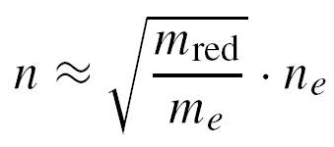
Forming “exotic” atoms
“normal” hydrogen
“exotic” (kaonic) hydrogen
n~25
n=1
n=1
n=2
p
e⁻
X-ray
K⁻
K⁻
2p → 1s
K_{α} transition

Slide 5
Cascade processes
n
~ 25
3
2
1
Stark-mixing
l=0 1 2 n-1
external Auger effect
chem. de-excitation
nuclear
absorption
Coulomb de-excitation
X-ray radiation
K_{α}
Γ_{1s}
observable hadronic
shift and broadening
ε_{1s}

Slide 6
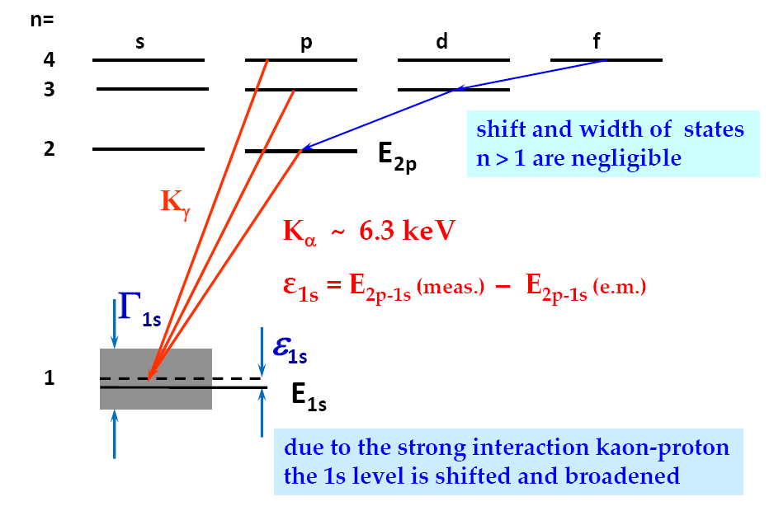
X-ray transitions to the 1s state

Slide 7
Motivation
Exotic (kaonic) atoms – probes for strong interaction
  hadronic shift ε_{1s} and width Γ_{1s} directly observable
  experimental study of low energy QCD.
  testing chiral symmetry breaking in systems with strangeness
Kaonic hydrogen
  scattering lengths, no extrapolation to zero energy
  precise experimental data important/missing
  kaonic deuterium never measured before
    determination of the isospin dependent KN
    scattering lengths
Information on Λ(1405) sub-threshold resonance

Slide 8
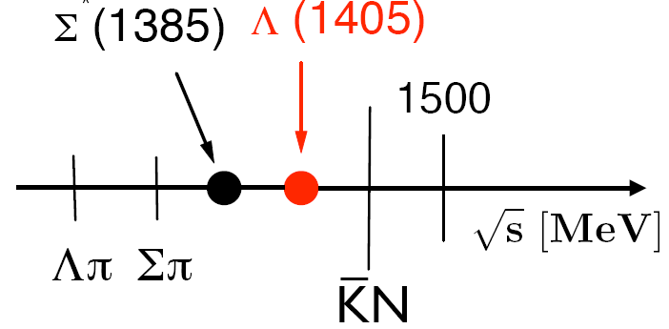
Low-energy K-N systems
Chiral perturbation theory, which was developed for
πp, ππ is not applicable for K-N systems
Non-perturbative
coupled channels
approach based on
chiral SU(3) dynamics
Notes:
appropriate framework to analyse the anti-kaon-nucleon system at low energy
In light exotic hadronic atoms the Bohr radius is still much larger than the typical range of strong interaction formulated in QCD, and the average momentum of the bound hadron is very small. Chiral perturbation theory (ChPT) [20–22], with symmetries and symmetry breaking patterns of QCD included, is an appropriate framework to analyse the dynamics of hadrons at low energy and to describe the observable effects in the spectrum of exotic hadronic atoms.
There are non-perturbative coupled-channel techniques based on the driving terms of the chiral effective Lagrangian which generate the Λ(1405) dynamically as a Kbar-N quasi-bound state and as a resonance in the pi-Sigma channel. They have proved useful and successful.
High precision K- p threshold data set important constraints for such theoretical approaches.

Slide 9
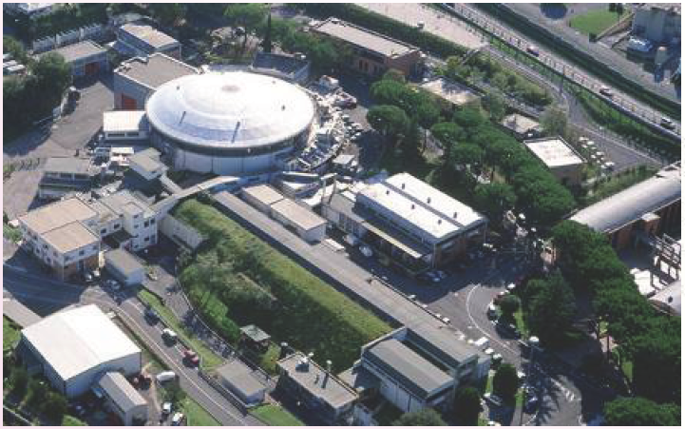
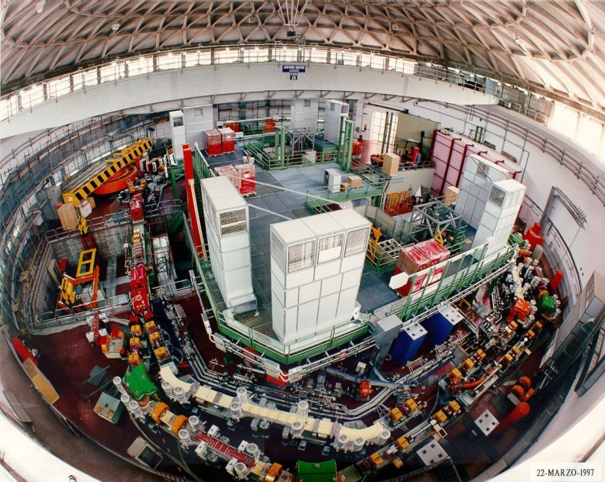
Kaonic hydrogen atoms at DAΦNE
e⁺-e⁻
collider
Accu.
LINAC

Slide 10
DAΦNE parameters
operates at the centre-of-mass energy of the Φ meson
mass m = 1019.413 ± .008 MeV
width Γ = 4.43 ± .06 MeV
produced via e⁺e⁻ collision with
σ(e⁺e⁻ → Φ) ~ 5 µb
average luminosity
L = 5 x 10³² cm⁻² s⁻¹
→ Φ production rate 2.5 x 10³ s⁻¹
Φ decays at rest to about
~ 50% K⁺K⁻
→ monochromatic kaon beam (127 MeV/c)

Slide 11

The SIDDHARTA setup

Slide 12
Lightweight cryogenic target cell
working T 22 K
working P 1.5 bar
Alu-grid
Side wall:
Kapton 50 µm
Kaon entrance
Window:
Kapton 75 µm

Slide 13
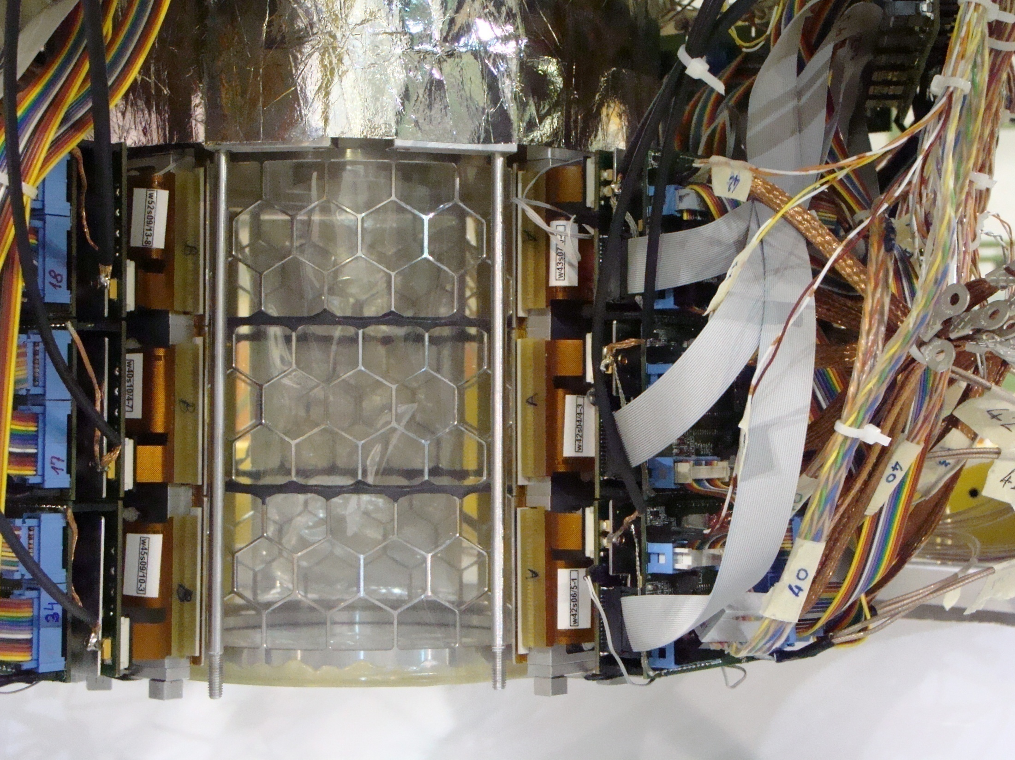

SIDDHARTA target - detector
Advanced Seminar Series Particles and Interactions

Slide 14
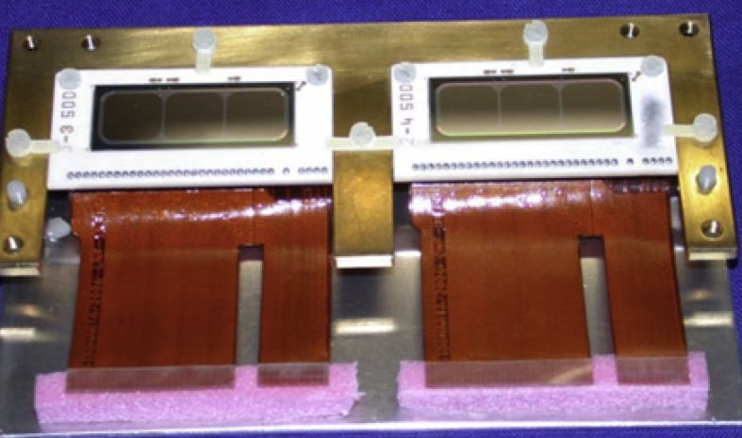
Development of large area SDDs
SDD window frame
(pure Al 99.999%)
flexible Kapton
boards
pre-amplifier
board
HV+LV distribution
board
FP-6 EU programme:
HadronPhysics

Slide 15
Excellent energy resolution
FWHM = 150 eV
@ 6keV

Slide 16
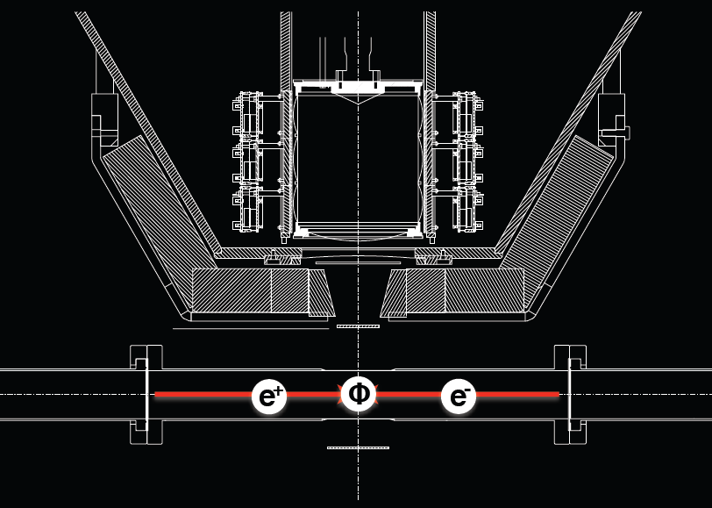
φ production

Slide 17
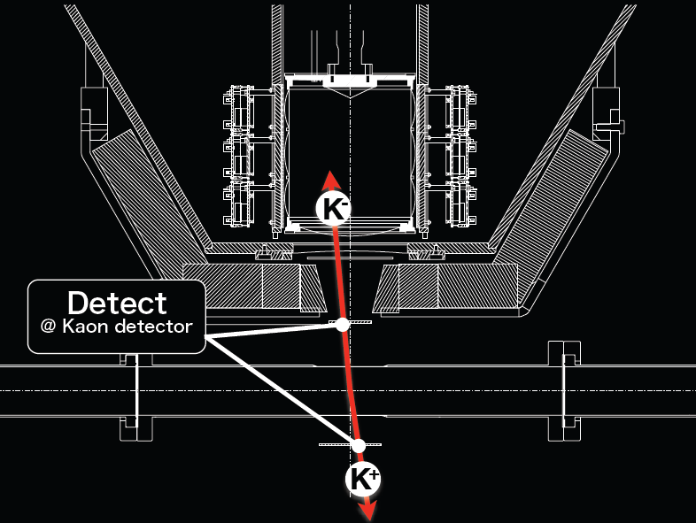
Kaon pair detection

Slide 18
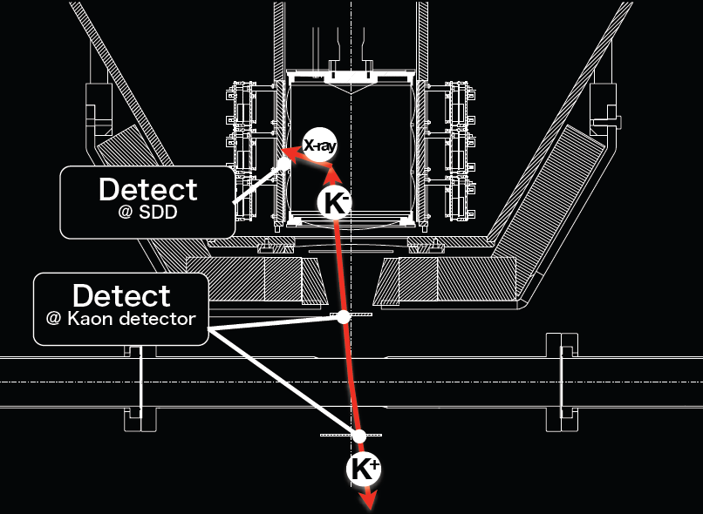
“triple” coincidence method

Slide 19
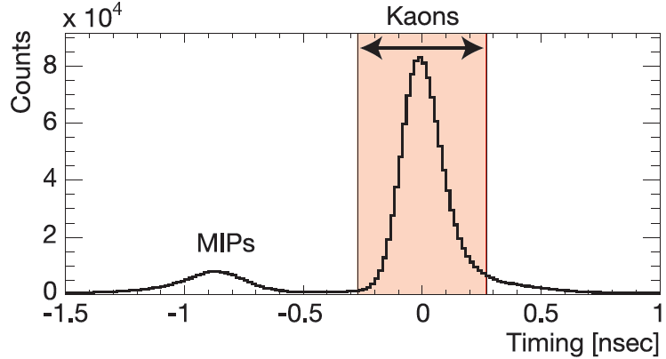
Measuring principle
Production of φ at rest
at DAΦNE
K⁻
SDDs
degrader
e⁻
φ
e⁺
Scintillators
K⁺

Slide 20
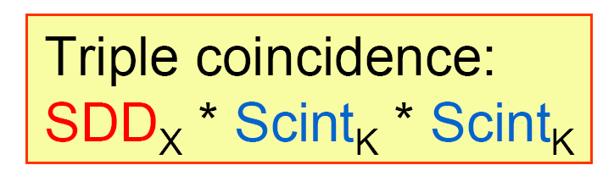
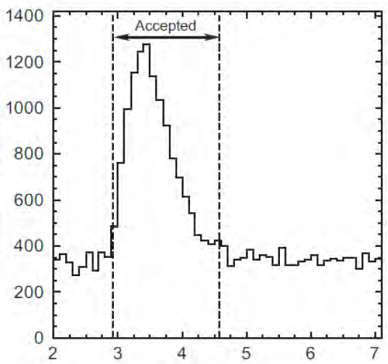
Measuring principle
Production of φ at rest
at DAΦNE
Triple coincidence
X-ray
K⁻
SDDs
degrader
e⁻
φ
e⁺
Scintillators
K⁺
counts / 100 ns
SDD timing [µs]

Slide 21
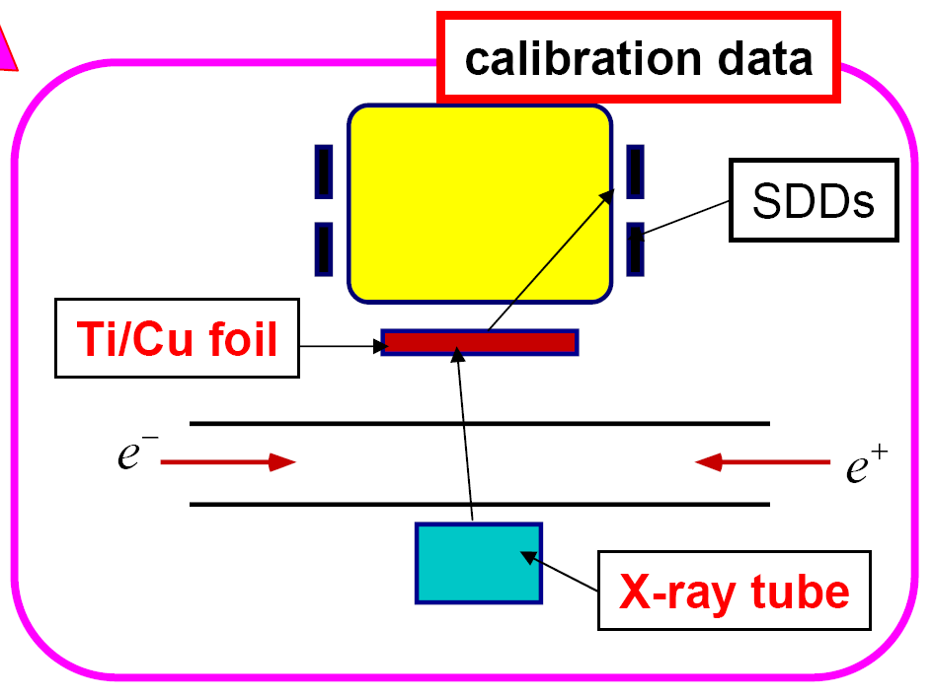
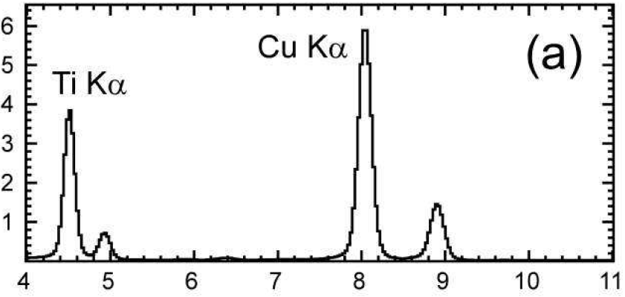
SDD X-ray energy spectra
“X-ray tube” data taken
estimated systematic error ~ 3-4 eV
counts / 30eV
energy [keV]

Slide 22
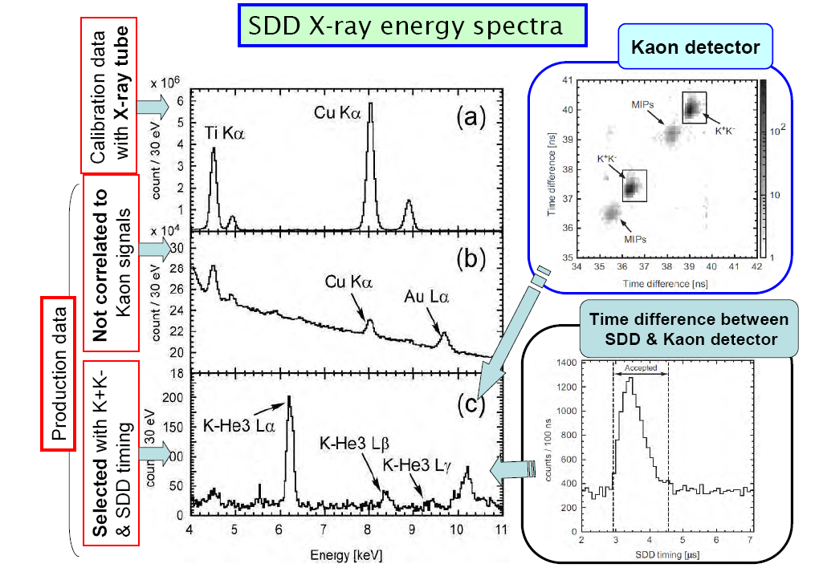
SDD X-ray energy spectra

Slide 23
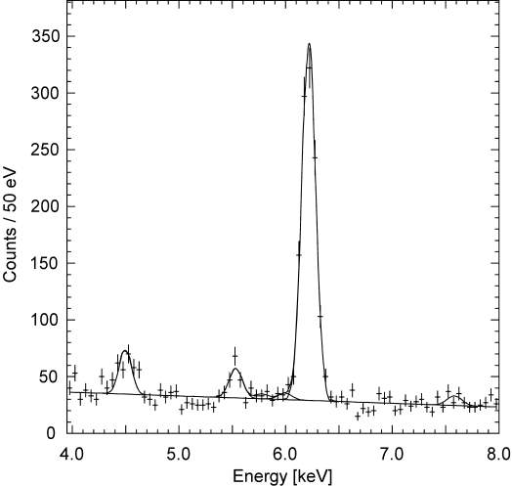
Kaonic helium-3 energy spectrum
QED value: E_{em}= 6224.6 eV
K-³He (3d-2p)
Ti Ka
K-O
K-C
K-N
First observation of
K-³He X-rays
arXiv:1010.4631v1 [nucl-ex], PLB697(2011)199

Slide 24
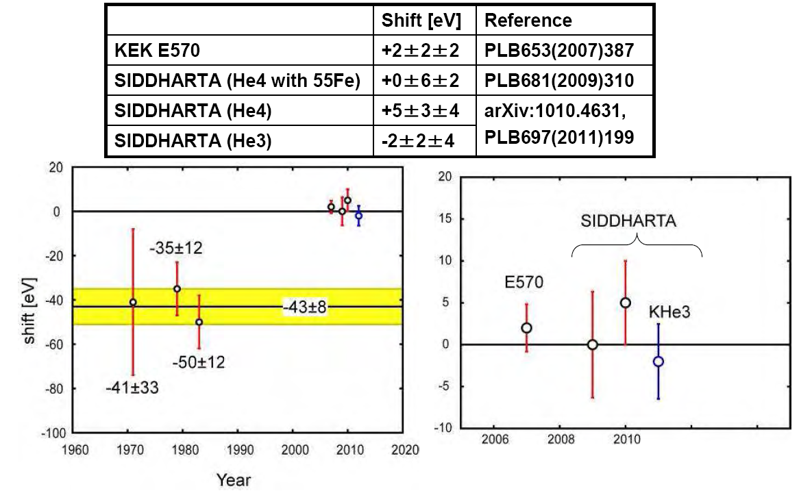
Kaonic helium results
talk given yesterday by Hideyuki Tatsuno
calibration under control within several eV

Slide 25
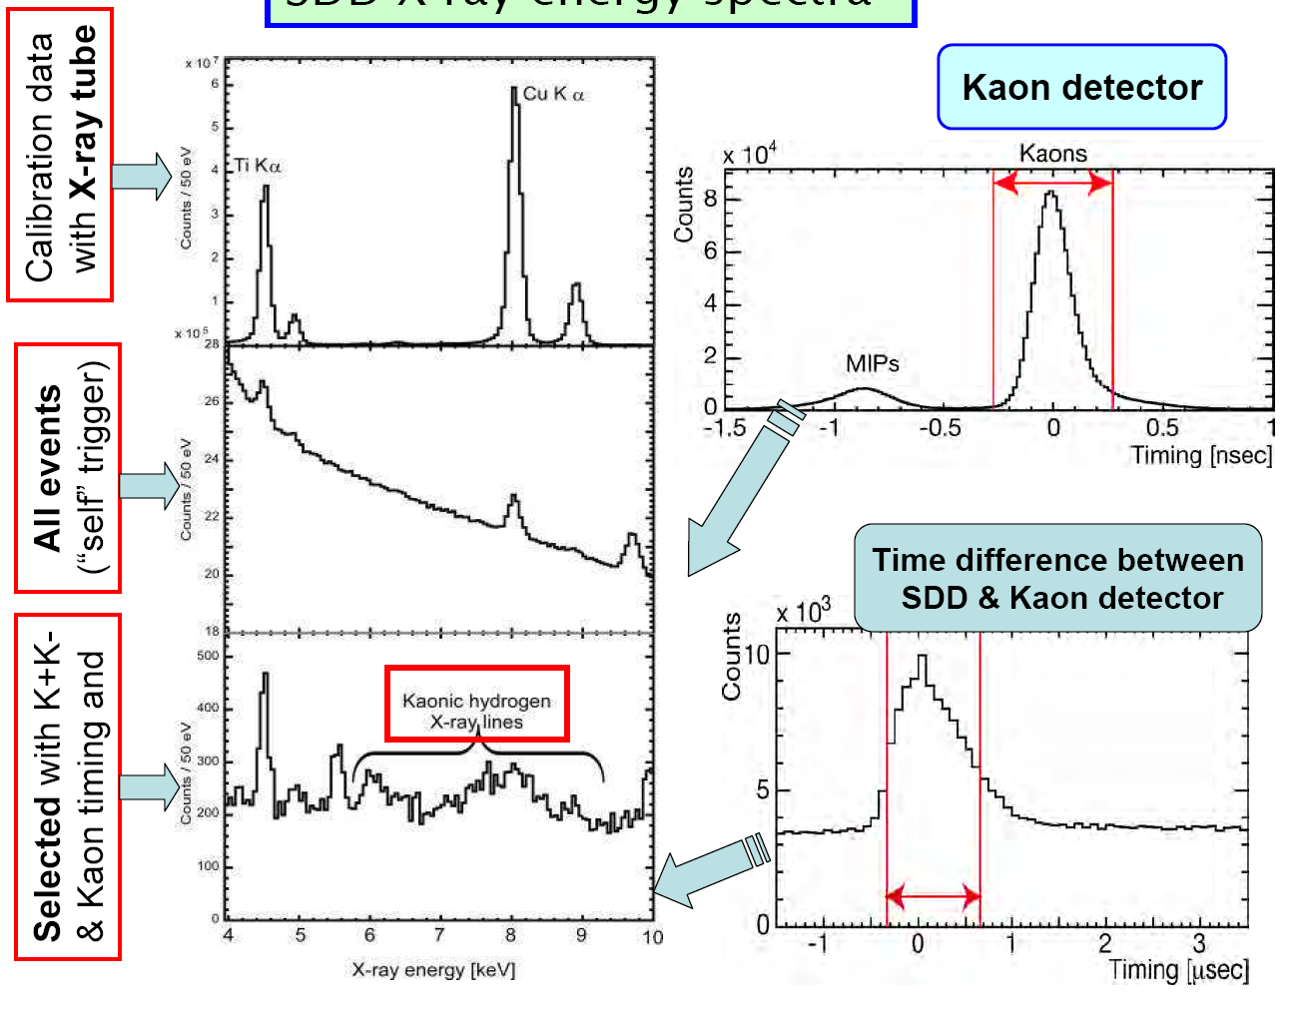
Kaonic hydrogen

Slide 26
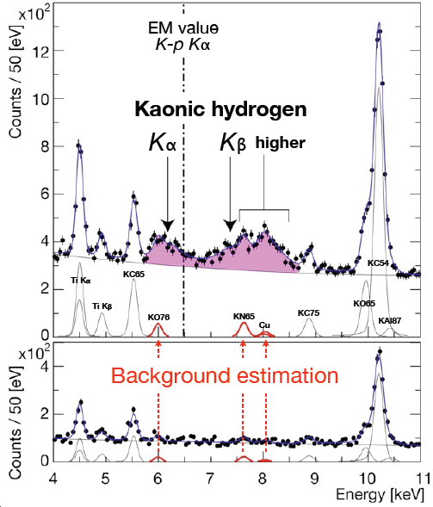
Fitting procedure
Hydrogen
simultaneous fit
Deuterium

Slide 27
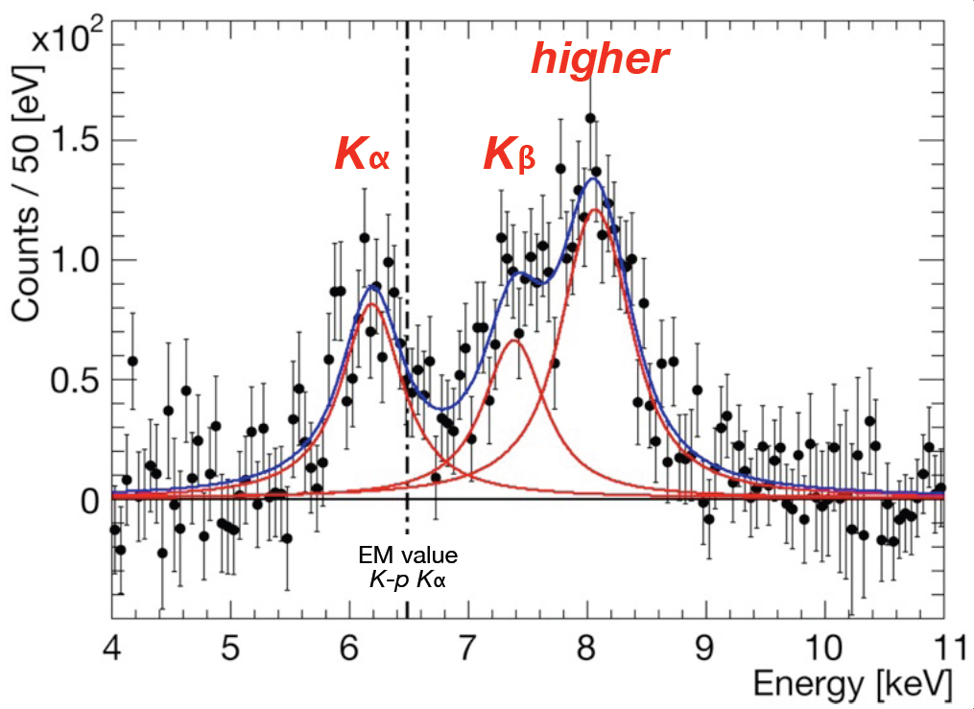
K⁻p spectrum after BG subtraction

Slide 28
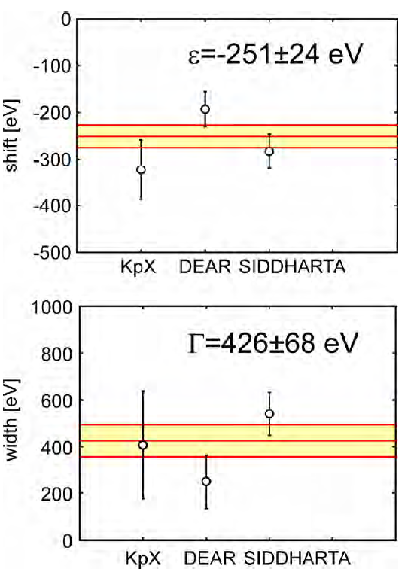
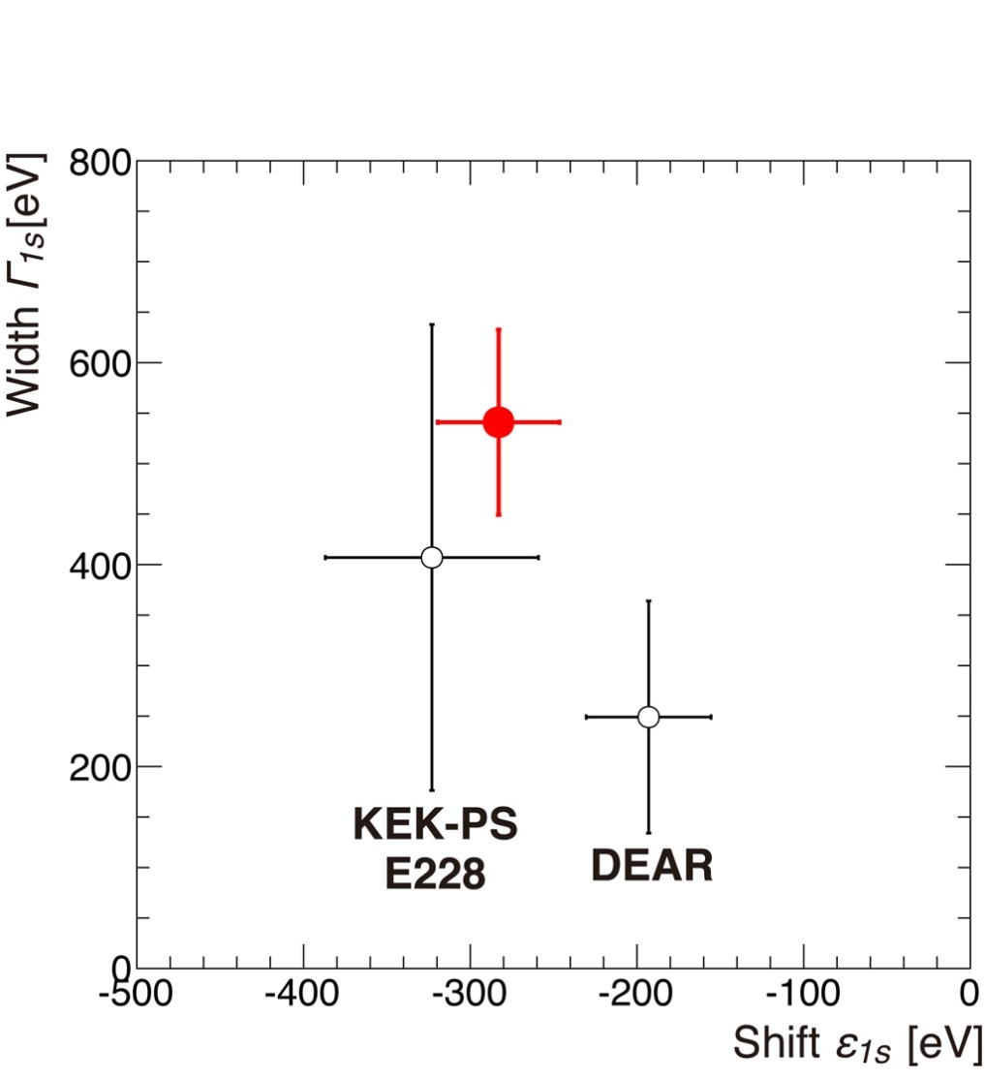
Kaonic hydrogen results
ε_{1s} = -283 ± 36(stat) ± 6(syst) eV
Γ_{1s} = 541 ± 89(stat) ± 22(syst) eV
SIDDHARTA

Slide 29
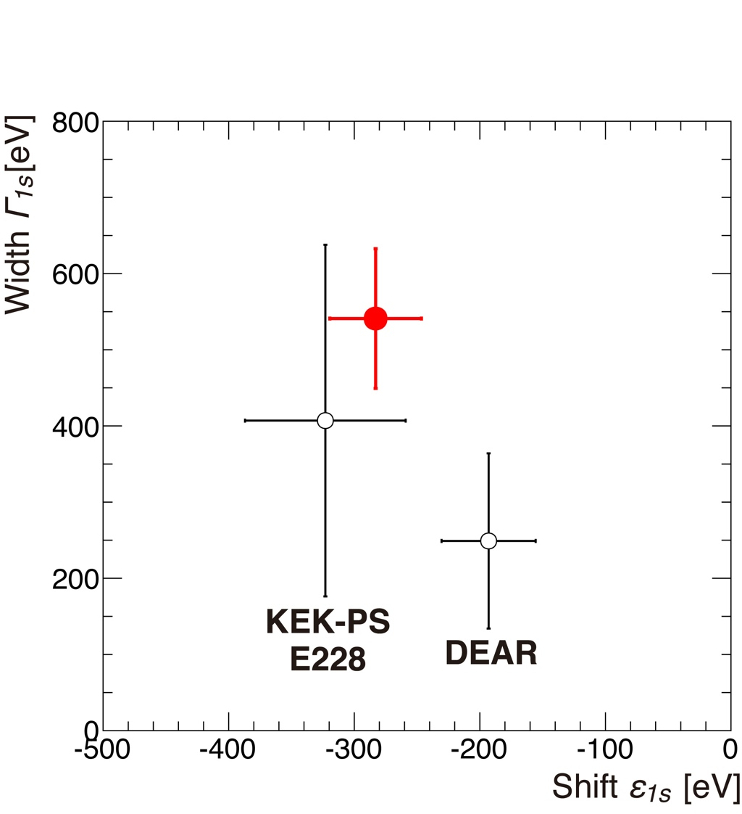
Kaonic hydrogen results
ε_{1s} = -283 ± 36(stat) ± 6(syst) eV
Γ_{1s} = 541 ± 89(stat) ± 22(syst) eV

Slide 30
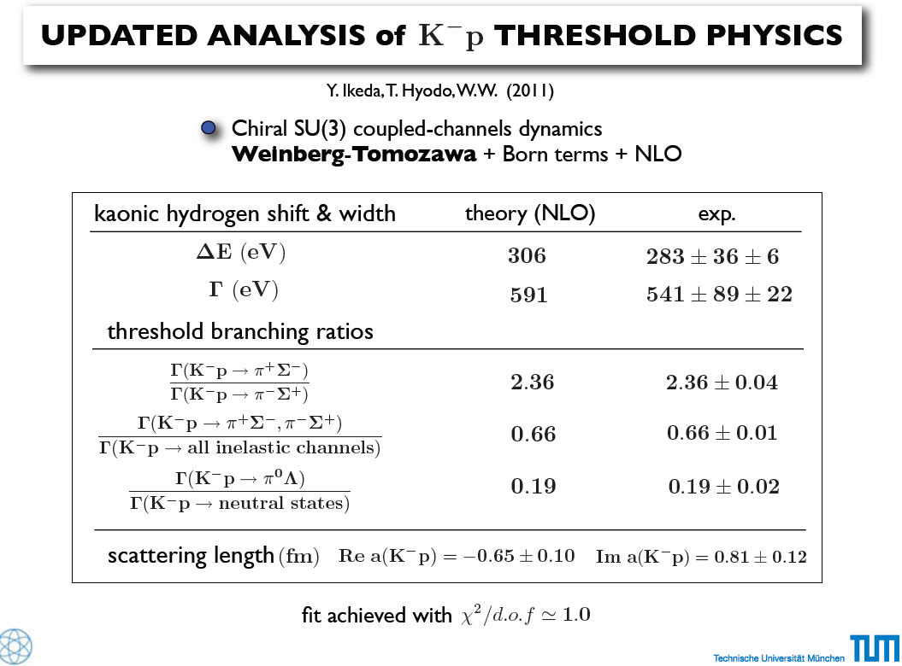
W.Weise,
HP-2 LEANNIS
July 2011
W. Weise

Slide 31
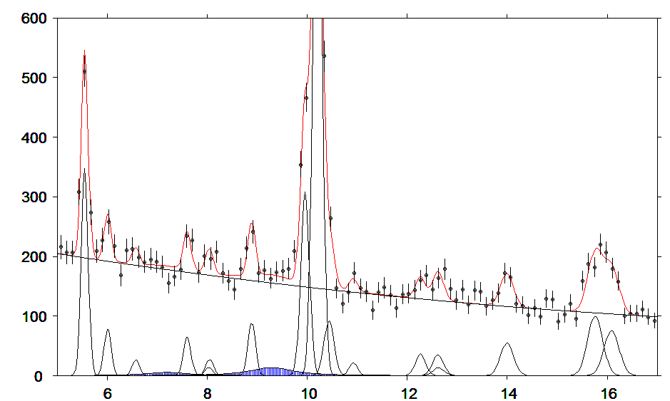
Kaonic deuterium data
fit for shift: about 500 eV
width: about 1000 eV
KC (5-4)
KC
(6-5)
KO
(6-5)
Kaonic deuterium
KO
(7-6)
KN
(6-5)
KC
(7-5)
KO
(9-7)
Cu
Kα
KAl
(8-7)
KAl
(10-8)
Pb
Lβ
KAl
(7-6)
KC
(6-4)
KN
(5-4)
KTi
(11-10)
Kd
Kcom
Kd
Kα
X-ray energy [keV]

Slide 32

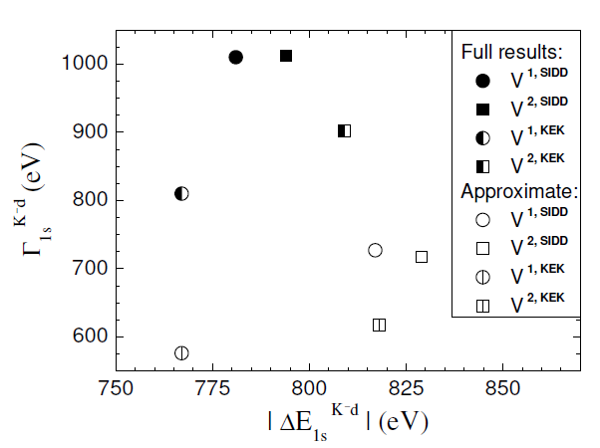
Kaonic deuterium: expected values
Compilation of predicted K⁻ d scattering lengths a_{d} and corresponding experimental values ε_{1s} and Γ_{1s}
calculated from eq. 1.
Modified Deser formula next-to-leading order in isospin breaking (Meißner, Raha, Rusetsky 2004ª)
(μ_{c} reduced mass of K⁻d )
^{a)} U.-G. Meißner, U.Raha, A.Rusetsky, Eur. phys. J. C35 (2004) 349
^{b)} The precision of a_{d} is quoted to be ~25%
[1] M. Döring, U.-G. Meißner, Phys. Lett. B 704 (2011) 663
[4] N.V. Shevchenko, arXiv:1103.4974v2 [nucl-th] (2011)
[5] A. Gal, Int. J. Mod. Phys. A22 (2007) 226
[6] U.-G. Meißner, U. Raha, A. Rusetsky, Eur. phys. J. C47 (2006) 473
[7] N.V. Shevchenko, arXiv:1201.3173v1 [nucl-th] (2012)
a_{d} [fm] | ε_{1s} [eV] | Γ_{1s} [eV] | Reference
-1.48 + i 1.22 | 818 | 724 | Shevchenko 2012 „one-pole“ [7]
-1.51 + i 1.23 | 829 | 715 | Shevchenko 2012 „two-pole“ [7]
-1.46 + i 1.08 | 779 | 650 | Meißner 2011 ^{b)} [1]
-1.49 + i 0.98 | 767 | 578 | Shevchenko 2011 „one-pole“ [4]
-1.57 + i 1.11 | 818 | 618 | Shevchenko 2011 „two-pole“ [4]
-1.42 + i 1.09 | 769 | 674 | Gal 2007 [5]
-1.66 + i 1.28 | 884 | 665 | Meißner 2006 [6]
-1.48 + i1.22 | 781 | 1010 | Shevchenko 2011 „one-pole“-full [4]
-1.51 + i 1.23 | 794 | 1012 | Shevchenko 2011 „two-pole“- full [4]
HP-3 LEANNIS
May 2012

Slide 33
The SIDDHARTA-2 setup,
essential improvements
      new target design
      new SDD arrangement
      vacuum chamber
      more cooling power
      improved trigger scheme
      shielding and anti-coincidence
Kaonic deuterium

Slide 34
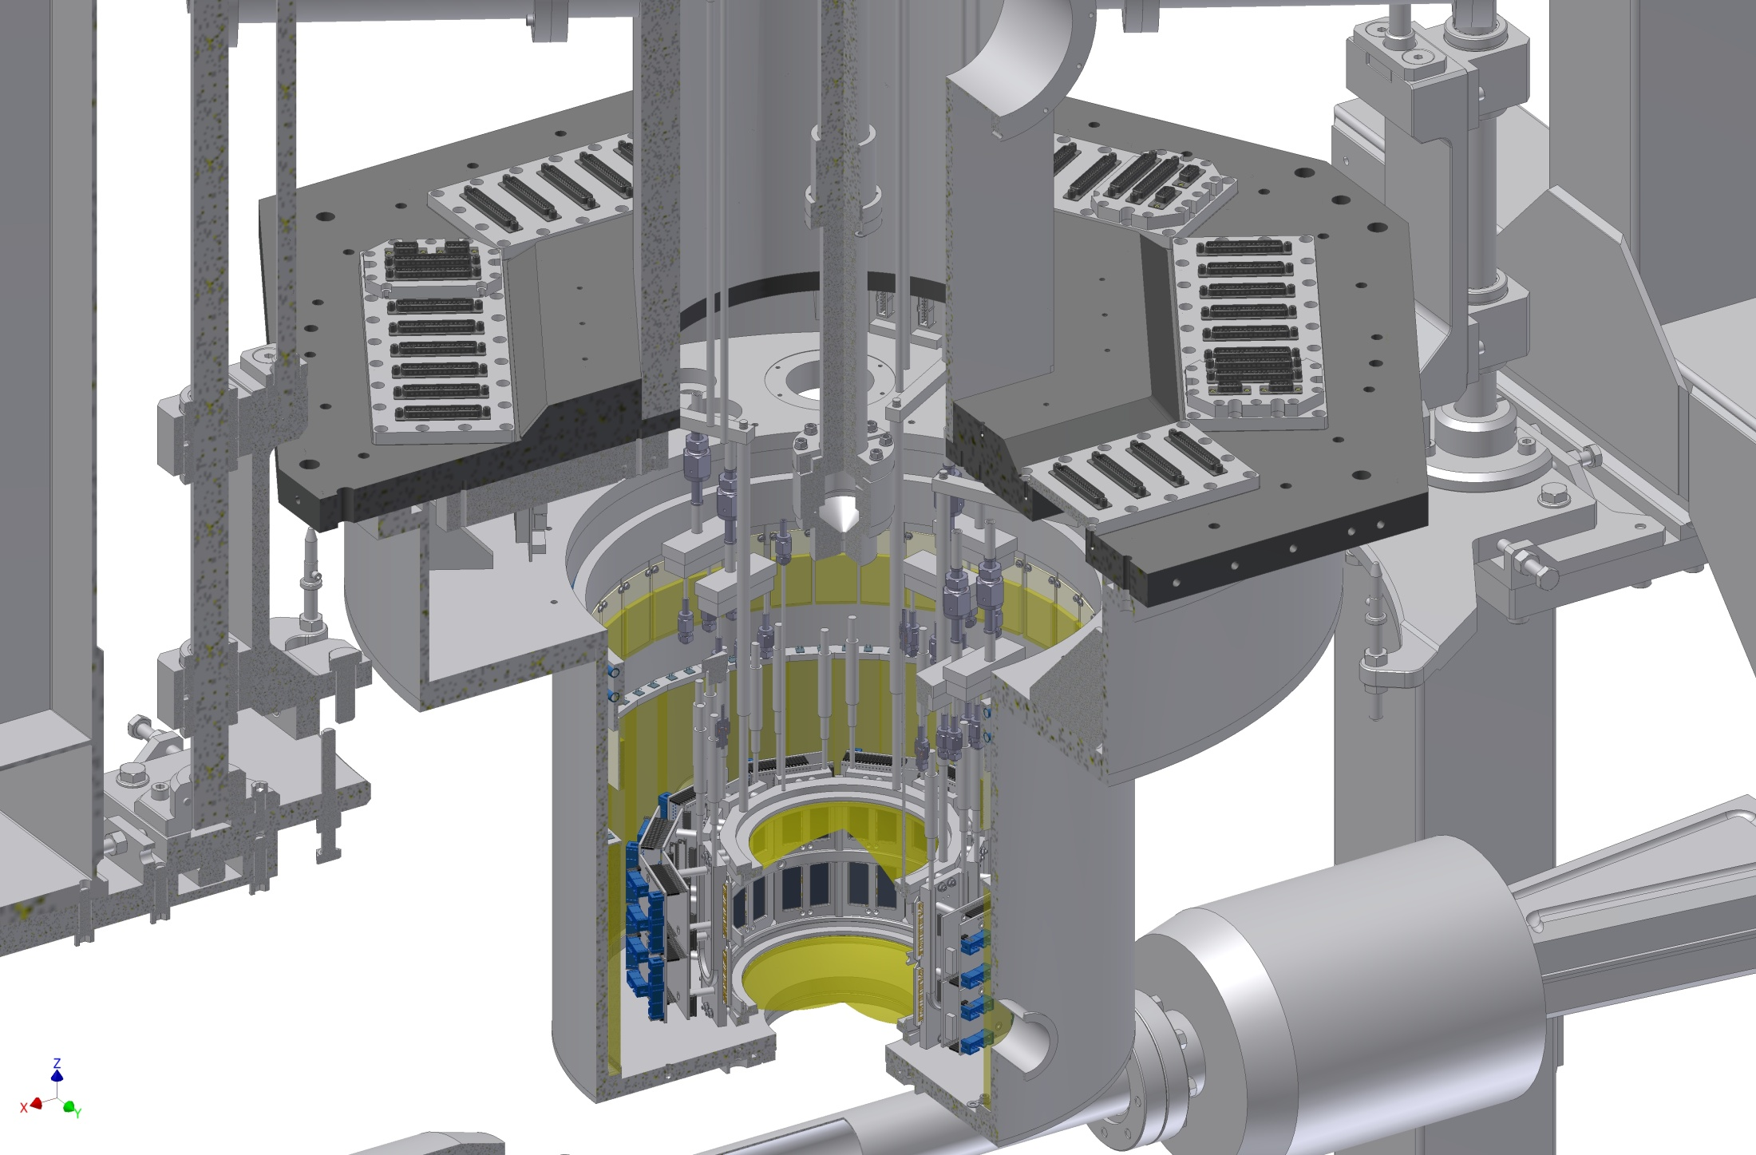
New target cell and SDD arrangement
Kaonic deuterium

Slide 35
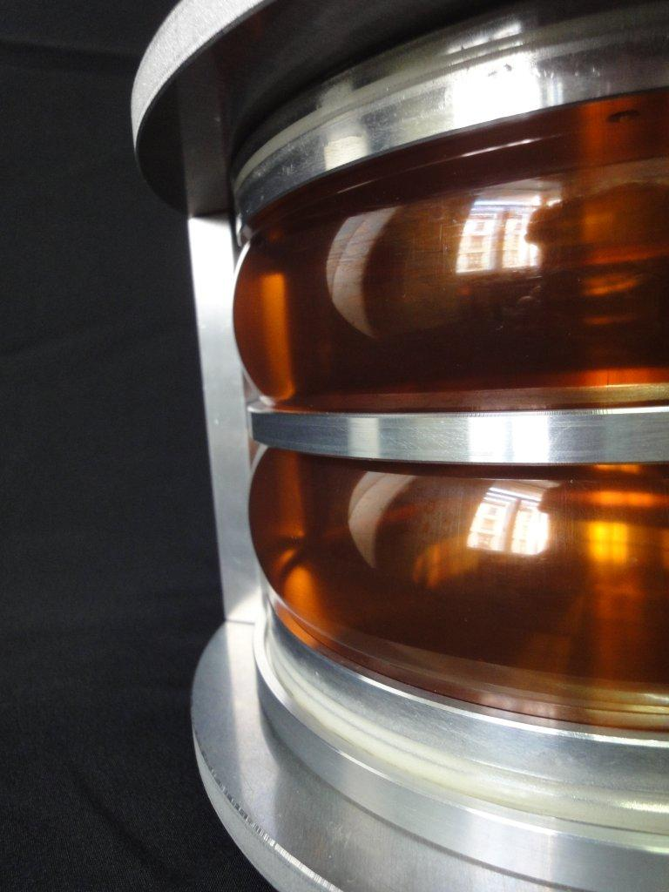
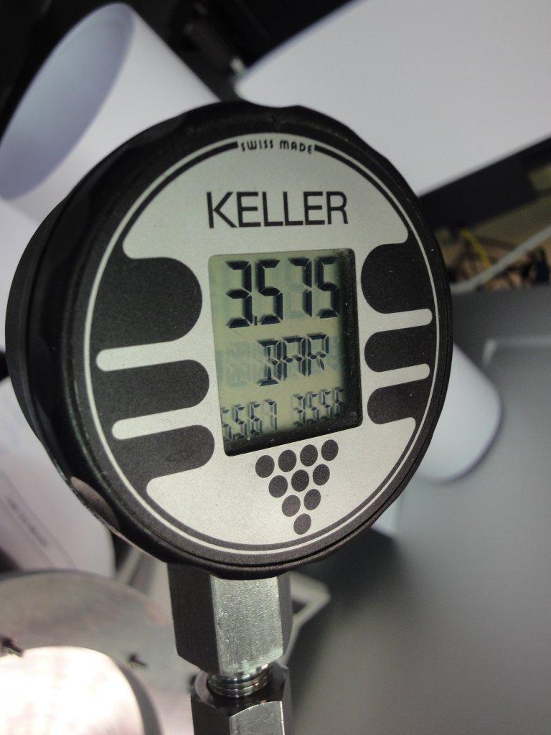
New target cell prototype
Kaonic deuterium

Slide 36
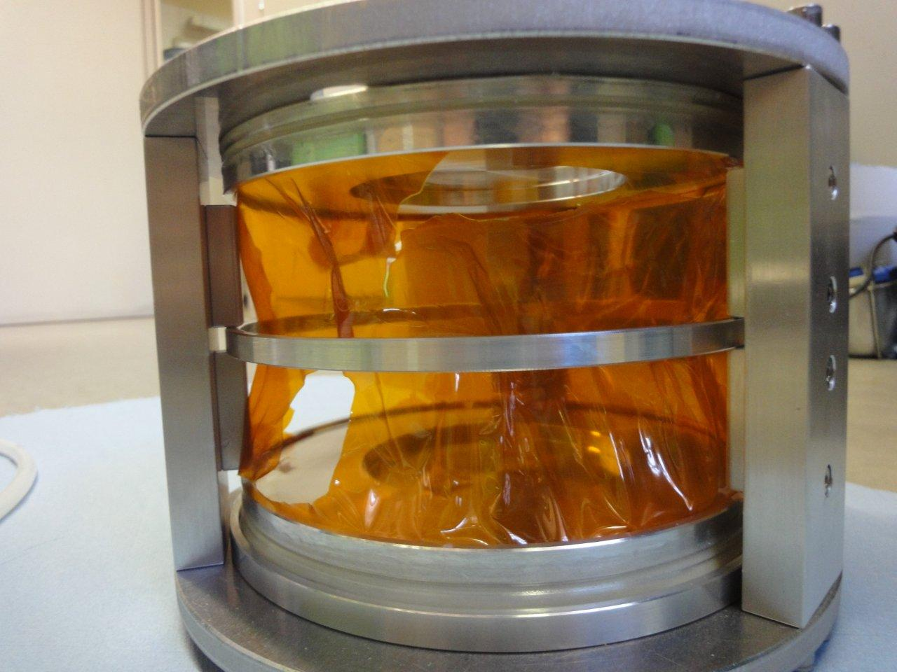
Burst pressure 3.5 bar (abs.)
Kaonic deuterium

Slide 37
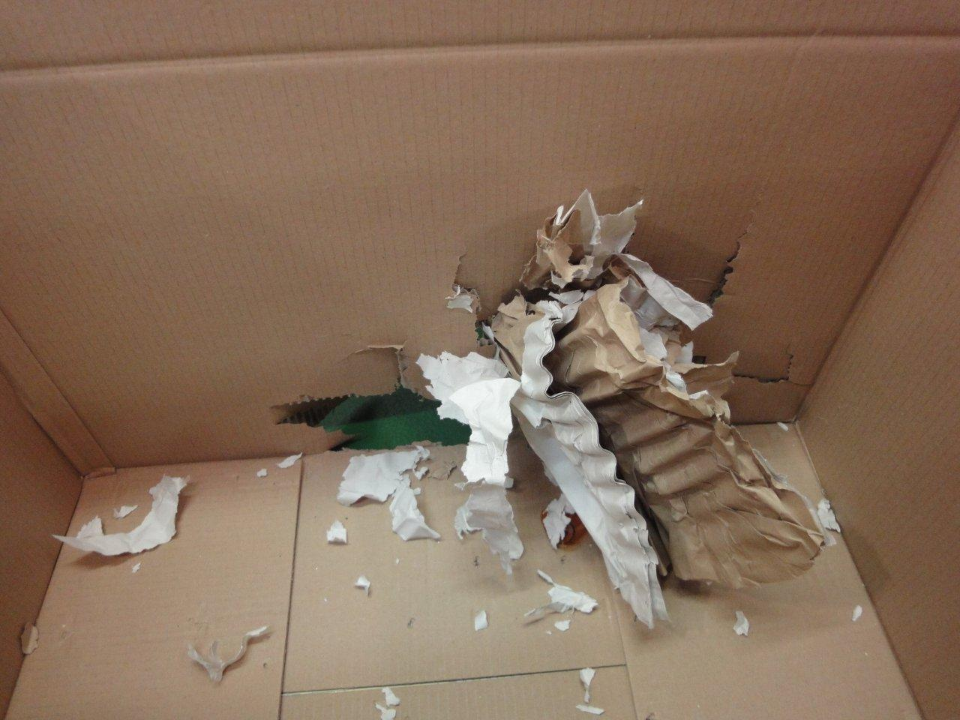
Result of the burst of a target cell
Kaonic deuterium

Slide 38
New design of the cooling transfer lines for
target and SDDs
Target cooling:
1 Leybold – 16 W @ 20 K
Liquid hydrogen cooling lines,
new target cell, selected materials
SDD cooling:
4 CryoTiger – 60 W @ 120 K
Liquid argon cooling lines:
SDD cooling to 100 – 120 K
Kaonic deuterium

Slide 39
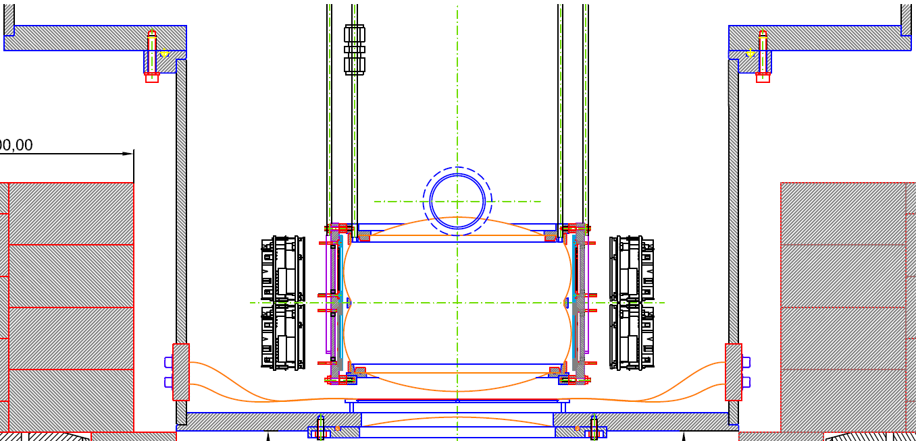
Improved trigger scheme
Target cell
SDDs
Kaonic deuterium
SDD-
electronic
Kaon monitor
upper scintillator
K⁻
Interaction
region
Veto counter
Kaon monitor
lower scintillator
K⁺
Kaonstopper:
K⁺-K⁻ discrimination

Slide 40
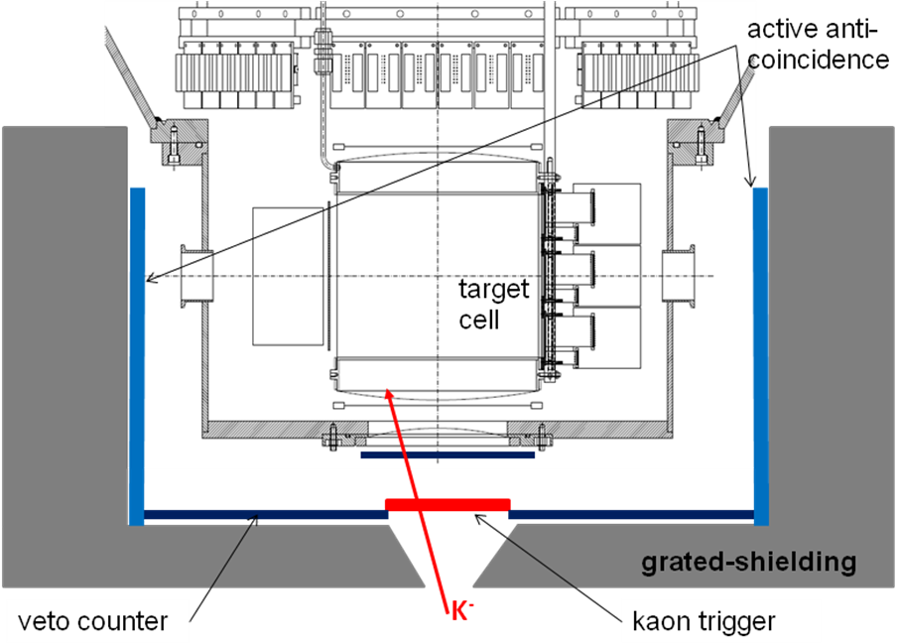
Shielding and anti-coincidence
Kaonic deuterium

Slide 41
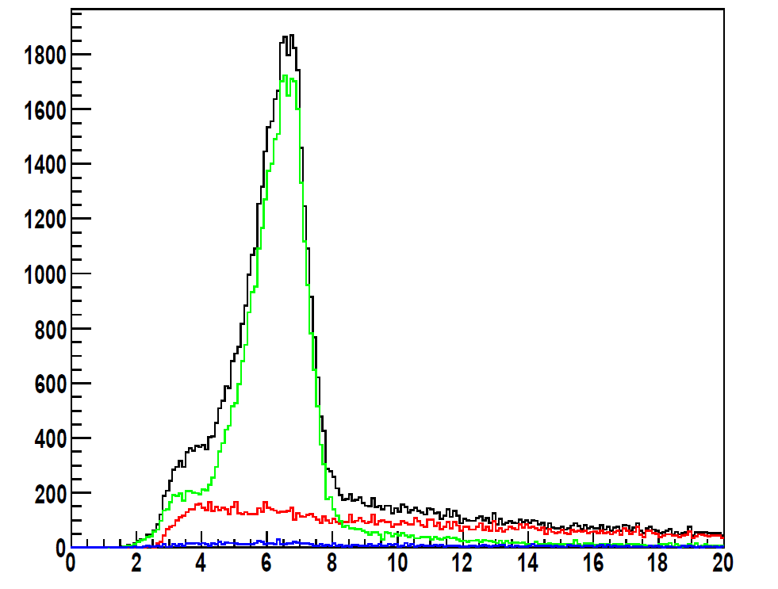
Anti-coincidence for further BG suppression
Timing (in ns) of a scintillator placed outside the vacuum chamber.
The main peak corresponds to particles produced by the K− absorption on a gas nucleus.
The green distribution is a selection of secondary tracks after the detection of a K+ in the bottom scintillator of the kaon detector (implying a K− reached the top side).
In red, the time spectrum is correlated to a K− crossing the bottom side of the kaon detector (the K+ is stopped in the target or in the walls); the distribution corresponds to the K+ decay.
In blue, the bottom kaon detector detects neither a K+ nor a K−.
Kaonic deuterium

Slide 42
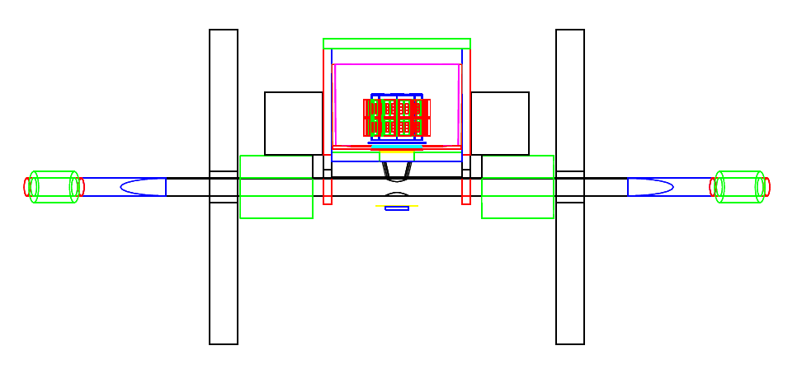
MC with Geant 4 – full setup
Kaonic deuterium
The GEANT4 package was used, with low energy tools included.
The low energy electromagnetic processes were simulated using the Livermore model, with particle tracking down to the few keV range and moreover, reproduces the X-ray fluorescence lines of the setup materials.
Both synchronous (hadronic) and asynchronous (machine) background were simulated, while the presence of other exotic atoms contributing to the acquired spectra were taken into account by a custom add-on of the atomic cascade to the standard kaon nuclear absorption class.

Slide 43
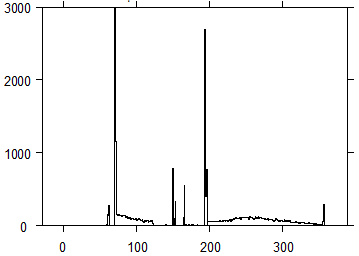
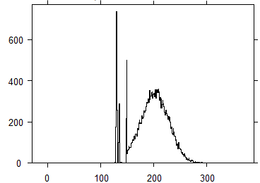
Result: Stopped kaon distribution
scintillator
shielding
degrader
SIDDHARTA, September 2009
vacuum
window
target windows
colli-
mator
gas
Kaonic deuterium
vaccum
window
scintillator
vertical position of stopped kaon (mm)
target window
SIDDHARTA-2
gas
vertical position of stopped kaons (mm)

Slide 44
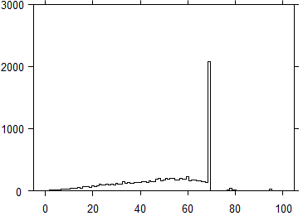
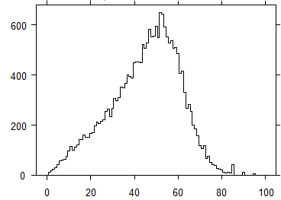
Result: Stopped kaon distribution
gas
cylindrical wall
SIDDHARTA, September 2009
Kaonic deuterium
radial position of stopped kaons (mm)
cylindrical
wall
gas
SIDDHARTA-2
radial position of stopped kaons (mm)

Slide 45
MC simulation - summary
 | new geometry & gas density | timing resolution | K± dis-crimination | del‘d anti-coinc. | prompt anti-coinc. | total impr. factor
Signal | 2.5 |  | 0.8 |  |  | 2.0
kaonic X-rays wall stops | 20 |  |  |  |  | 20
continuous background /Signal /keV | 3.8 ratio of gasstops vs. decay+wallstops |  | 2 events due to decay of K⁺ removed |  | 2 charged particle veto | 15.2
beam background (asynchron) | 4.8 less trigger per signal | 1.5 smaller coincidence gate |  | 3 „active shielding“ |  | 21.6
Kaonic deuterium

Slide 46
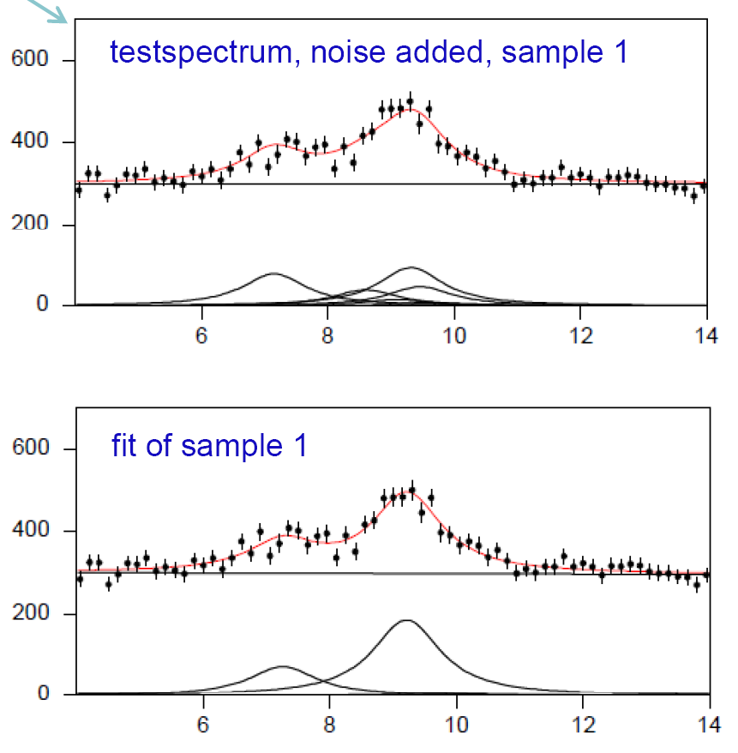
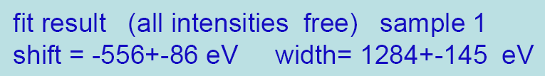
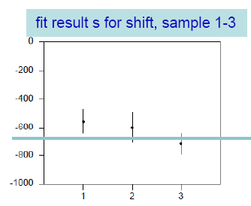
Kaonic deuterium – MC simulations
model input
shift = - 660 eV
width= 1200 eV
energy [keV]

Slide 47
Summary
SIDDHARTA setup was working with 144 SDDs
Kaonic X-ray spectra measured with several gaseous
targets:
  K⁻p: provided the most precise values
  (PLB 704 (2011) 113)
  K⁻d: first exploratory measurement
  small signal (large width)
  K⁻³He: first-time measurement
  (PLB 697 (2011) 199)
  K-⁴He: measured in gaseous target
  (PLB 681 (2009) 310)

Slide 48
Conclusion
We are confident that with the planned improvements of the setup and with an integrated luminosity of 600 pb⁻¹, SIDDHARTA-2 will be able to perform a first X-ray measurement of the strong interaction parameters - the energy displacement and the width of the konic deuterium ground state.
Kaonic deuterium

Slide 49
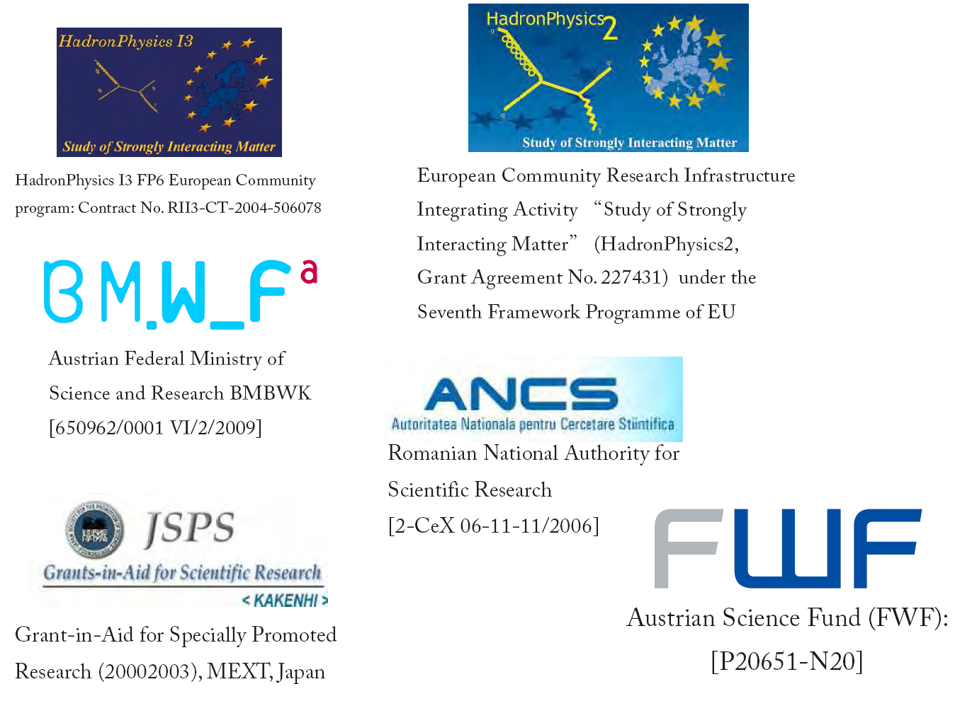
Supported by
Thank you

